Slide 1
OLD
Church
of Christ
UNION

Slide 2
Welcome Guests!
OLD UNION
NEW LIFE
Following Jesus changes everything!

Slide 3
Wednesdays @ 7PM Teen Room

Slide 5
Wednesday Night 7pm Fellowship Hall Bible Class

Slide 6
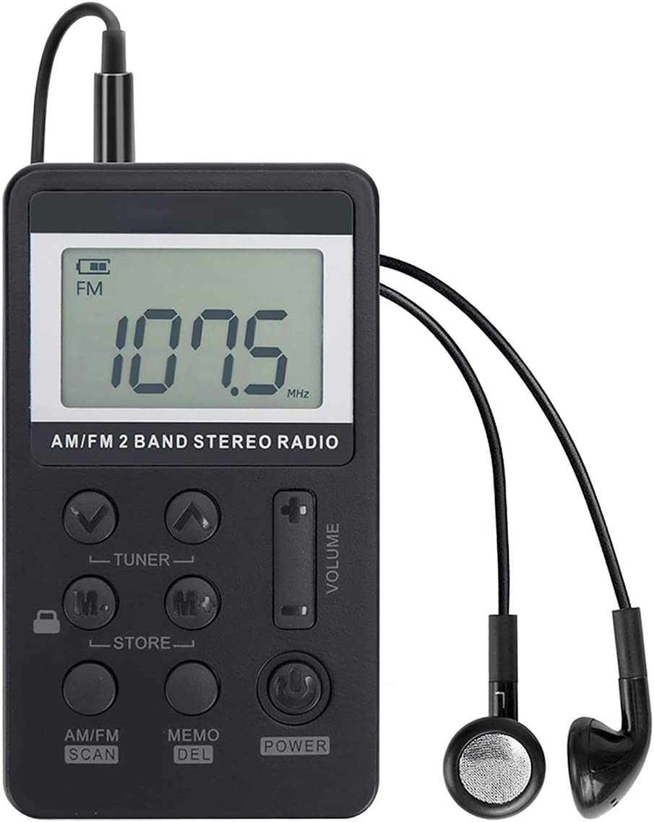
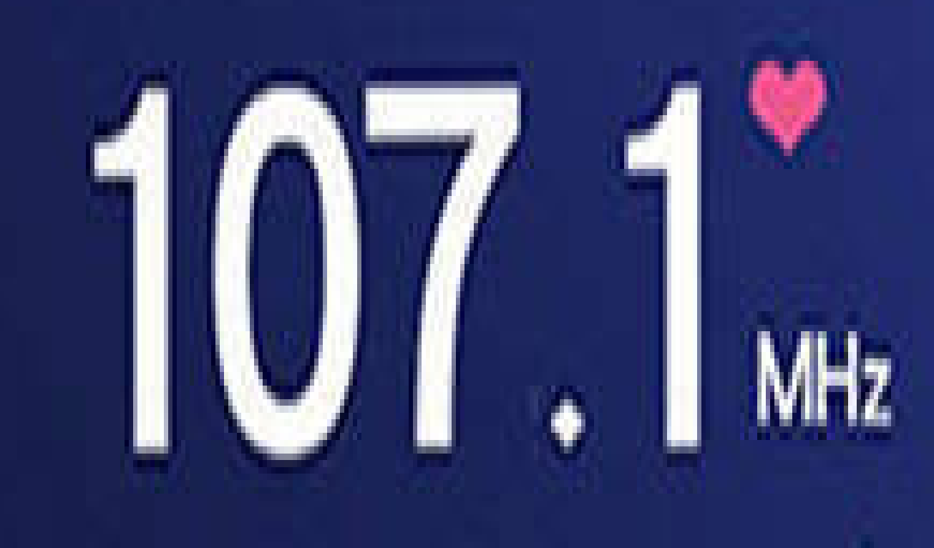
HAVING TROUBLE HEARING? WE HAVE AUDIO AIDS TO ASSIST
See one of the Ushers or Deacons in the foyer and we will be glad to get you a device for service.

Slide 8
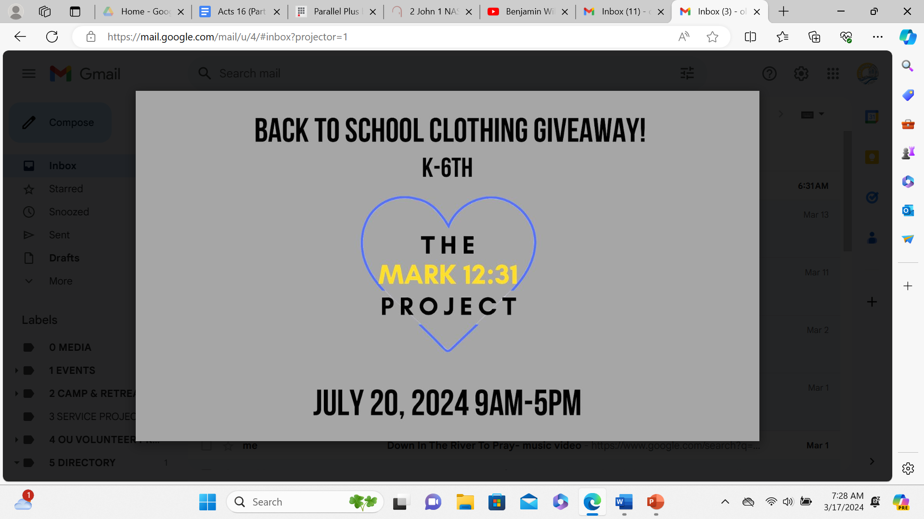

Slide 9
Congregation Membership is a blessing. If interested see our Shepherds.

Slide 10
ENCOURAGEMENT CARD OF THE WEEK Jarrett and April Schiavone
Jarrett and April were married yesterday. Their relationship has been inspiring and will bless many. Let’s encourage them. (Note their new address.)

Slide 11
Church Building and Grounds Work Days 4/26 and 4/27

Slide 12
Annual Spring Clean and
New Playground Prep
See Scott Dalke for more details.

Slide 13
First Sunday Singings
Every first Sunday of
the month at 5PM.
This a great time to sing and also improve our song ministry. Please consider attending.

Slide 16
Jesus said, “Let the little children come to Me.”

Slide 17
OUKids Time
Sundays 9AM
Memory, Songs,
and Prayer
Sundays 9:30am
(0-5th Grade Classes)
Wednesdays 7PM
(0-5th Grade Classes)

Slide 18
Lamentations 3:22-24
The steadfast love of the LORD never ceases;
His mercies never come to an end.
They are new every morning.
Great is Thy faithfulness.
The LORD is my portion says my soul;
Therefore I will hope in Him.

Slide 19
Psalm 95:1-2
Come let us sing with joy to the LORD;
Let us shout aloud,
to the Rock of our salvation.
Let us come before Him with thanksgiving;
And extol Him with music and song.

Slide 20
Psalm 95:3-5
For the LORD is a great God
A great King above all gods,
In His hands are the depths of the earth,
And the mountain peaks belong to Him.
The sea is His, He made it.
And His hands they formed the dry land.

Slide 21
Psalm 95:6-7
Come, let us worship and bow down,
Let us kneel before the LORD our Maker.
For He is our God,
and we are the people of His pasture.
And the sheep of His hand.

Slide 22
Psalm 3:3
Thou, O LORD,
Are a shield about me.
You’re my glory,
You’re the lifter of my head.
(Hallelujah)

Slide 23
Philippians 4:4
Rejoice in the Lord always;
And again I say rejoice!

Slide 24
Genesis 1:27-28
“God created man in His own image…”
Memory Heart Verse

Slide 25
²⁷ God created man in His own image, in the image of God He created him; male and female He created them.
²⁸ God blessed them; and God said to them, “Be fruitful and multiply, and fill the earth, and subdue it; and rule over the fish of the sea and over the birds of the sky and over every living thing that moves on the earth.”
Genesis 1:27-28

Slide 26
Why did God make us?
Then God said, “Let Us make man in Our image, according to Our likeness; and let them rule over… all the earth...in the image of God He created him; male and female He created them.”
Genesis 1:26-27 (abbr.)
To Share Himself with Us.

Slide 27
Who is Jesus?
Simon Peter answered,
“You are the Christ,
the Son of the living God.”
Matthew 16:16
The Christ, the Son of the Living God

Slide 28
What is our PURPOSE?
Praise be to the God and Father of our Lord Jesus Christ, who has blessed us in the heavenly realms with every spiritual blessing in Christ.
Ephesians 1:3-6
To PRAISE and ENJOY God!

Slide 29
How GOOD is our God?
Oh give thanks to the LORD, for He is good,
For His lovingkindness is everlasting.
Let the redeemed of the Lord say so,
Psalm 107:1-2a
SO GOOD!!!

Slide 30
Where can we find Jesus’ Sermon on the Mount?
The Gospel of Matthew
Chapters 5, 6, and 7

Slide 31
What is God doing?
And He who sits on the throne said, “Behold I am making all things new.”
Revelation 21:5
Making all things new.

Slide 32
How does God show us love?
“But God demonstrates His own love toward us, in that while we were yet sinners, Christ died for us.”
Romans 8:5
By Christ dying for us.

Slide 33
The Books of the New Testament
Acts
Romans
1 2 Corinthians
Galatians
Ephesians
Philippians
Colossians
1 2 Thessalonians
1 2 Timothy
Titus
Philemon
Hebrews
James
1 2 Peter
Matthew
Mark
Luke
John
1 2 3 John
Jude
Revelation

Slide 34
The Books of the Old Testament
Genesis
Exodus
Leviticus
Numbers
Deuteronomy
Joshua
Judges
Ruth
1 2 Samuel
1 2 Kings
1 2 Chronicles
Ezra
Nehemiah
Esther
Job
Psalms
Proverbs
Ecclesiastes
Songs of Solomon
Isaiah
Jeremiah
Lamentations
Ezekiel
Daniel
Hosea, Joel
Amos, Obadiah
Jonah, Micah
Nahum
Habakkuk
Zephaniah
Haggai
Zechariah
Malachi

Slide 35
What does God want from us?
He has shown you, O mortal, what is good.
And what does the Lord require of you?
To act justly and to love mercy
and to walk humbly with your God.
Micah 6:8
To Act Justly, Love Mercy, and Walk Humbly

Slide 36
What is Success?
“How blessed is the man…
Who delights in the law of the LORD.
He will be like a tree planted firmly…
And in whatever he does, he prospers.”
Psalm 1
Living with God, Now and Forever!

Slide 37
What is the Bible?
All Scripture is (God-breathed) and profitable for teaching, for reproof, for correction, for training in righteousness; so that the man of God may be adequate, equipped for every good work.
2 Timothy 3:16-17
Scripture, Inspired by God.

Slide 38
What is the Greatest Command?
You shall love the Lord your God
with all your heart and with all your soul and with all your might.
Deuteronomy 6:5

Slide 39
What is the 2nd Greatest Command?
Love your neighbor as yourself.
Mark 12:31

Slide 40
How does God save us?
For by grace you have been saved through faith; and that not of yourselves, it is the gift of God;
Ephesians 2:8
By GRACE through FAITH.

Slide 41
The Fruit of the Spirit
LOVE
JOY
PEACE
PATIENCE
KINDNESS
GOODNESS
FAITHFULNESS
GENTLENESS
SELF-CONTROL
“Against such things there is no law.”
Galatians 5:22-23

Slide 42
Welcome Guests!
OLD UNION
NEW LIFE
Following Jesus changes everything!

Slide 43
Here I Am To Worship

Slide 44
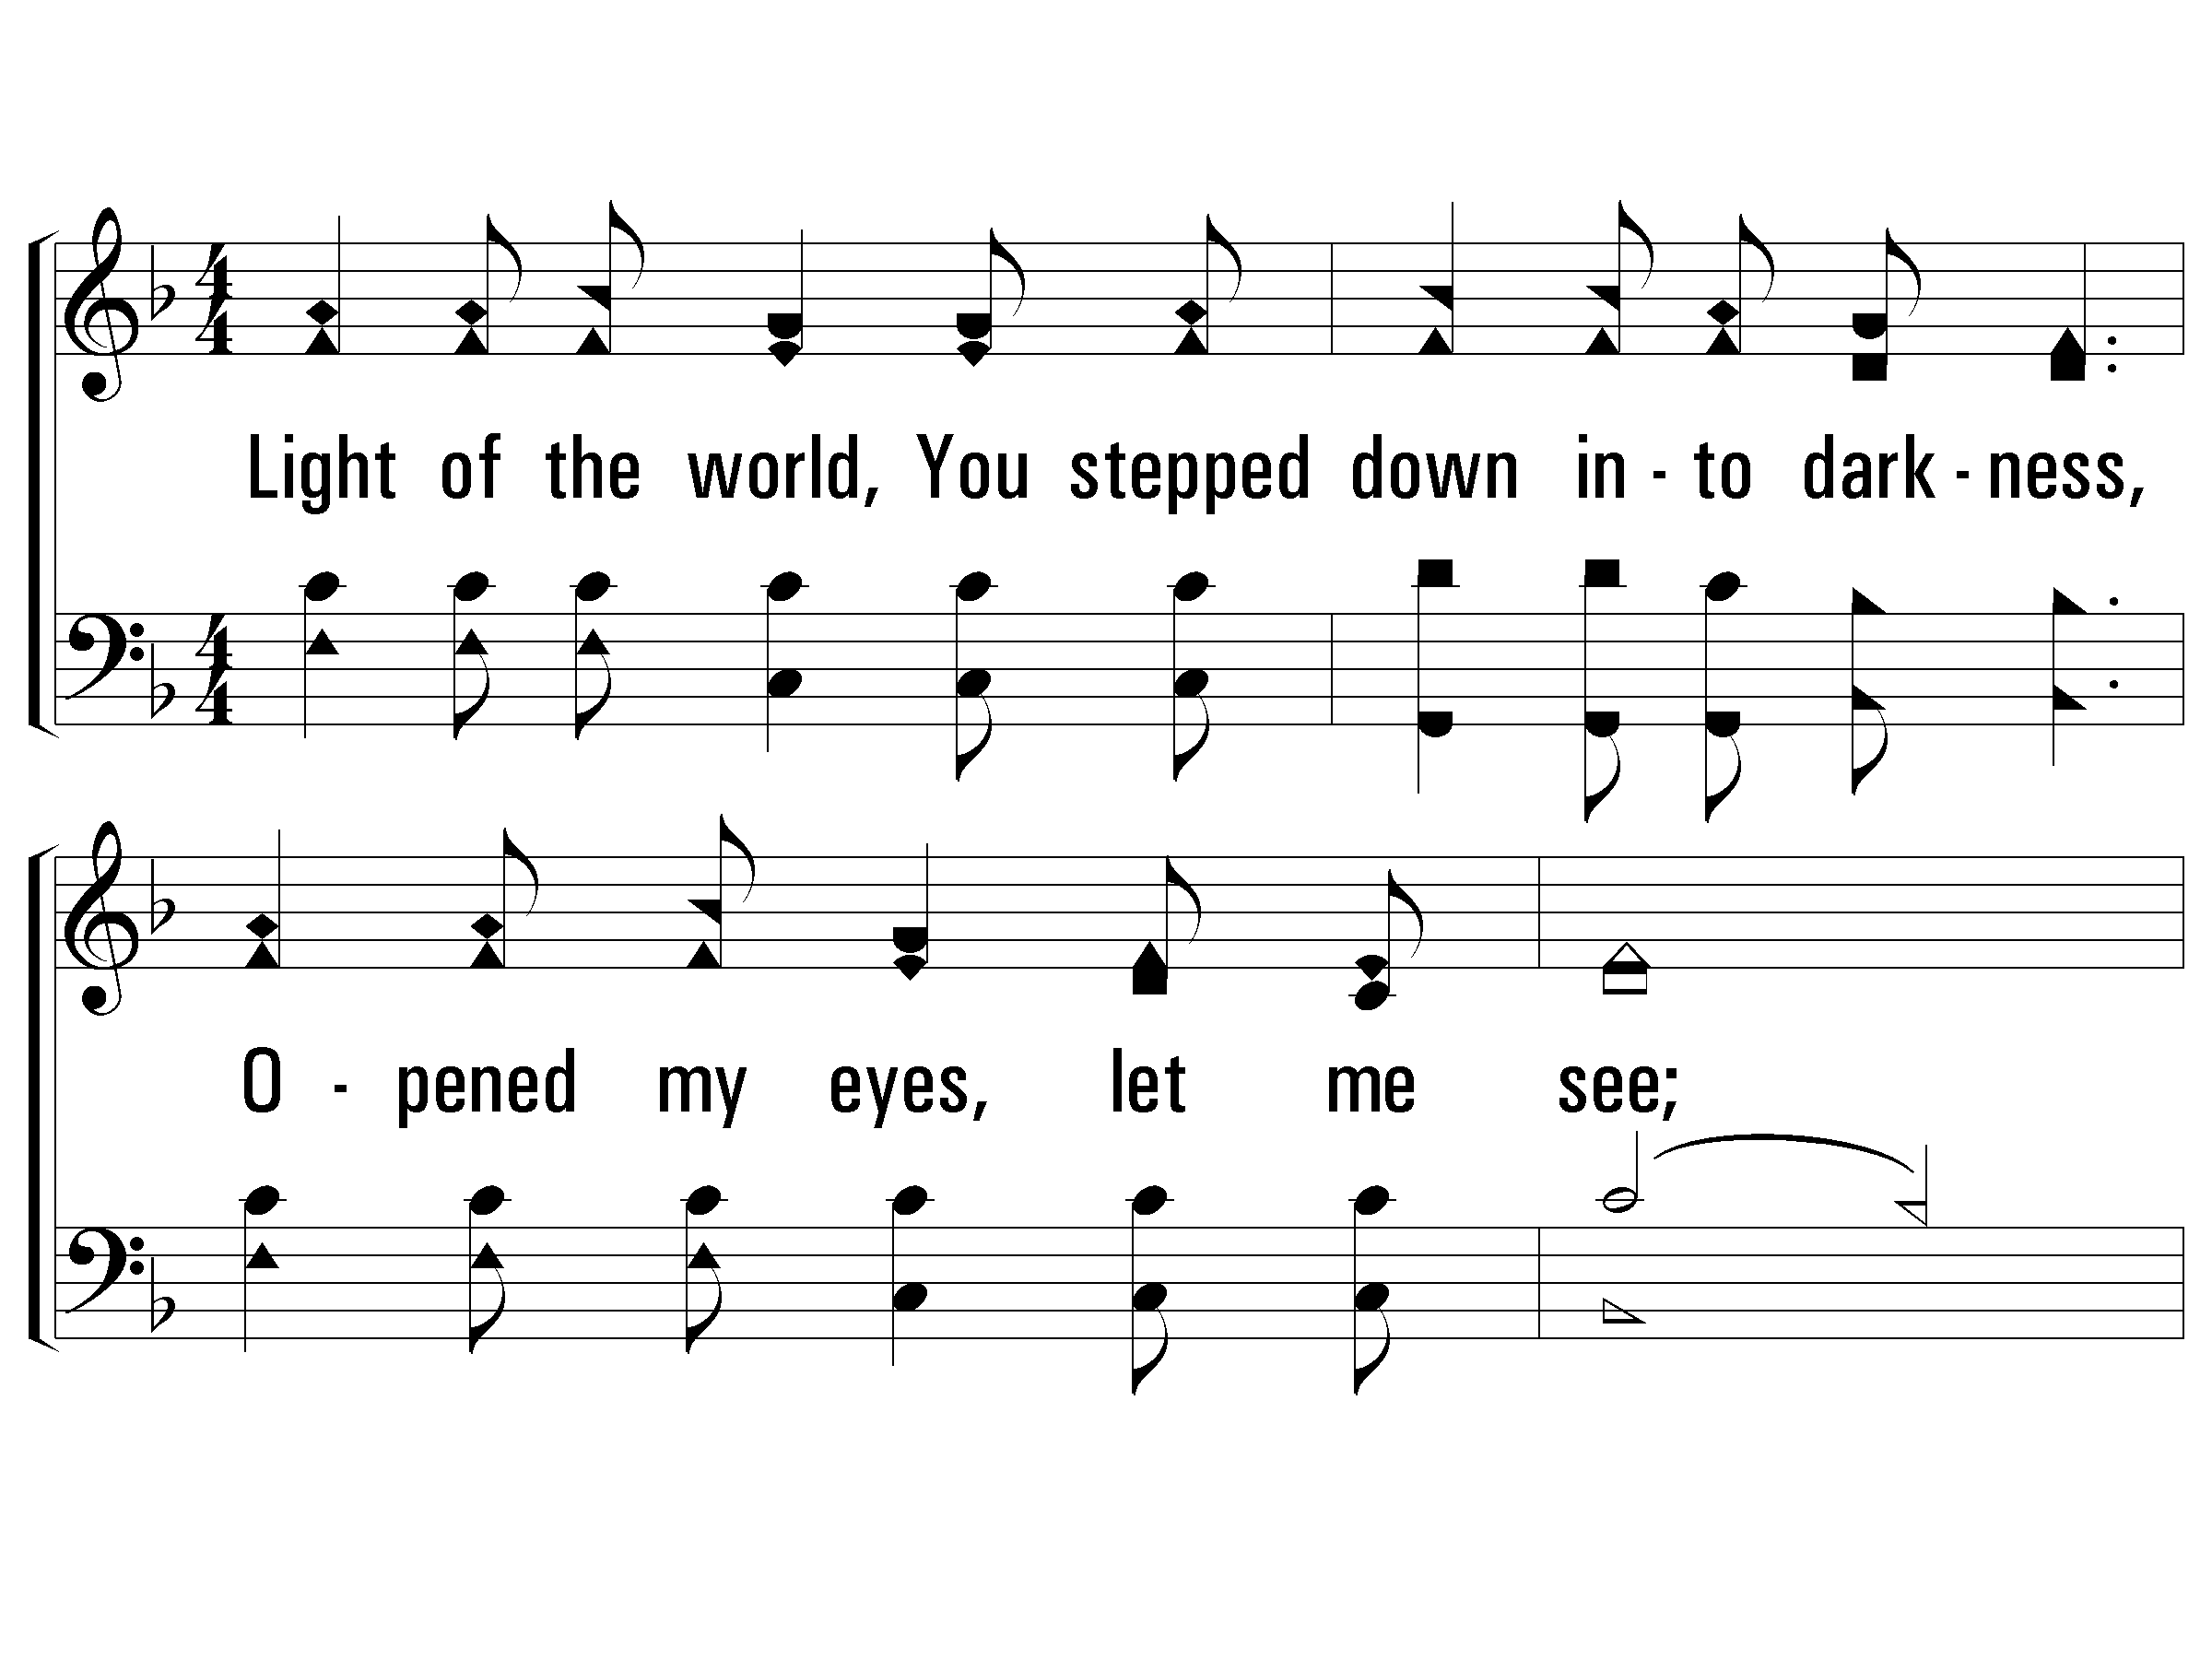
1 – Here I Am To Worship
Light of the world, You stepped down into darkness,
Opened my eyes, let me see,
Beauty that made this heart adore You,
Hope of a life spent with You.
Word and Music: Tim Hughes / Arr: James W. Tackett
Copyright © 2000 Thankyou Music (Admin. EMI Christian Music Publishing)
International Copyright Secured. All Rights Reserved. Used By Permission.
© 2006 The Paperless Hymnal®

Slide 45
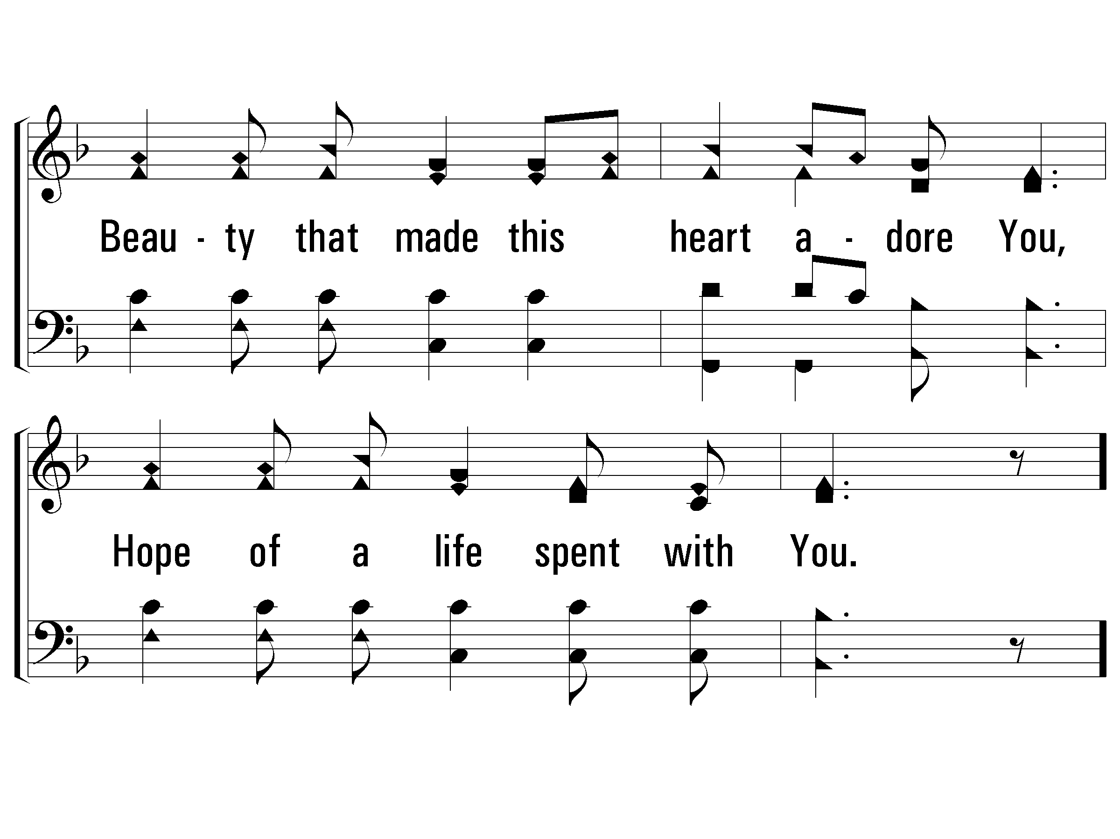
1 – Here I Am To Worship
© 2006 The Paperless Hymnal®

Slide 46
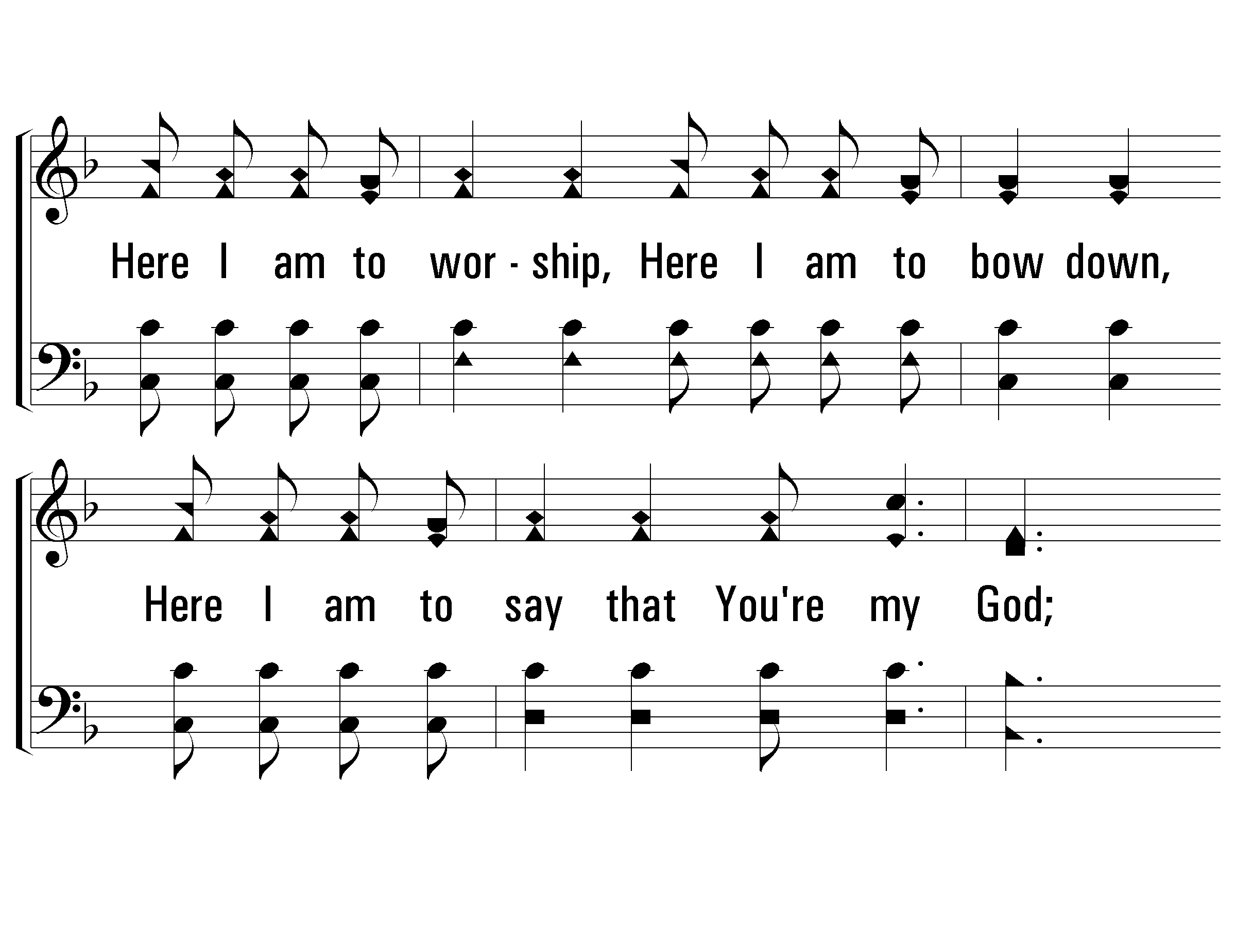
c – Here I Am To Worship
Here I am to worship. Here I am to bow down.
Here I am to say that You're my God.
You're altogether lovely, altogether worthy,
altogether wonderful to me.
© 2006 The Paperless Hymnal®

Slide 47
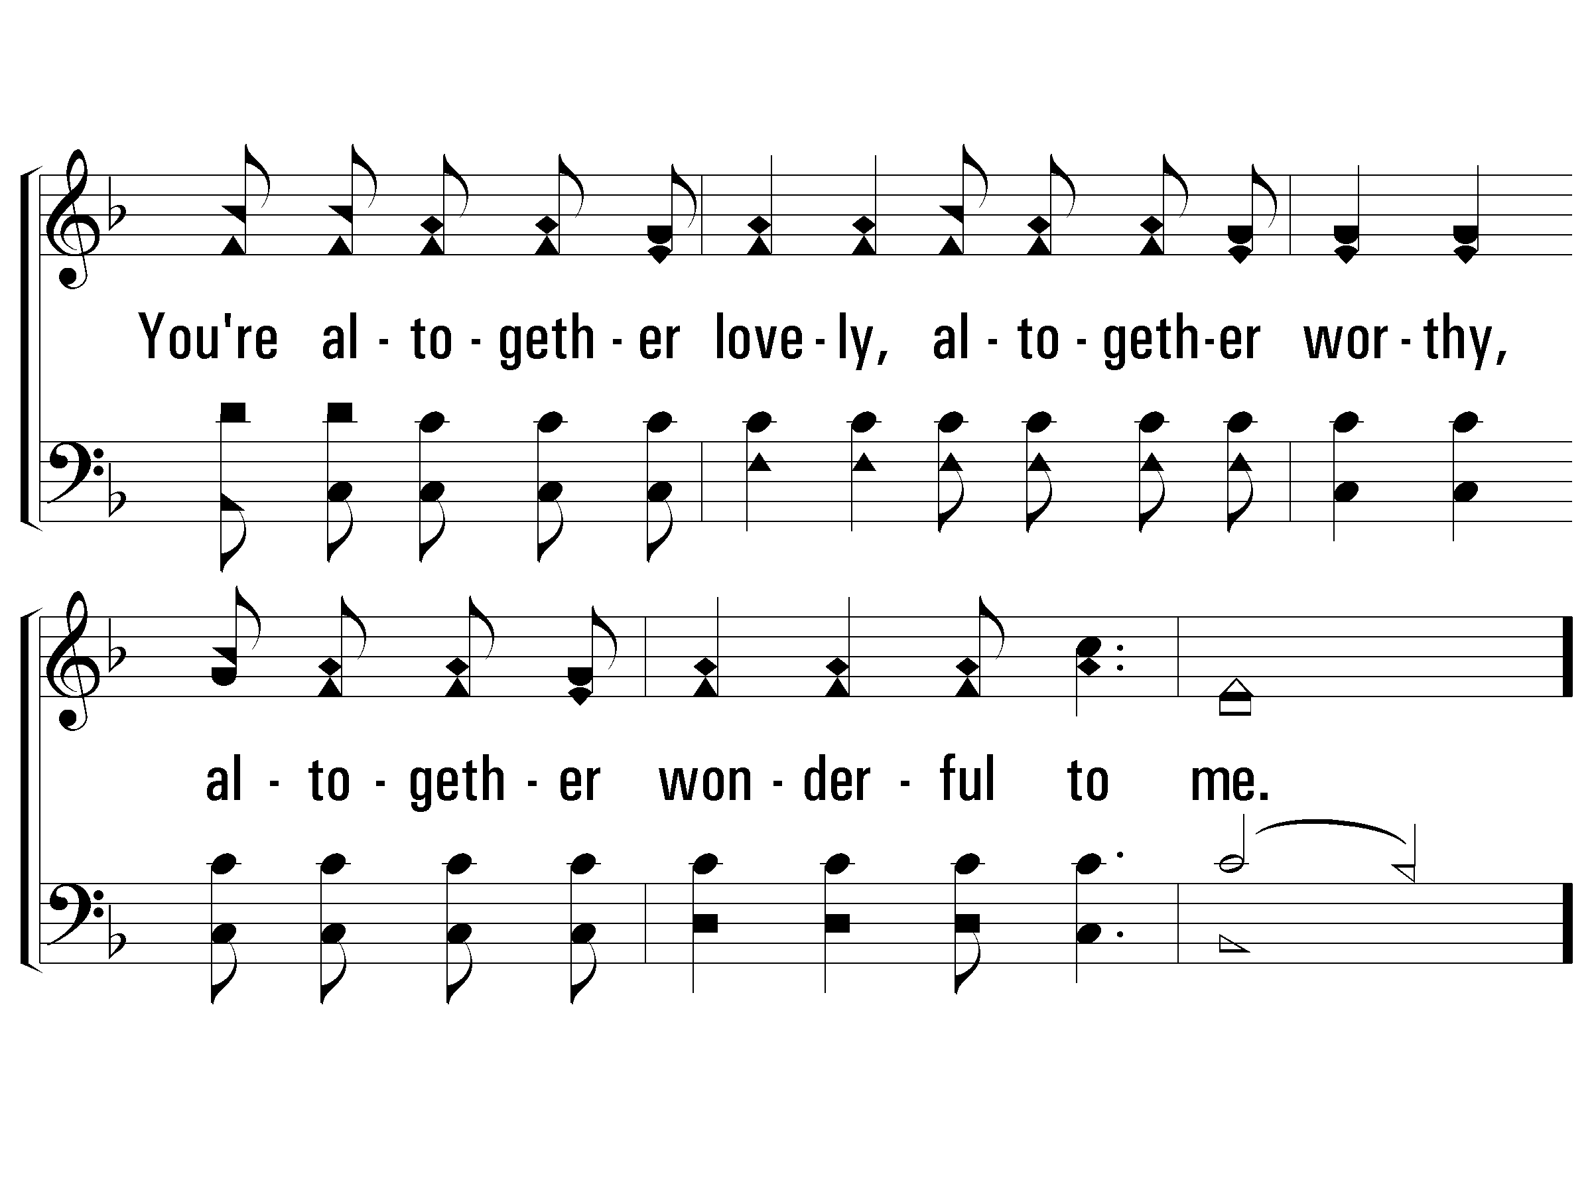
c – Here I Am To Worship
© 2006 The Paperless Hymnal®

Slide 48
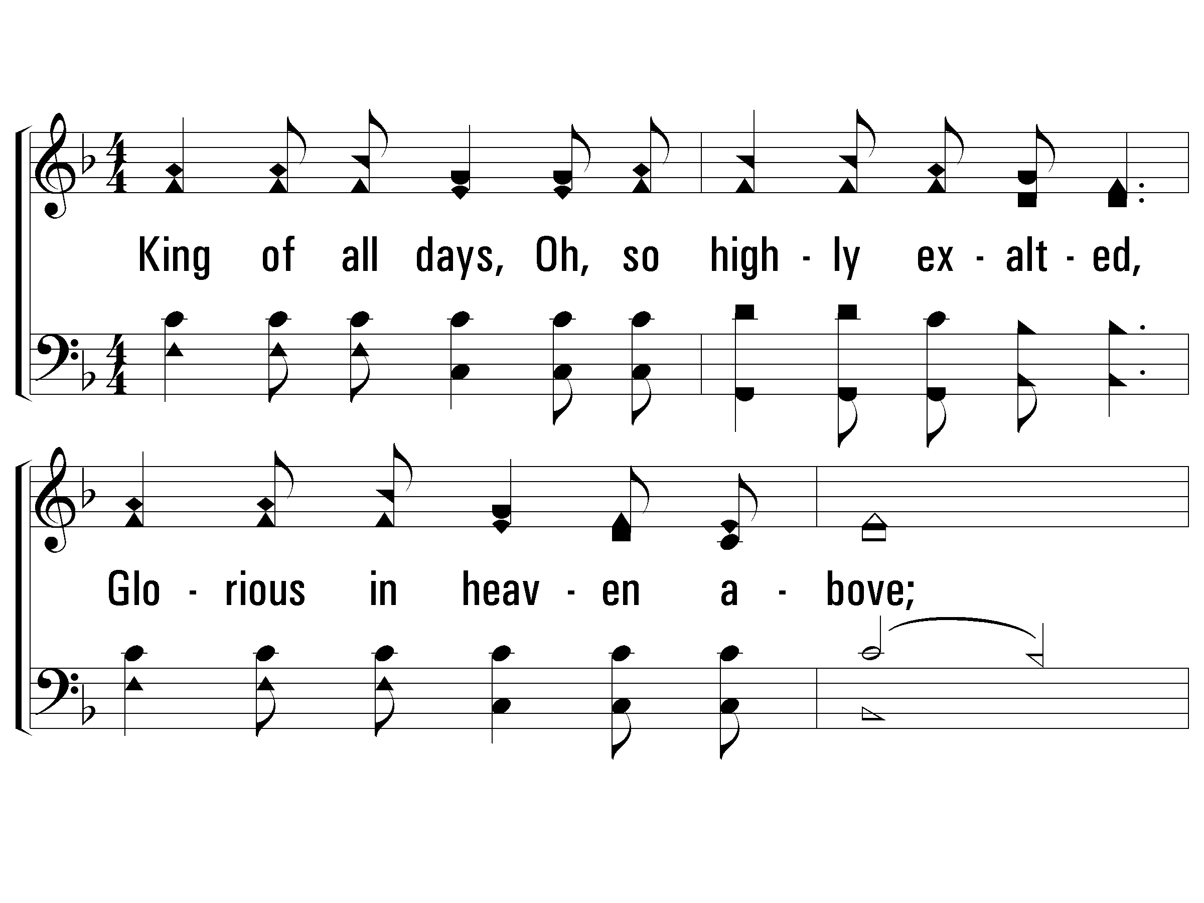
2 – Here I Am To Worship
King of all days, all so highly exalted,
Glorious in heaven above,
Humbly You came to the earth You created,
All for our sake be-came poor.
Beauty that made this heart adore You,
Hope of a life spent with You.
Word and Music: Tim Hughes / Arr: James W. Tackett
Copyright © 2000 Thankyou Music (Admin. EMI Christian Music Publishing)
International Copyright Secured. All Rights Reserved. Used By Permission.
© 2006 The Paperless Hymnal®

Slide 49
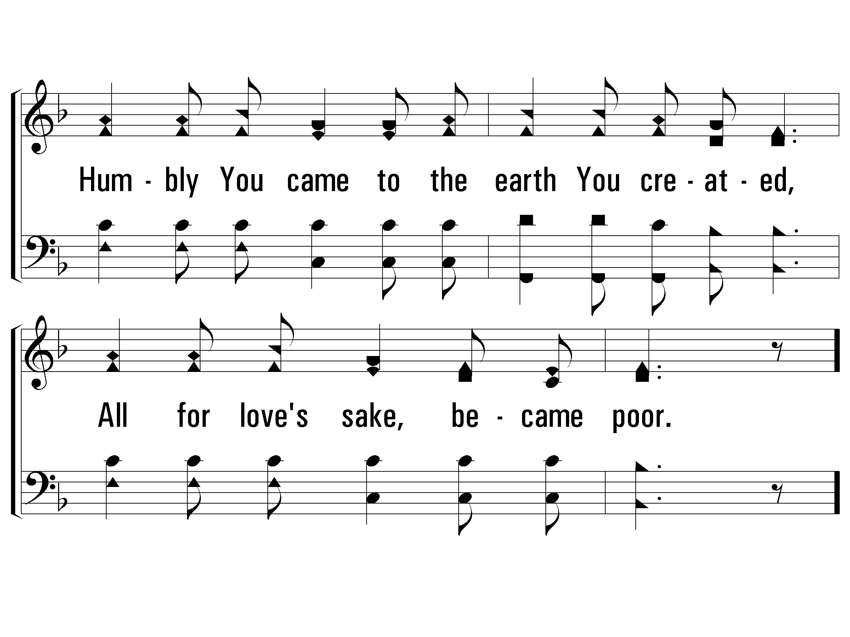
2 – Here I Am To Worship
© 2006 The Paperless Hymnal®

Slide 50
c – Here I Am To Worship
Here I am to worship. Here I am to bow down.
Here I am to say that You're my God.
You're altogether lovely, altogether worthy,
altogether wonderful to me.
© 2006 The Paperless Hymnal®

Slide 51
c – Here I Am To Worship
© 2006 The Paperless Hymnal®

Slide 52
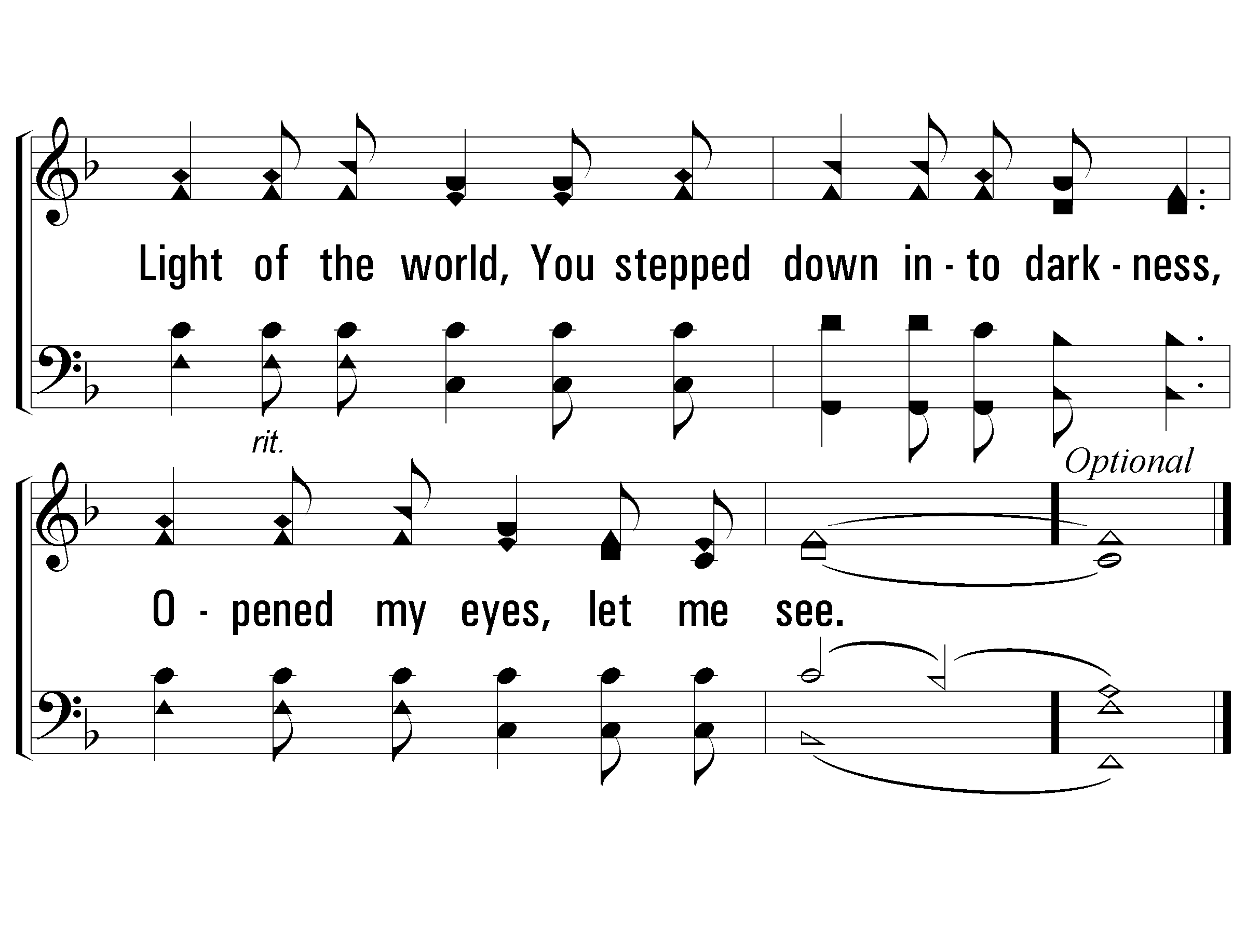
C – Here I Am To Worship
© 2006 The Paperless Hymnal®

Slide 53
Blessed
Assurance
#71

Slide 54
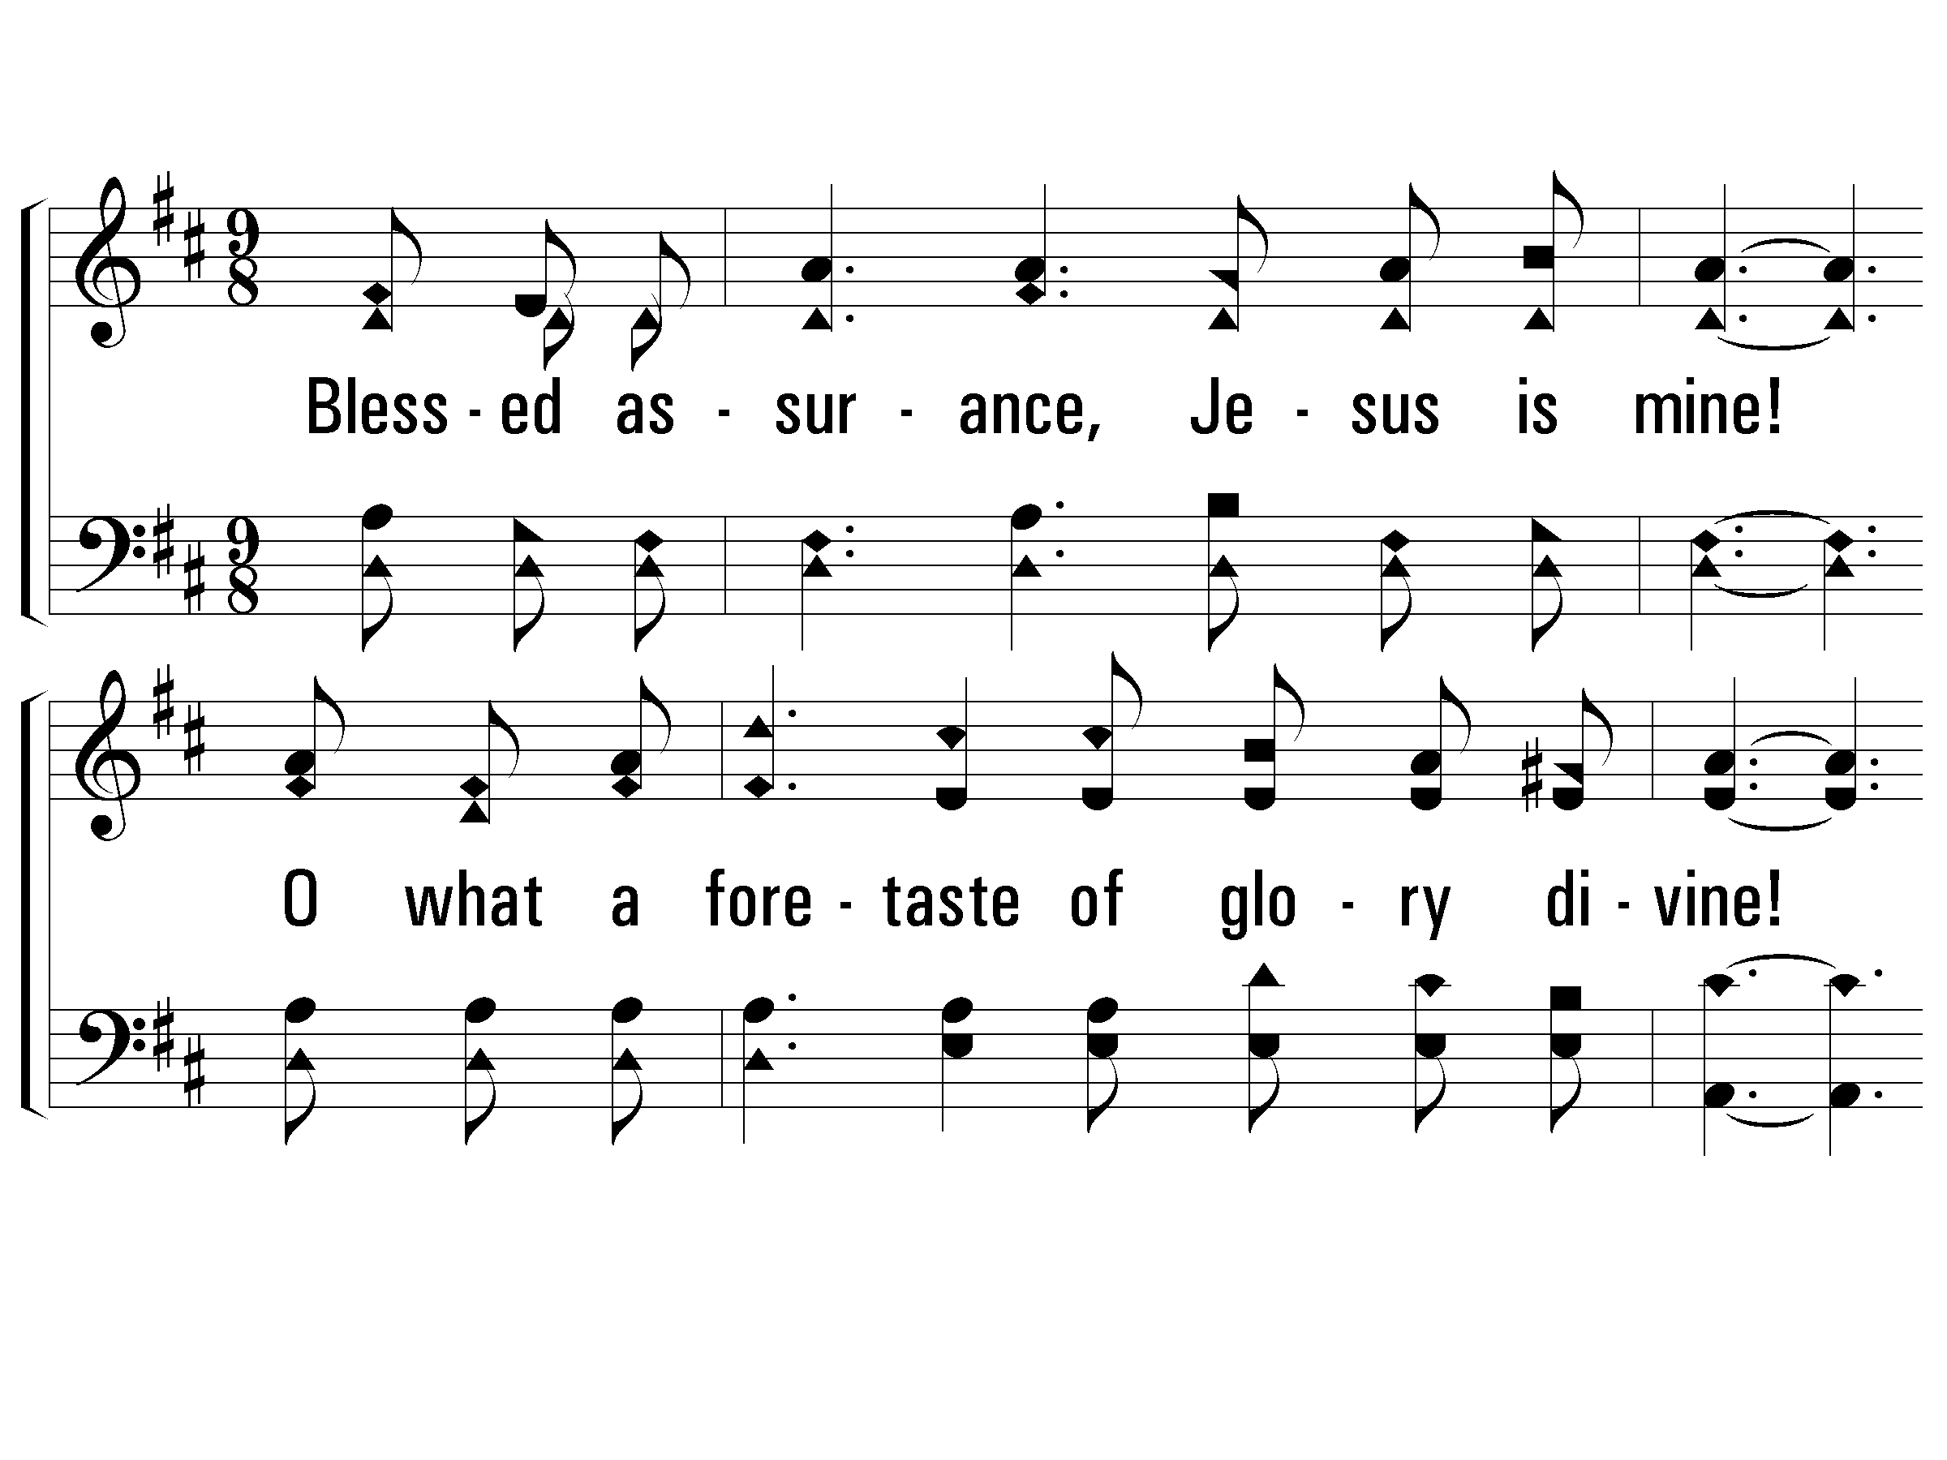
1 – Blessed Assurance
1.
Blessed assurance, Jesus is mine!
O what a foretaste of glory divine!
Heir of salvation, purchase of God,
Born of His Spirit, washed in His blood.
Words by: Fanny J. Crosby
Music by: Mrs. Joseph F. Knapp
© 2001 The Paperless Hymnal™

Slide 55
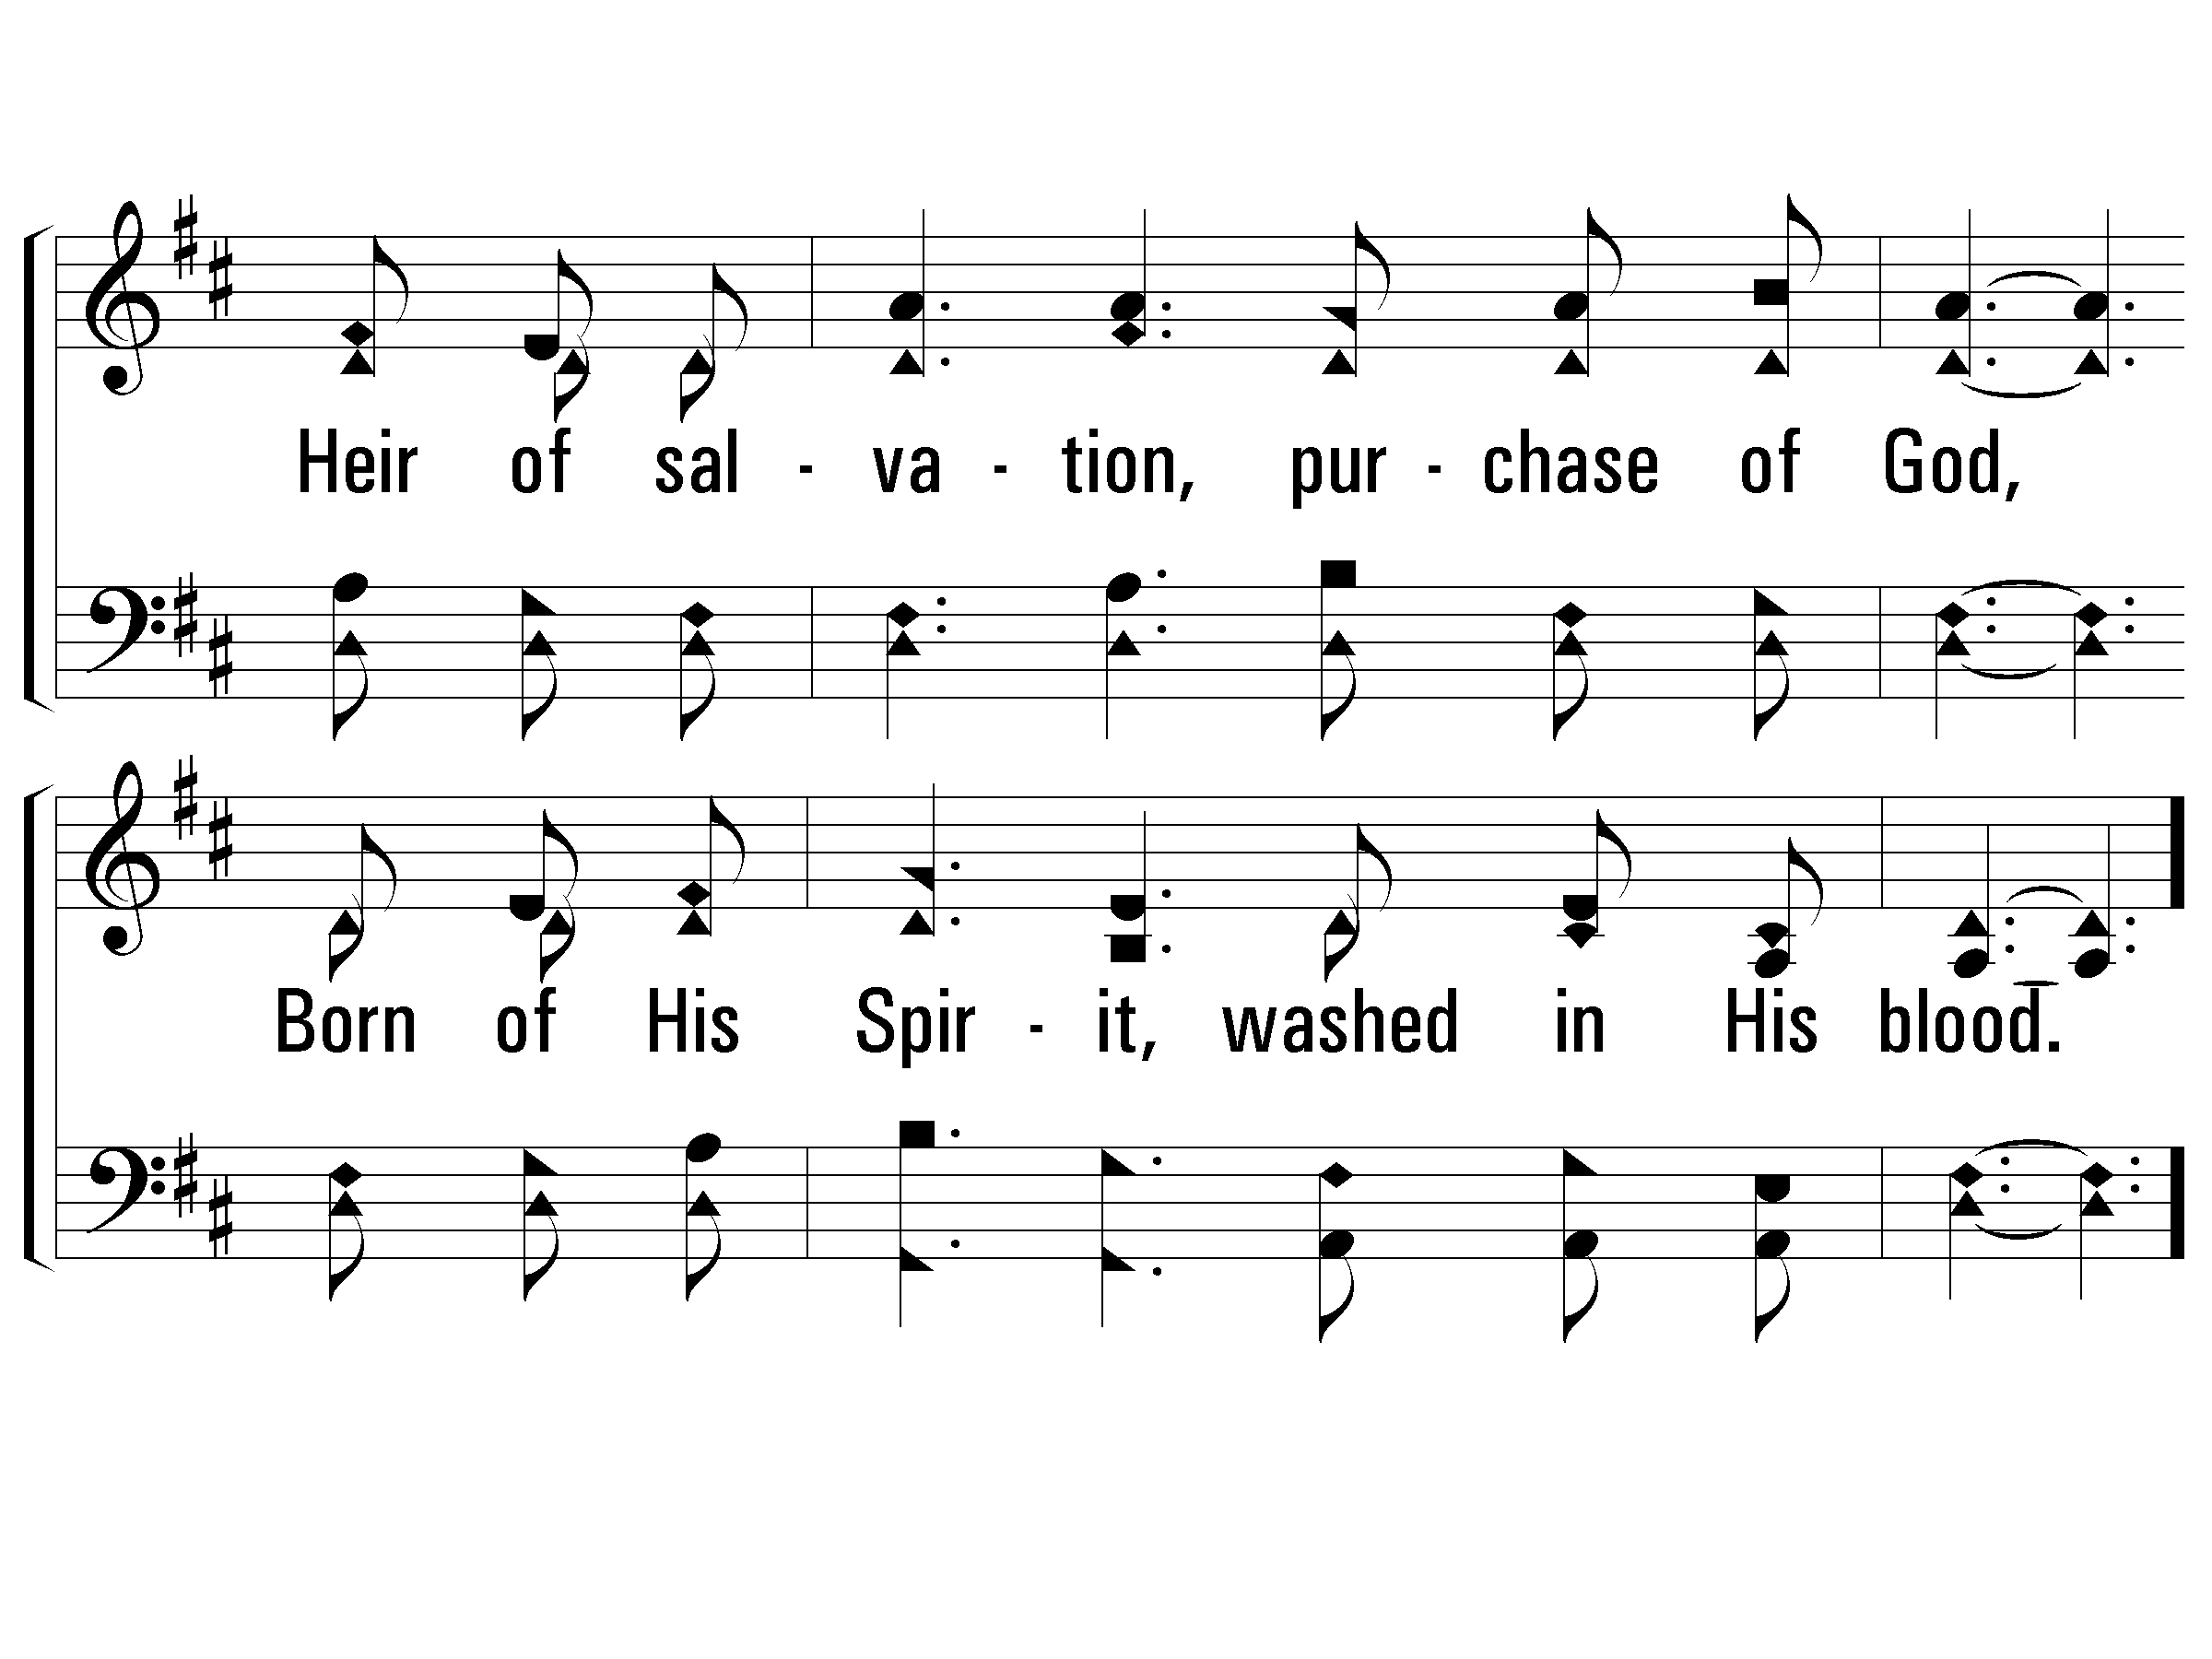
1 – Blessed Assurance
© 2001 The Paperless Hymnal™

Slide 56
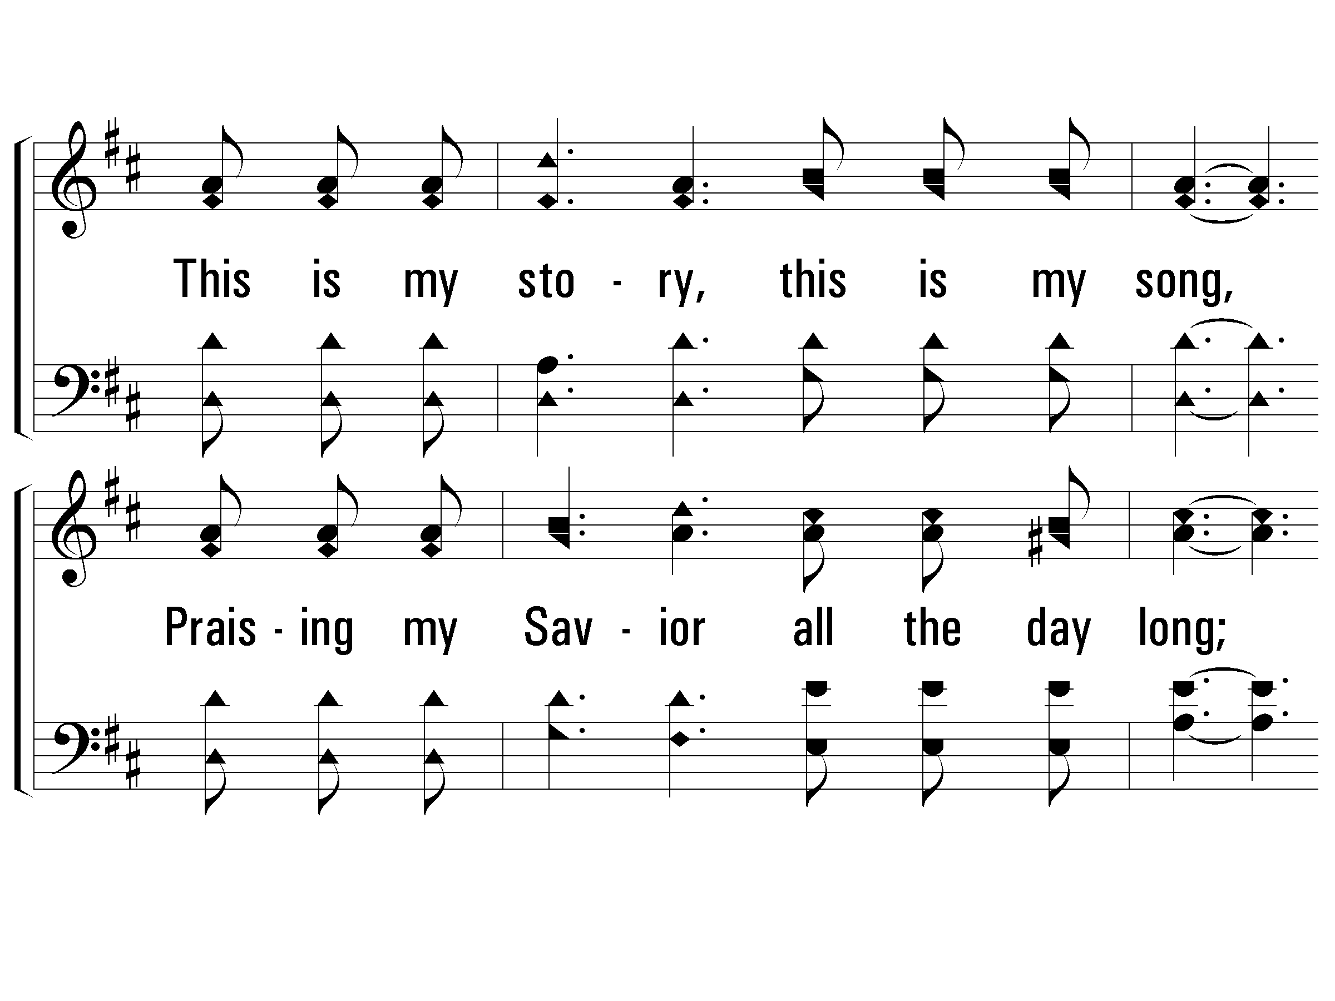
c – Blessed Assurance
This is my story, this is my song,
Praising my Savior all the day long;
This is my story, this is my song,
Praising my Savior all the day long.
© 2001 The Paperless Hymnal™

Slide 57
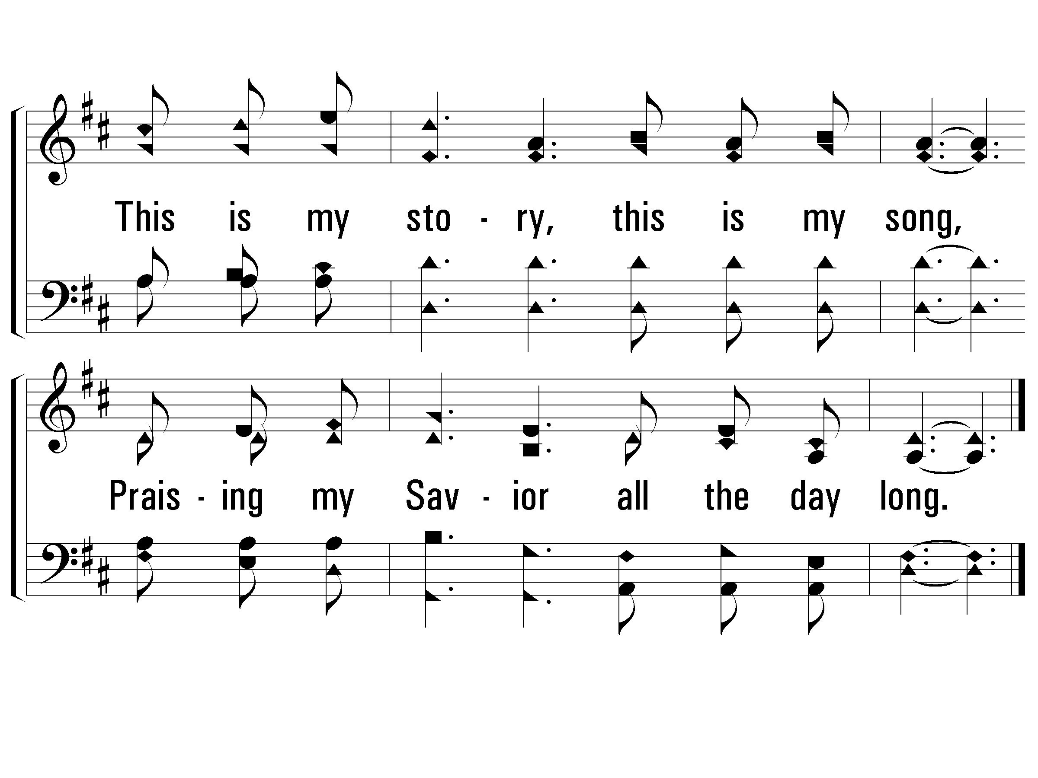
c – Blessed Assurance
© 2001 The Paperless Hymnal™

Slide 58
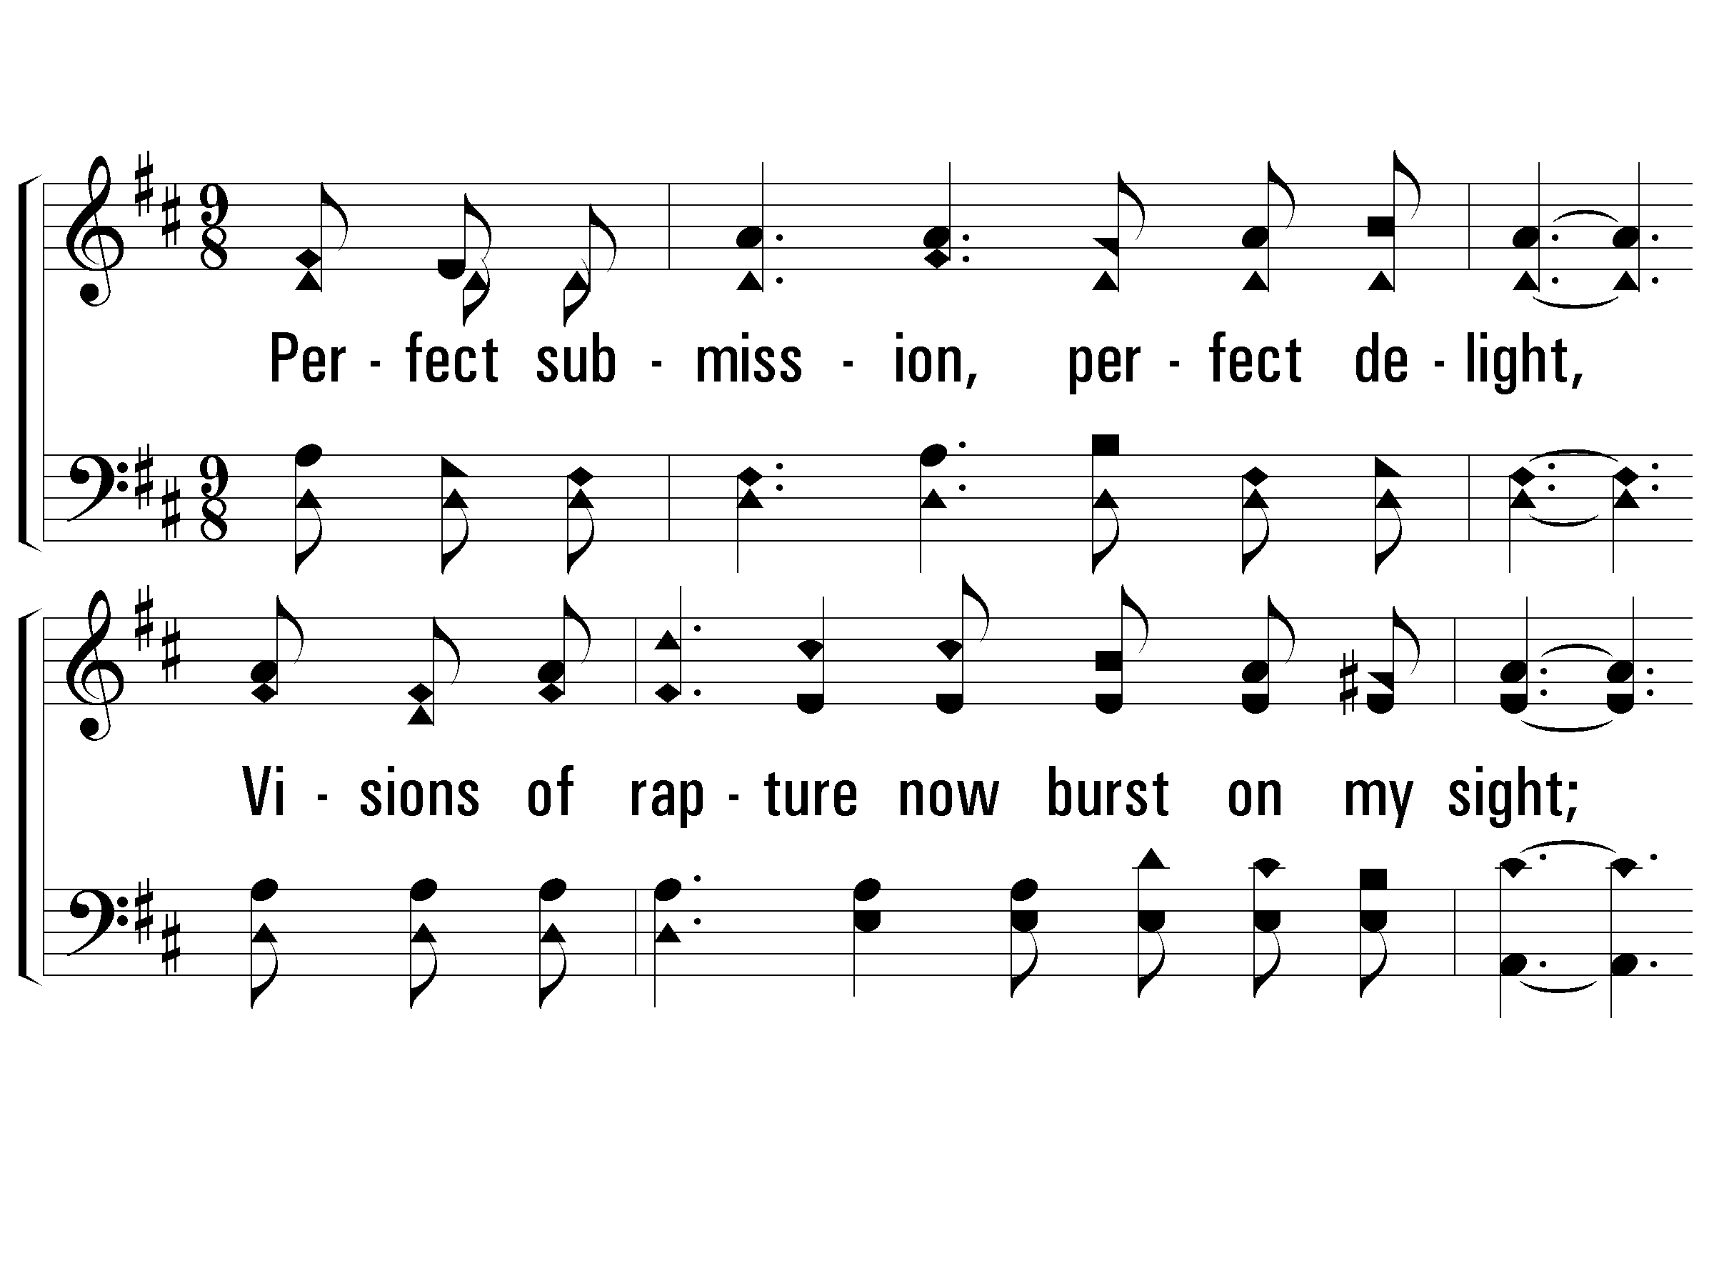
2 – Blessed Assurance
2.
Perfect submission, perfect delight,
Visions of rapture now burst on my sight;
Angels descending bring from above
Echoes of mercy, whispers of love.
Words by: Fanny J. Crosby
Music by: Mrs. Joseph F. Knapp
© 2001 The Paperless Hymnal™

Slide 59
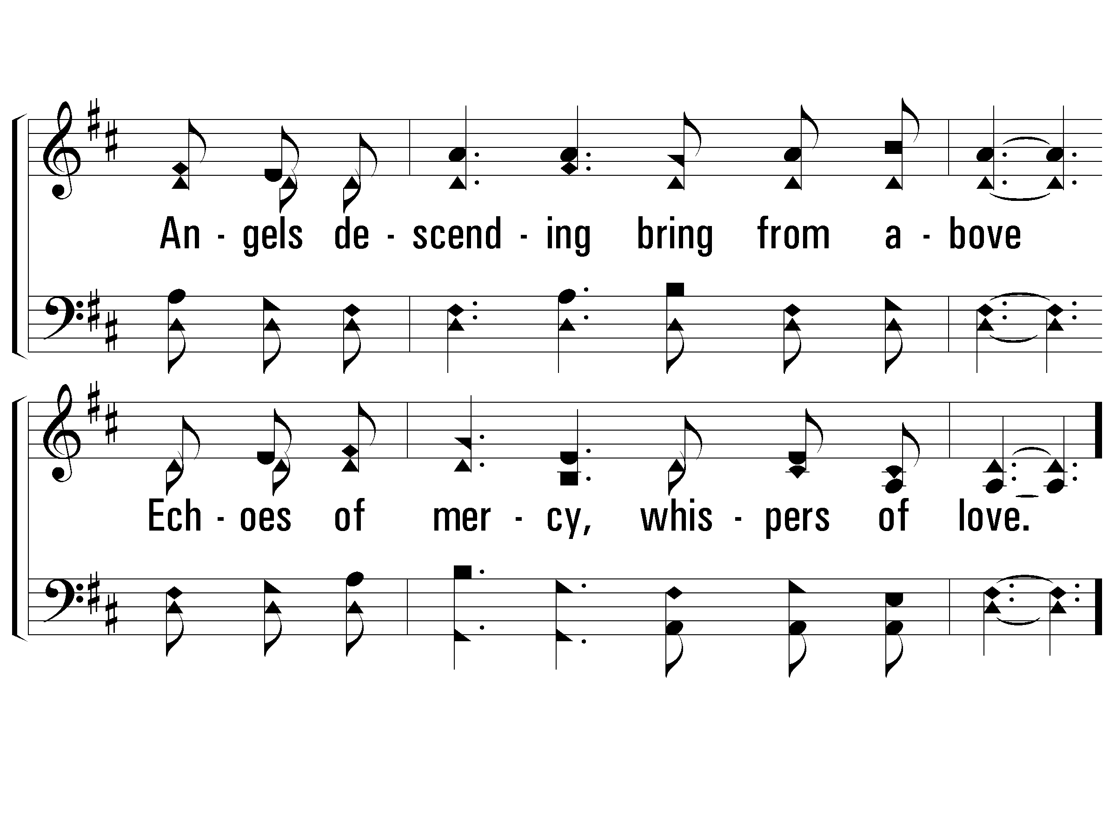
2 – Blessed Assurance
© 2001 The Paperless Hymnal™

Slide 60
c – Blessed Assurance
© 2001 The Paperless Hymnal™

Slide 61
c – Blessed Assurance
© 2001 The Paperless Hymnal™

Slide 62
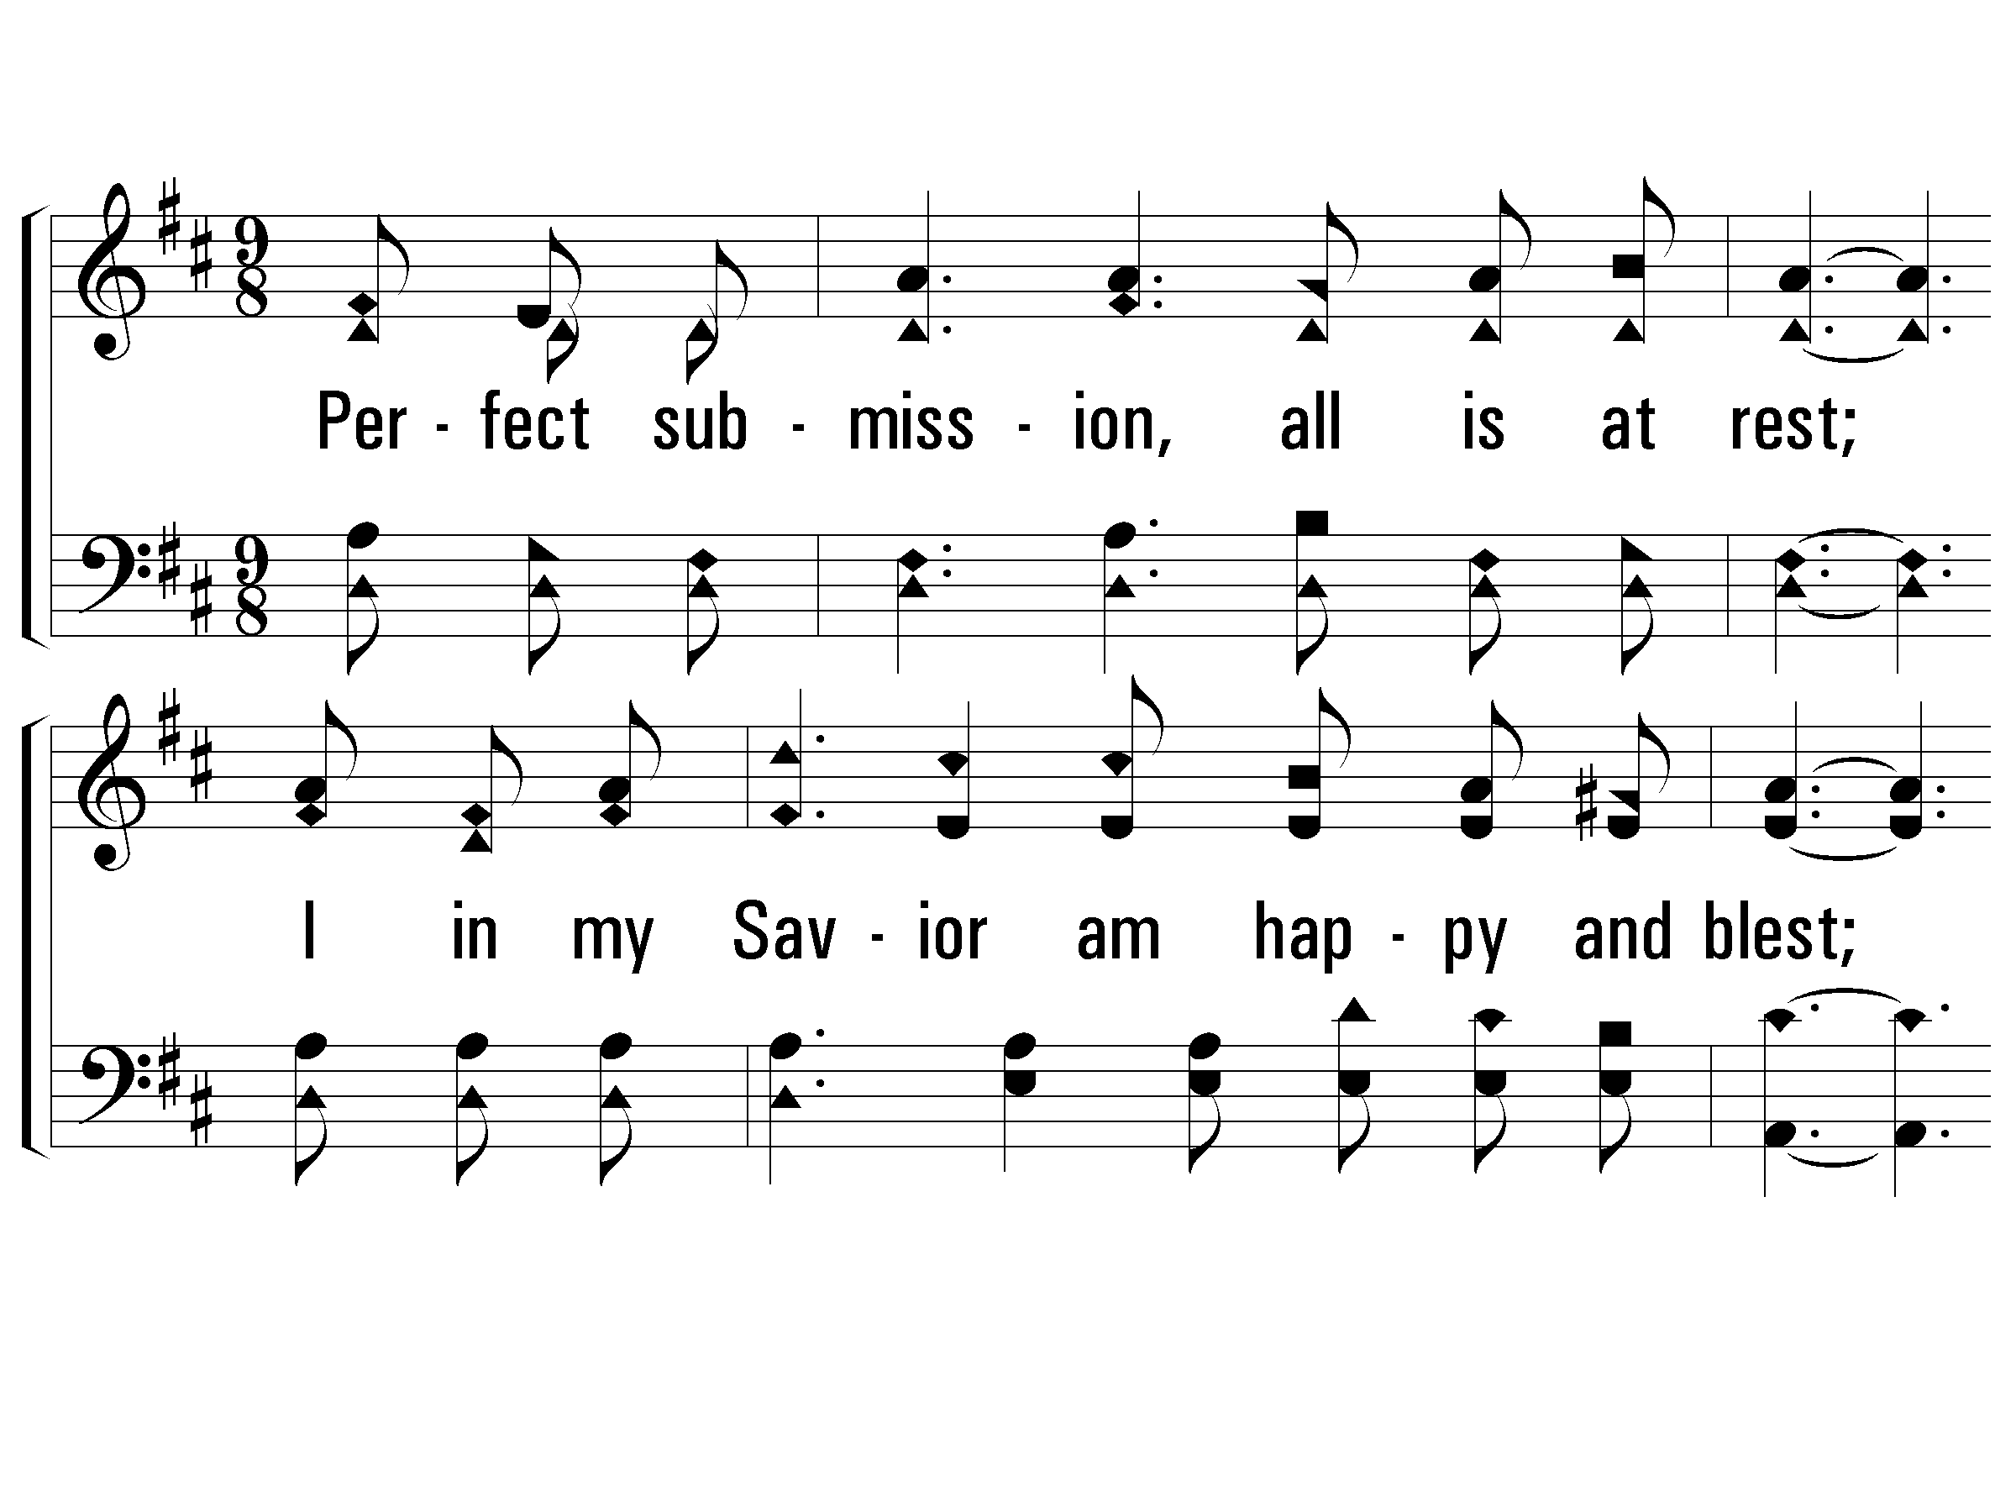
3 – Blessed Assurance
3.
Perfect submission, all is at rest;
I in my Savior am happy and blest;
Watching and waiting, looking above,
Filled with His good-ness, lost in His love.
Words by: Fanny J. Crosby
Music by: Mrs. Joseph F. Knapp
© 2001 The Paperless Hymnal™

Slide 63
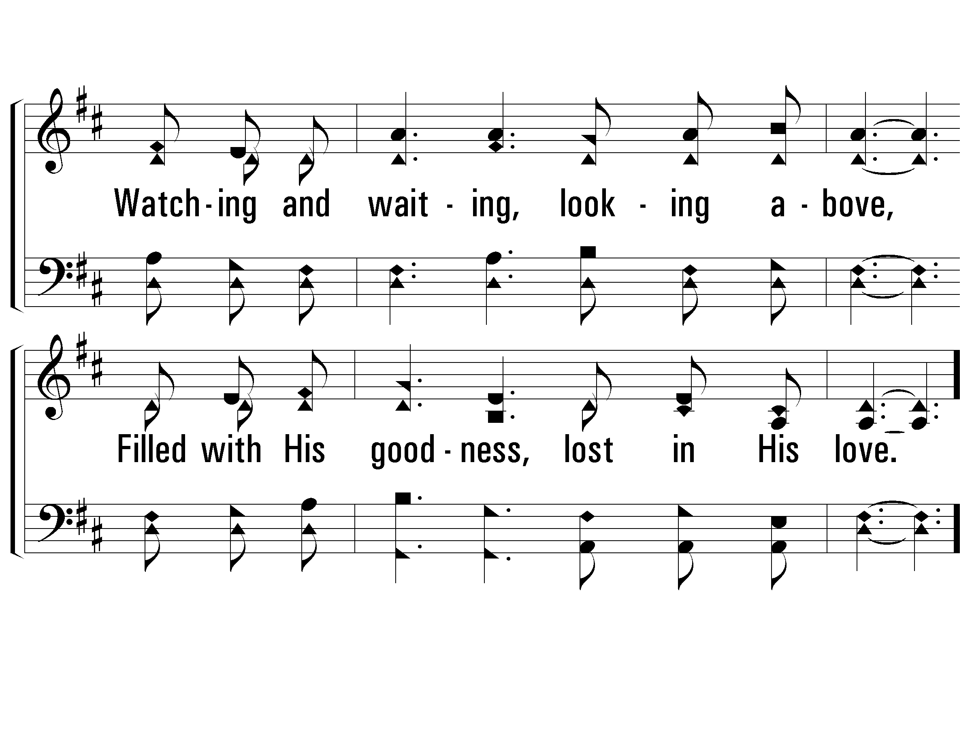
3 – Blessed Assurance
© 2001 The Paperless Hymnal™

Slide 64
c – Blessed Assurance
© 2001 The Paperless Hymnal™

Slide 65
c – Blessed Assurance
© 2001 The Paperless Hymnal™

Slide 66
Be With
Me Lord
#40

Slide 67
1 - Be With Me, Lord
1.
Be with me, Lord I cannot live without Thee,
I dare not try to take one step alone,
I cannot bear the loads of life, unaided,
I need Thy strength to lean myself upon.
Words by: T. O. Chisholm / Music by: L. O. Sanderson
Copyright © 1963, Renewal, Leon B. Sanderson, owner.
All Rights Reserved. Used by Permission
© 2001 The Paperless Hymnal™

Slide 68
1 - Be With Me, Lord
© 2001 The Paperless Hymnal™

Slide 69
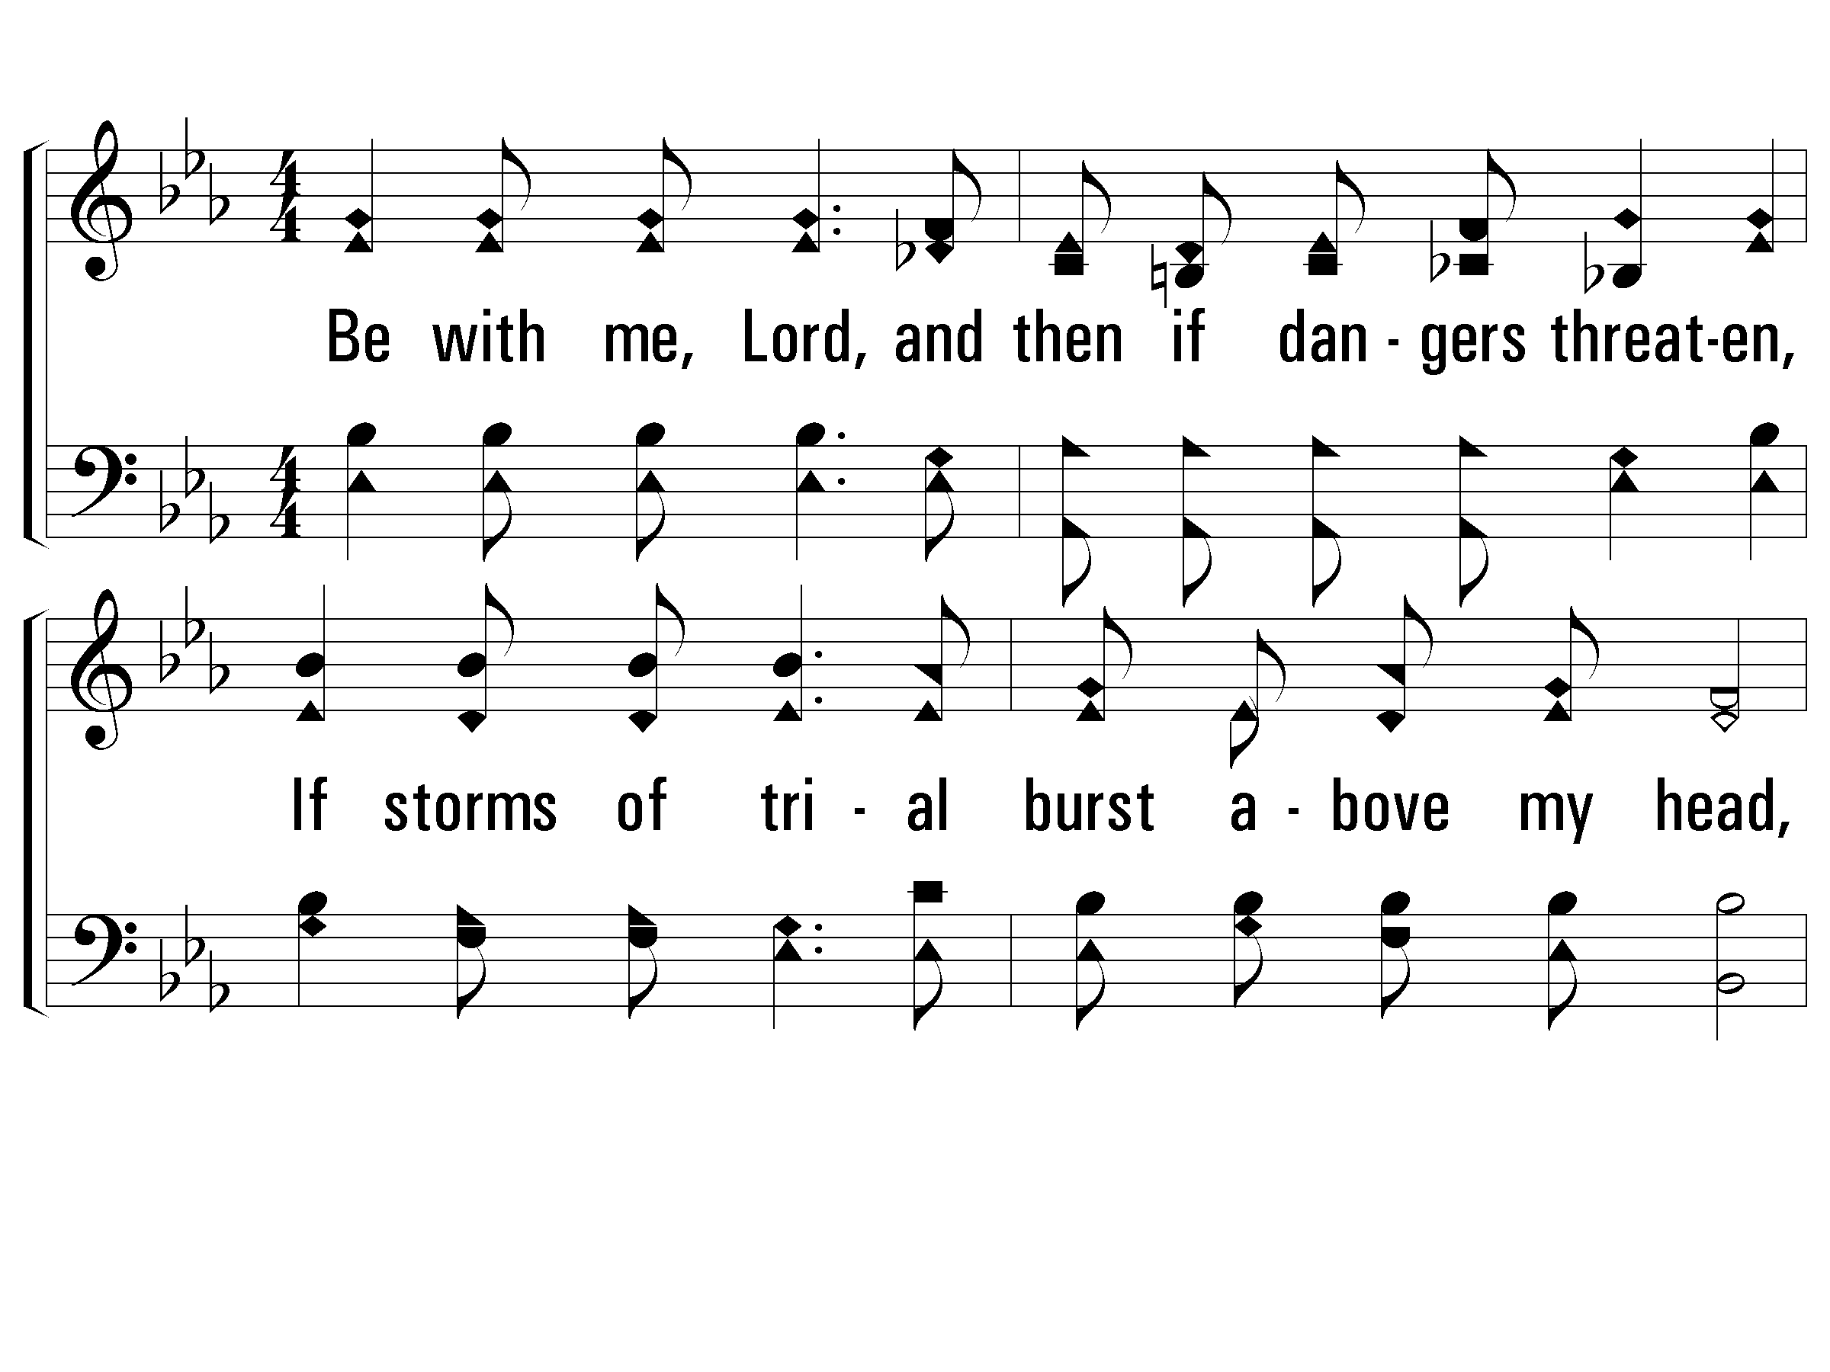
2 - Be With Me, Lord
2.
Be with me, Lord, and then if dangers threaten,
If storms of trial burst above my head,
If lashing seas leap everywhere about me,
They cannot harm, or make my heart afraid.
Words by: T. O. Chisholm / Music by: L. O. Sanderson
Copyright © 1963, Renewal, Leon B. Sanderson, owner.
All Rights Reserved. Used by Permission
© 2001 The Paperless Hymnal™

Slide 70
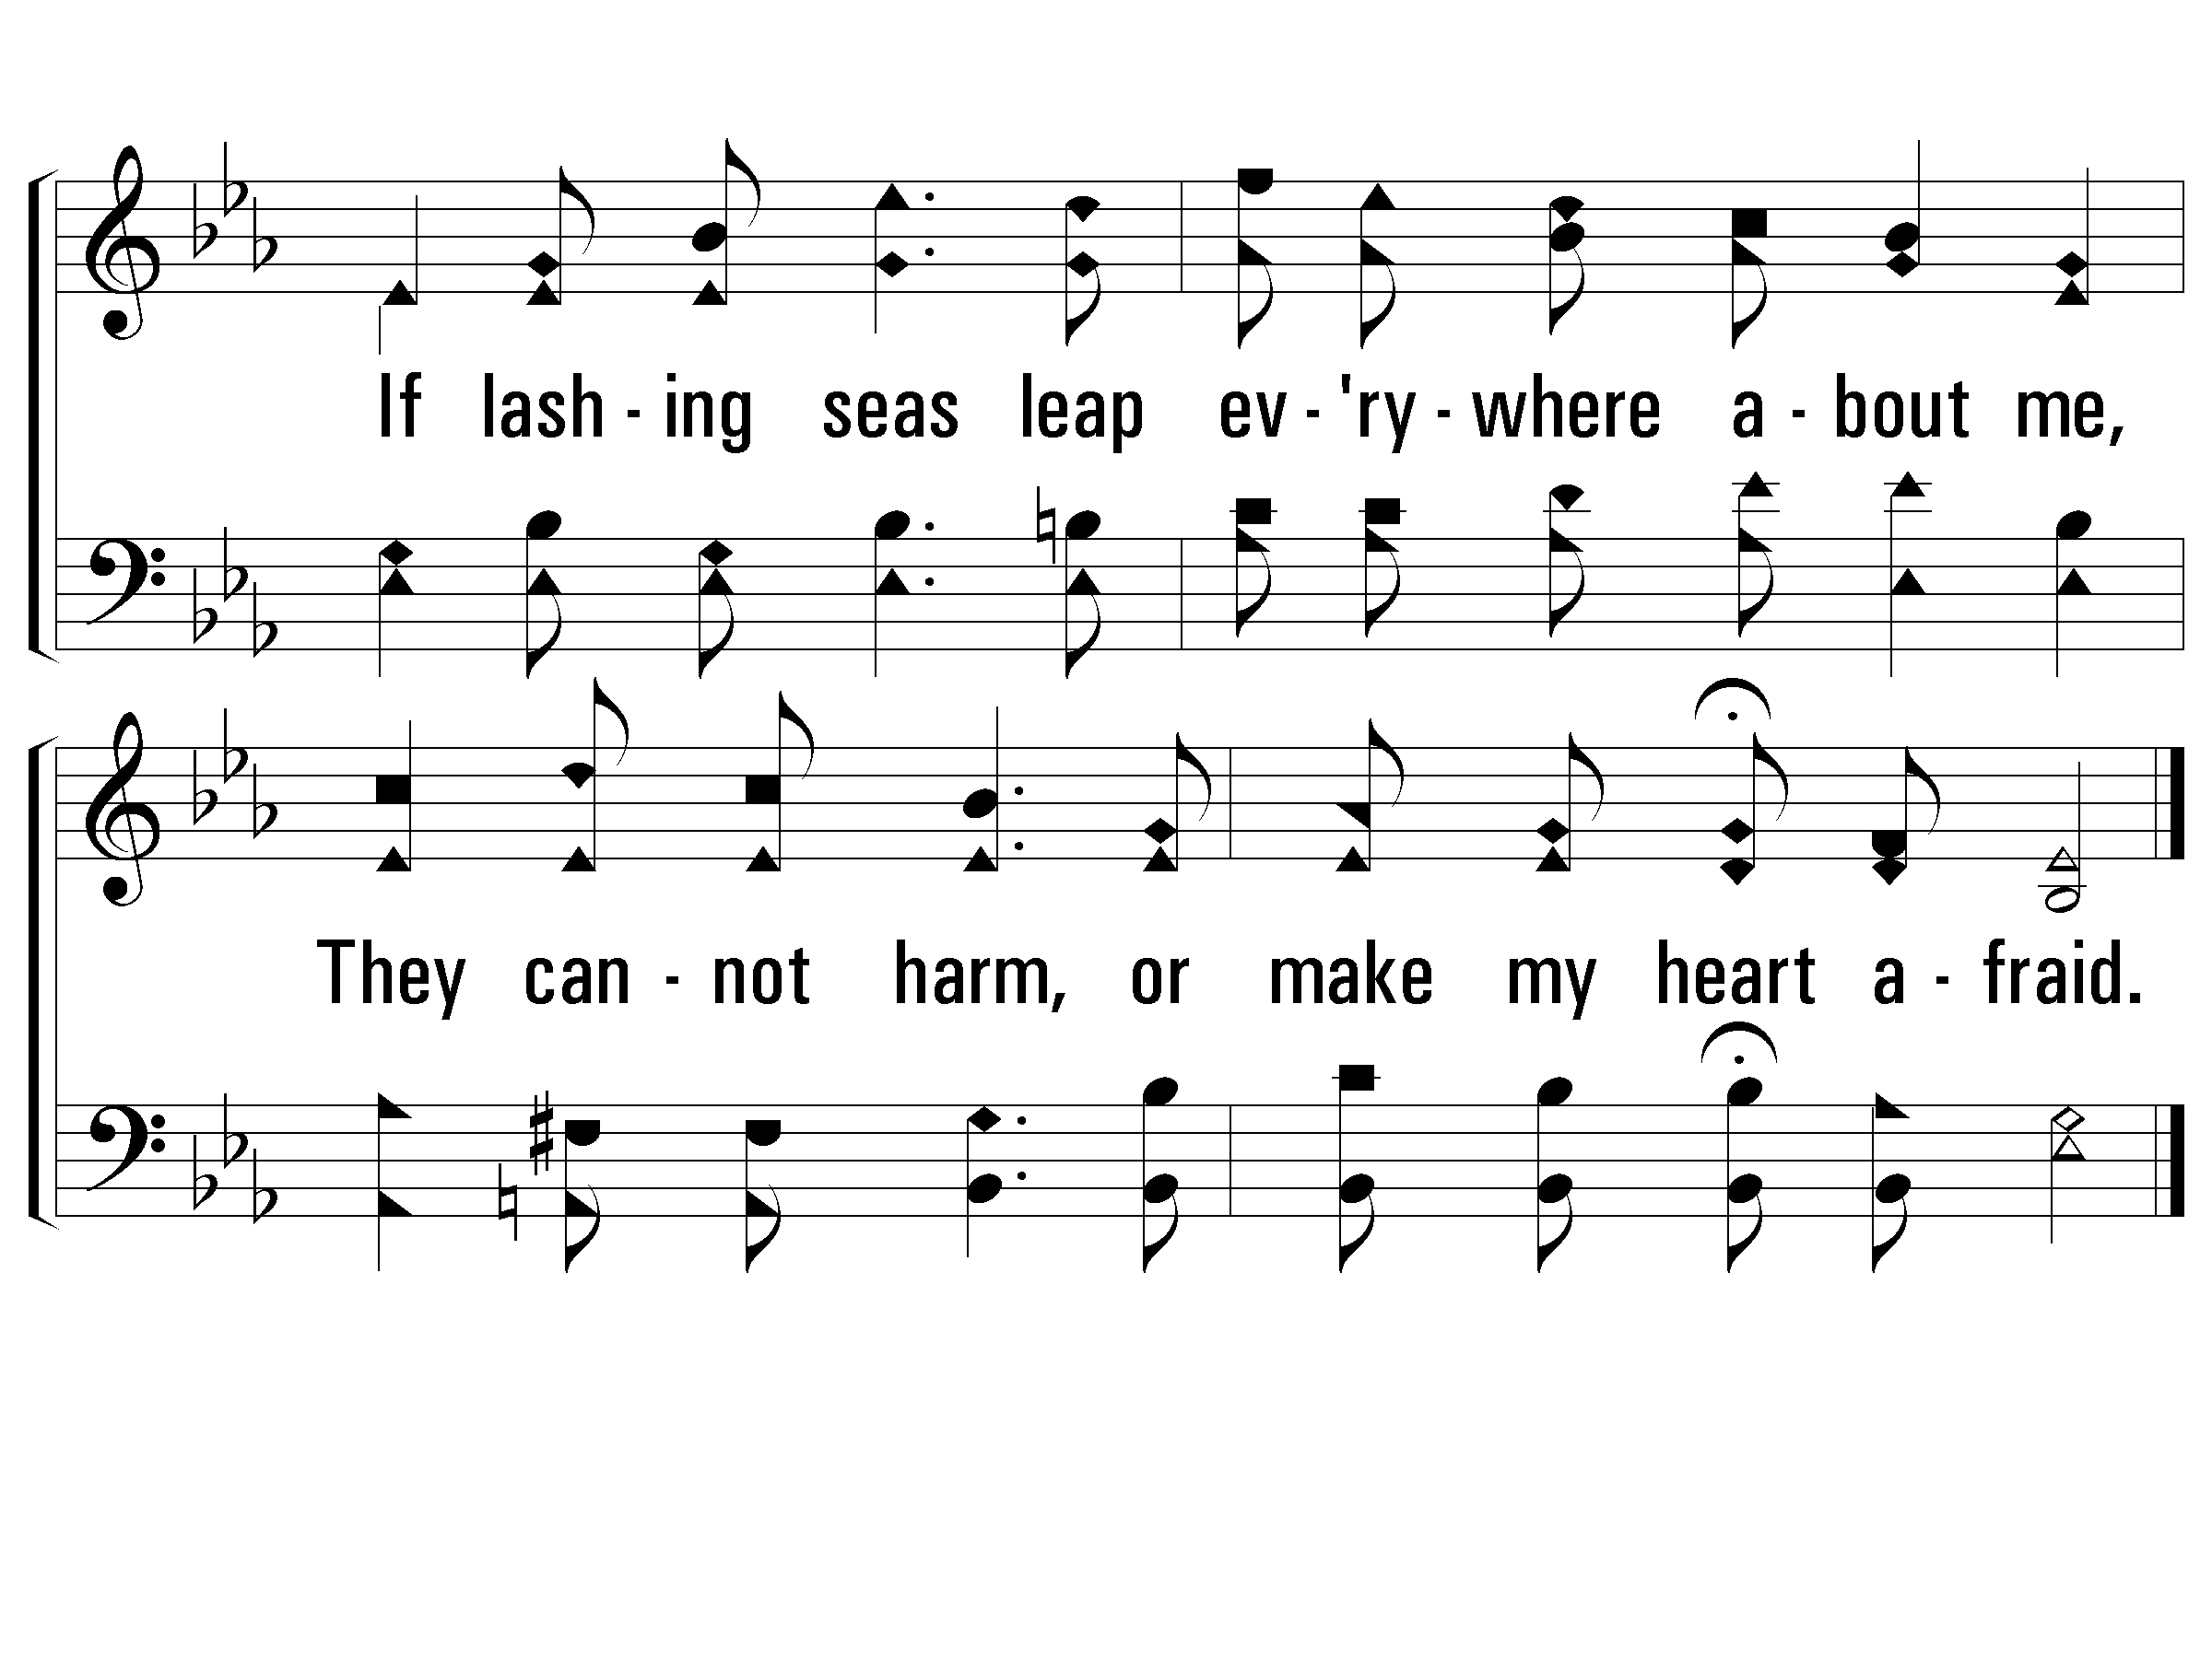
2 - Be With Me, Lord
© 2001 The Paperless Hymnal™

Slide 71
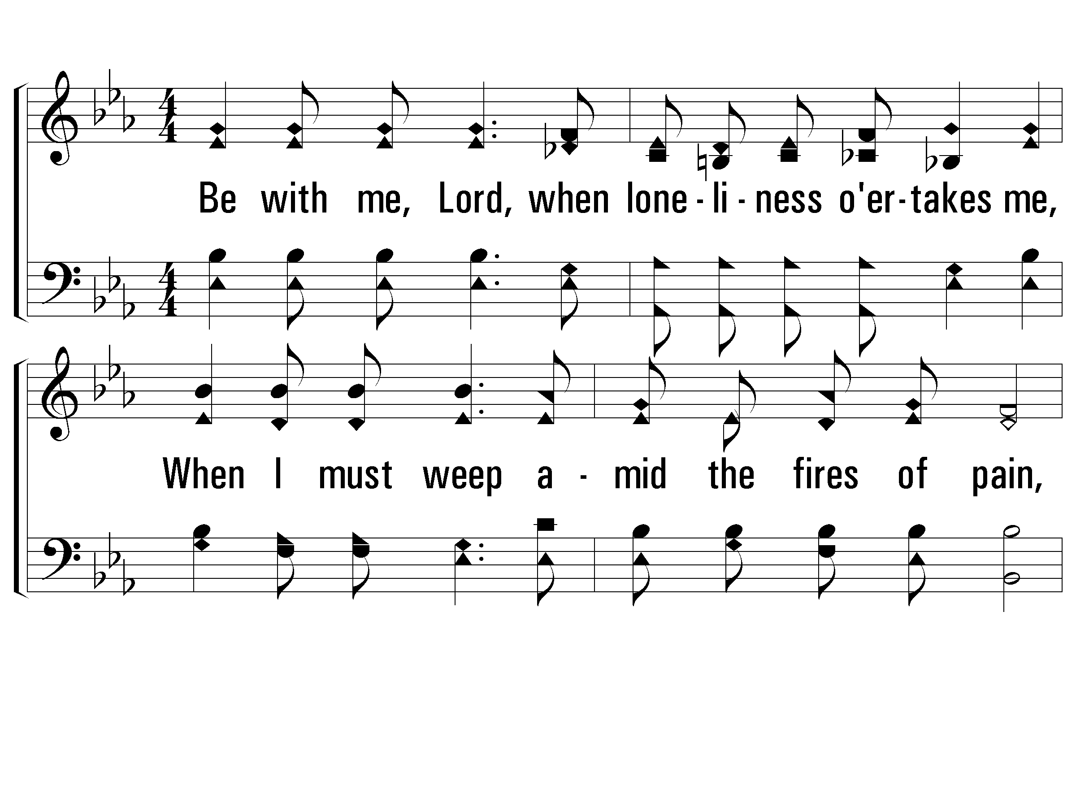
4 - Be With Me, Lord
4.
Be with me, Lord, when loveliness o'ertakes me,
When I must weep amid the fires of pain,
And when shall come the hour of "my departure"
For "worlds unknown," O Lord, be with me then.
Words by: T. O. Chisholm / Music by: L. O. Sanderson
Copyright © 1963, Renewal, Leon B. Sanderson, owner.
All Rights Reserved. Used by Permission
© 2001 The Paperless Hymnal™

Slide 72
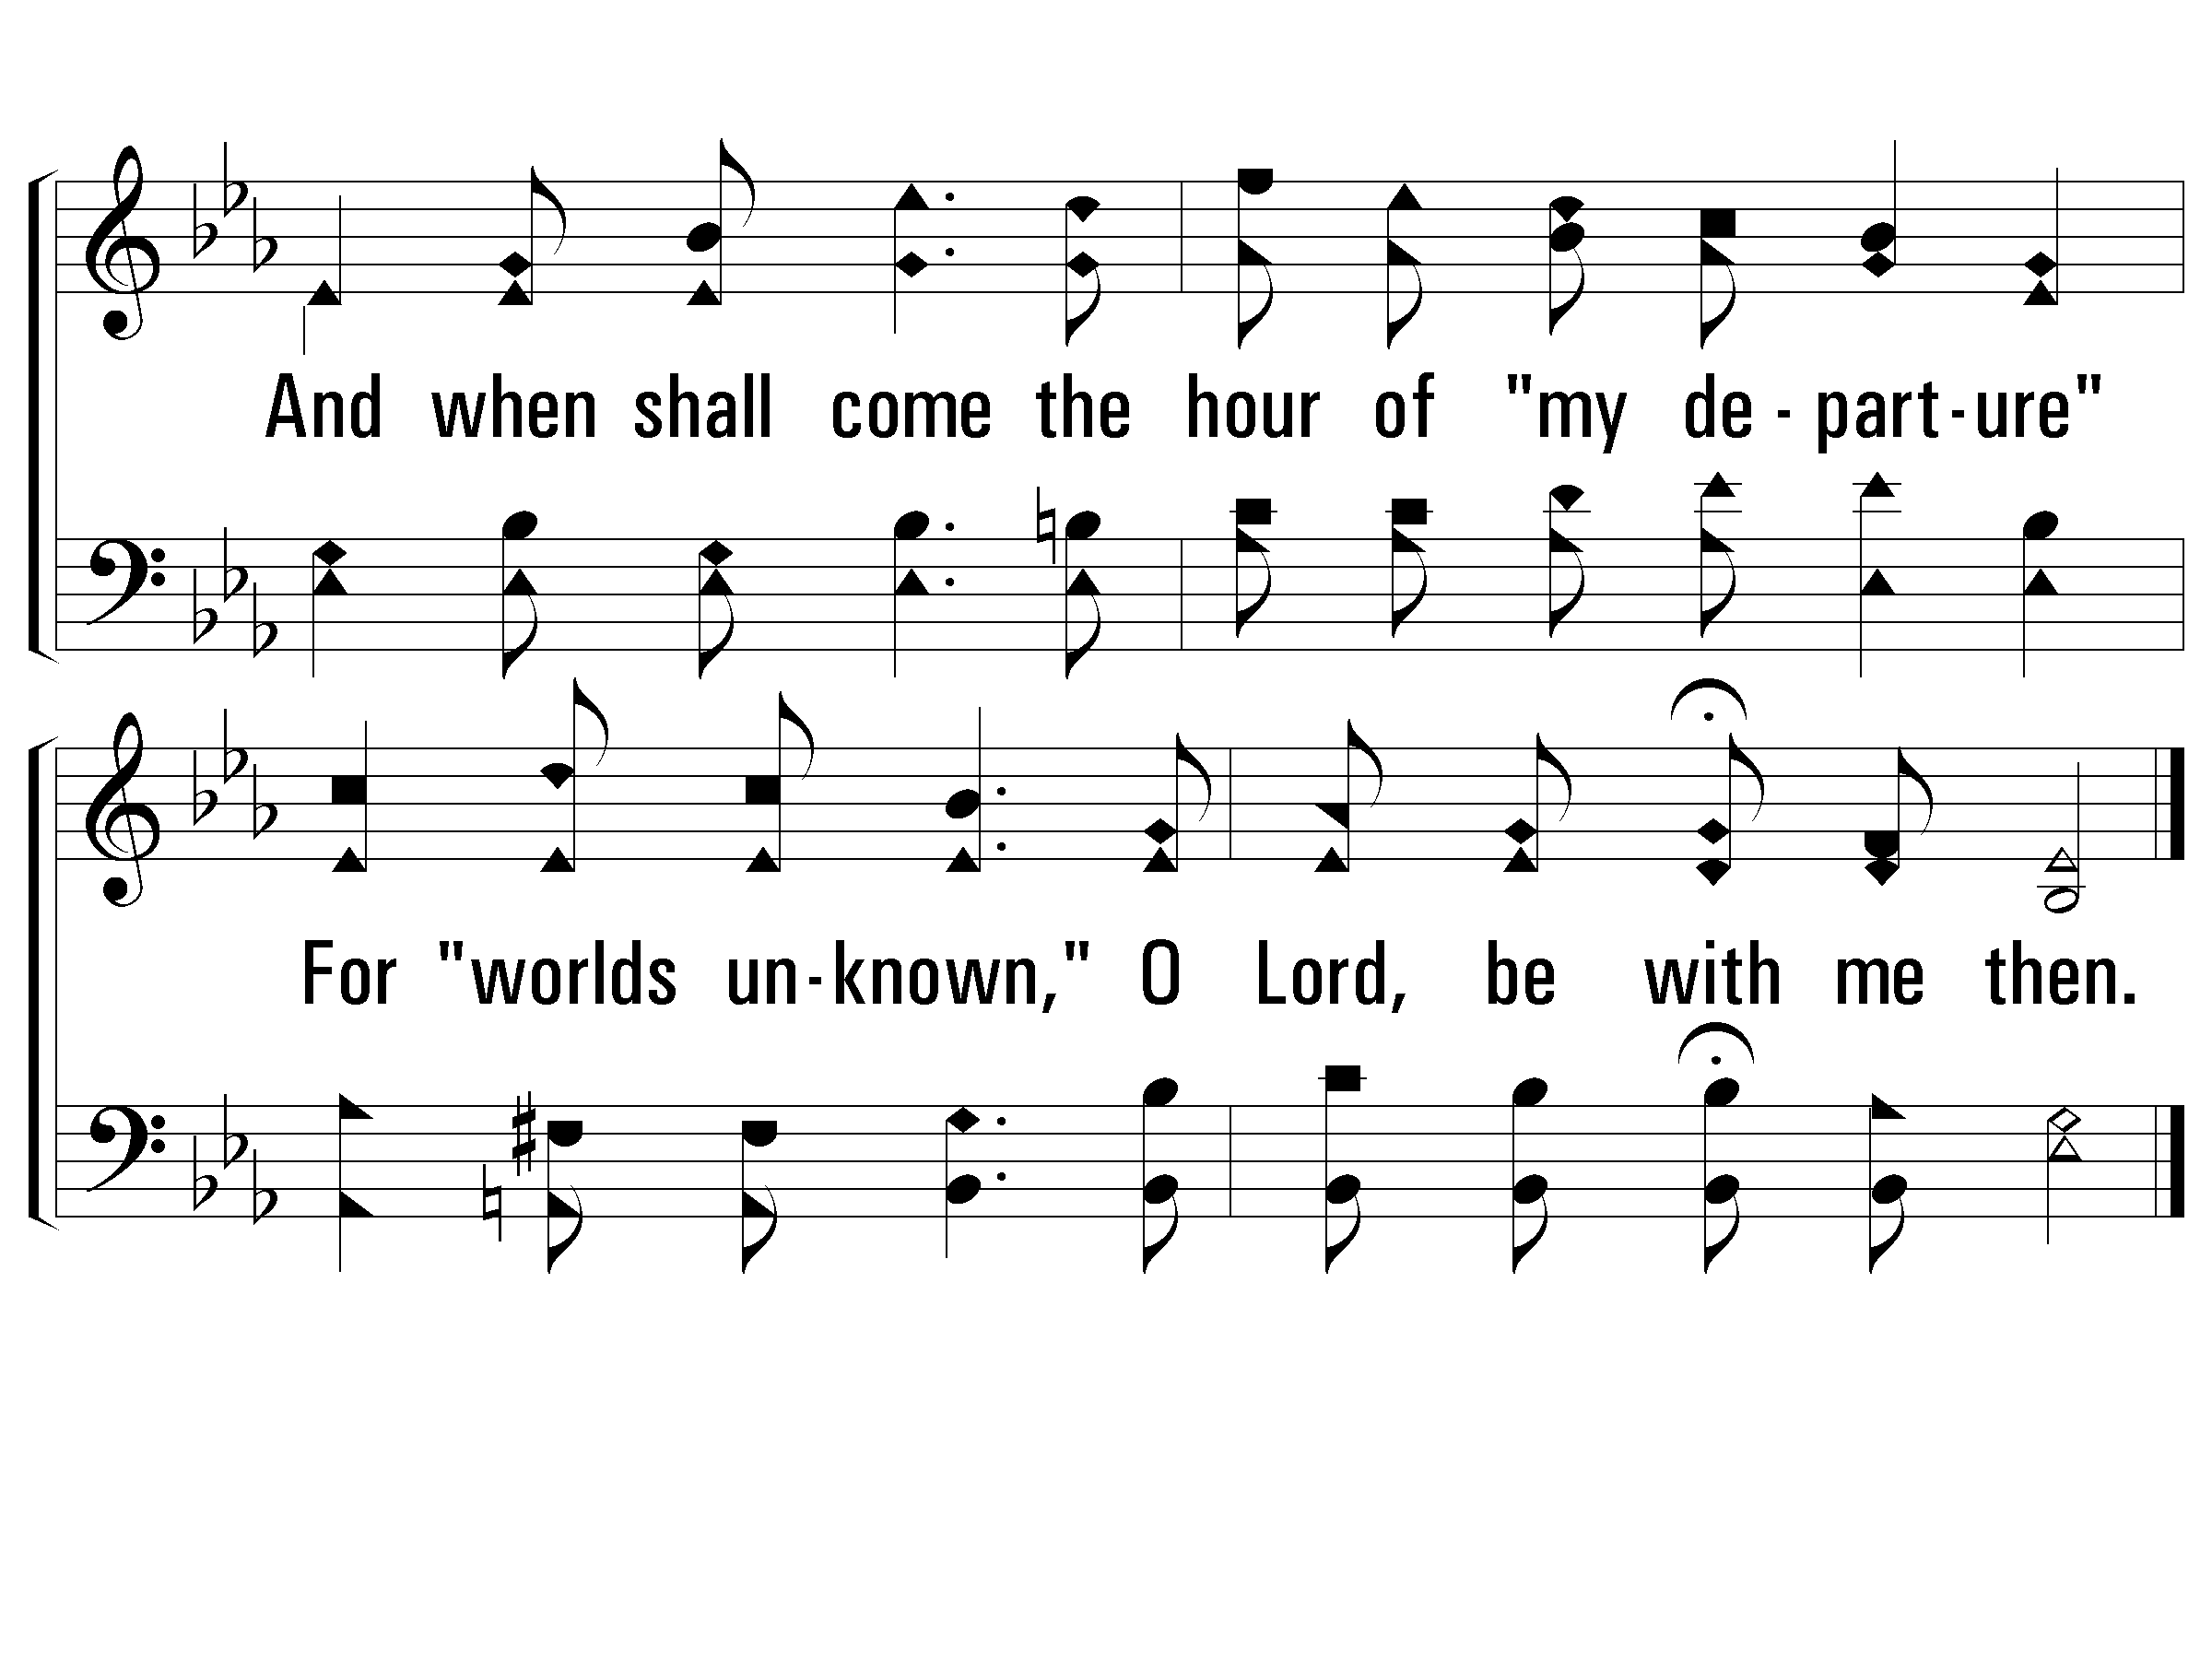
4 - Be With Me, Lord
© 2001 The Paperless Hymnal™

Slide 73
3 - Be With Me, Lord
3.
Be with me, Lord! No other gift or blessing
Thou couldst bestow could with this one compare
A constant sense of Thy abiding presence,
Where'er I am, to feel that Thou art near.
Words by: T. O. Chisholm / Music by: L. O. Sanderson
Copyright © 1963, Renewal, Leon B. Sanderson, owner.
All Rights Reserved. Used by Permission
© 2001 The Paperless Hymnal™

Slide 74
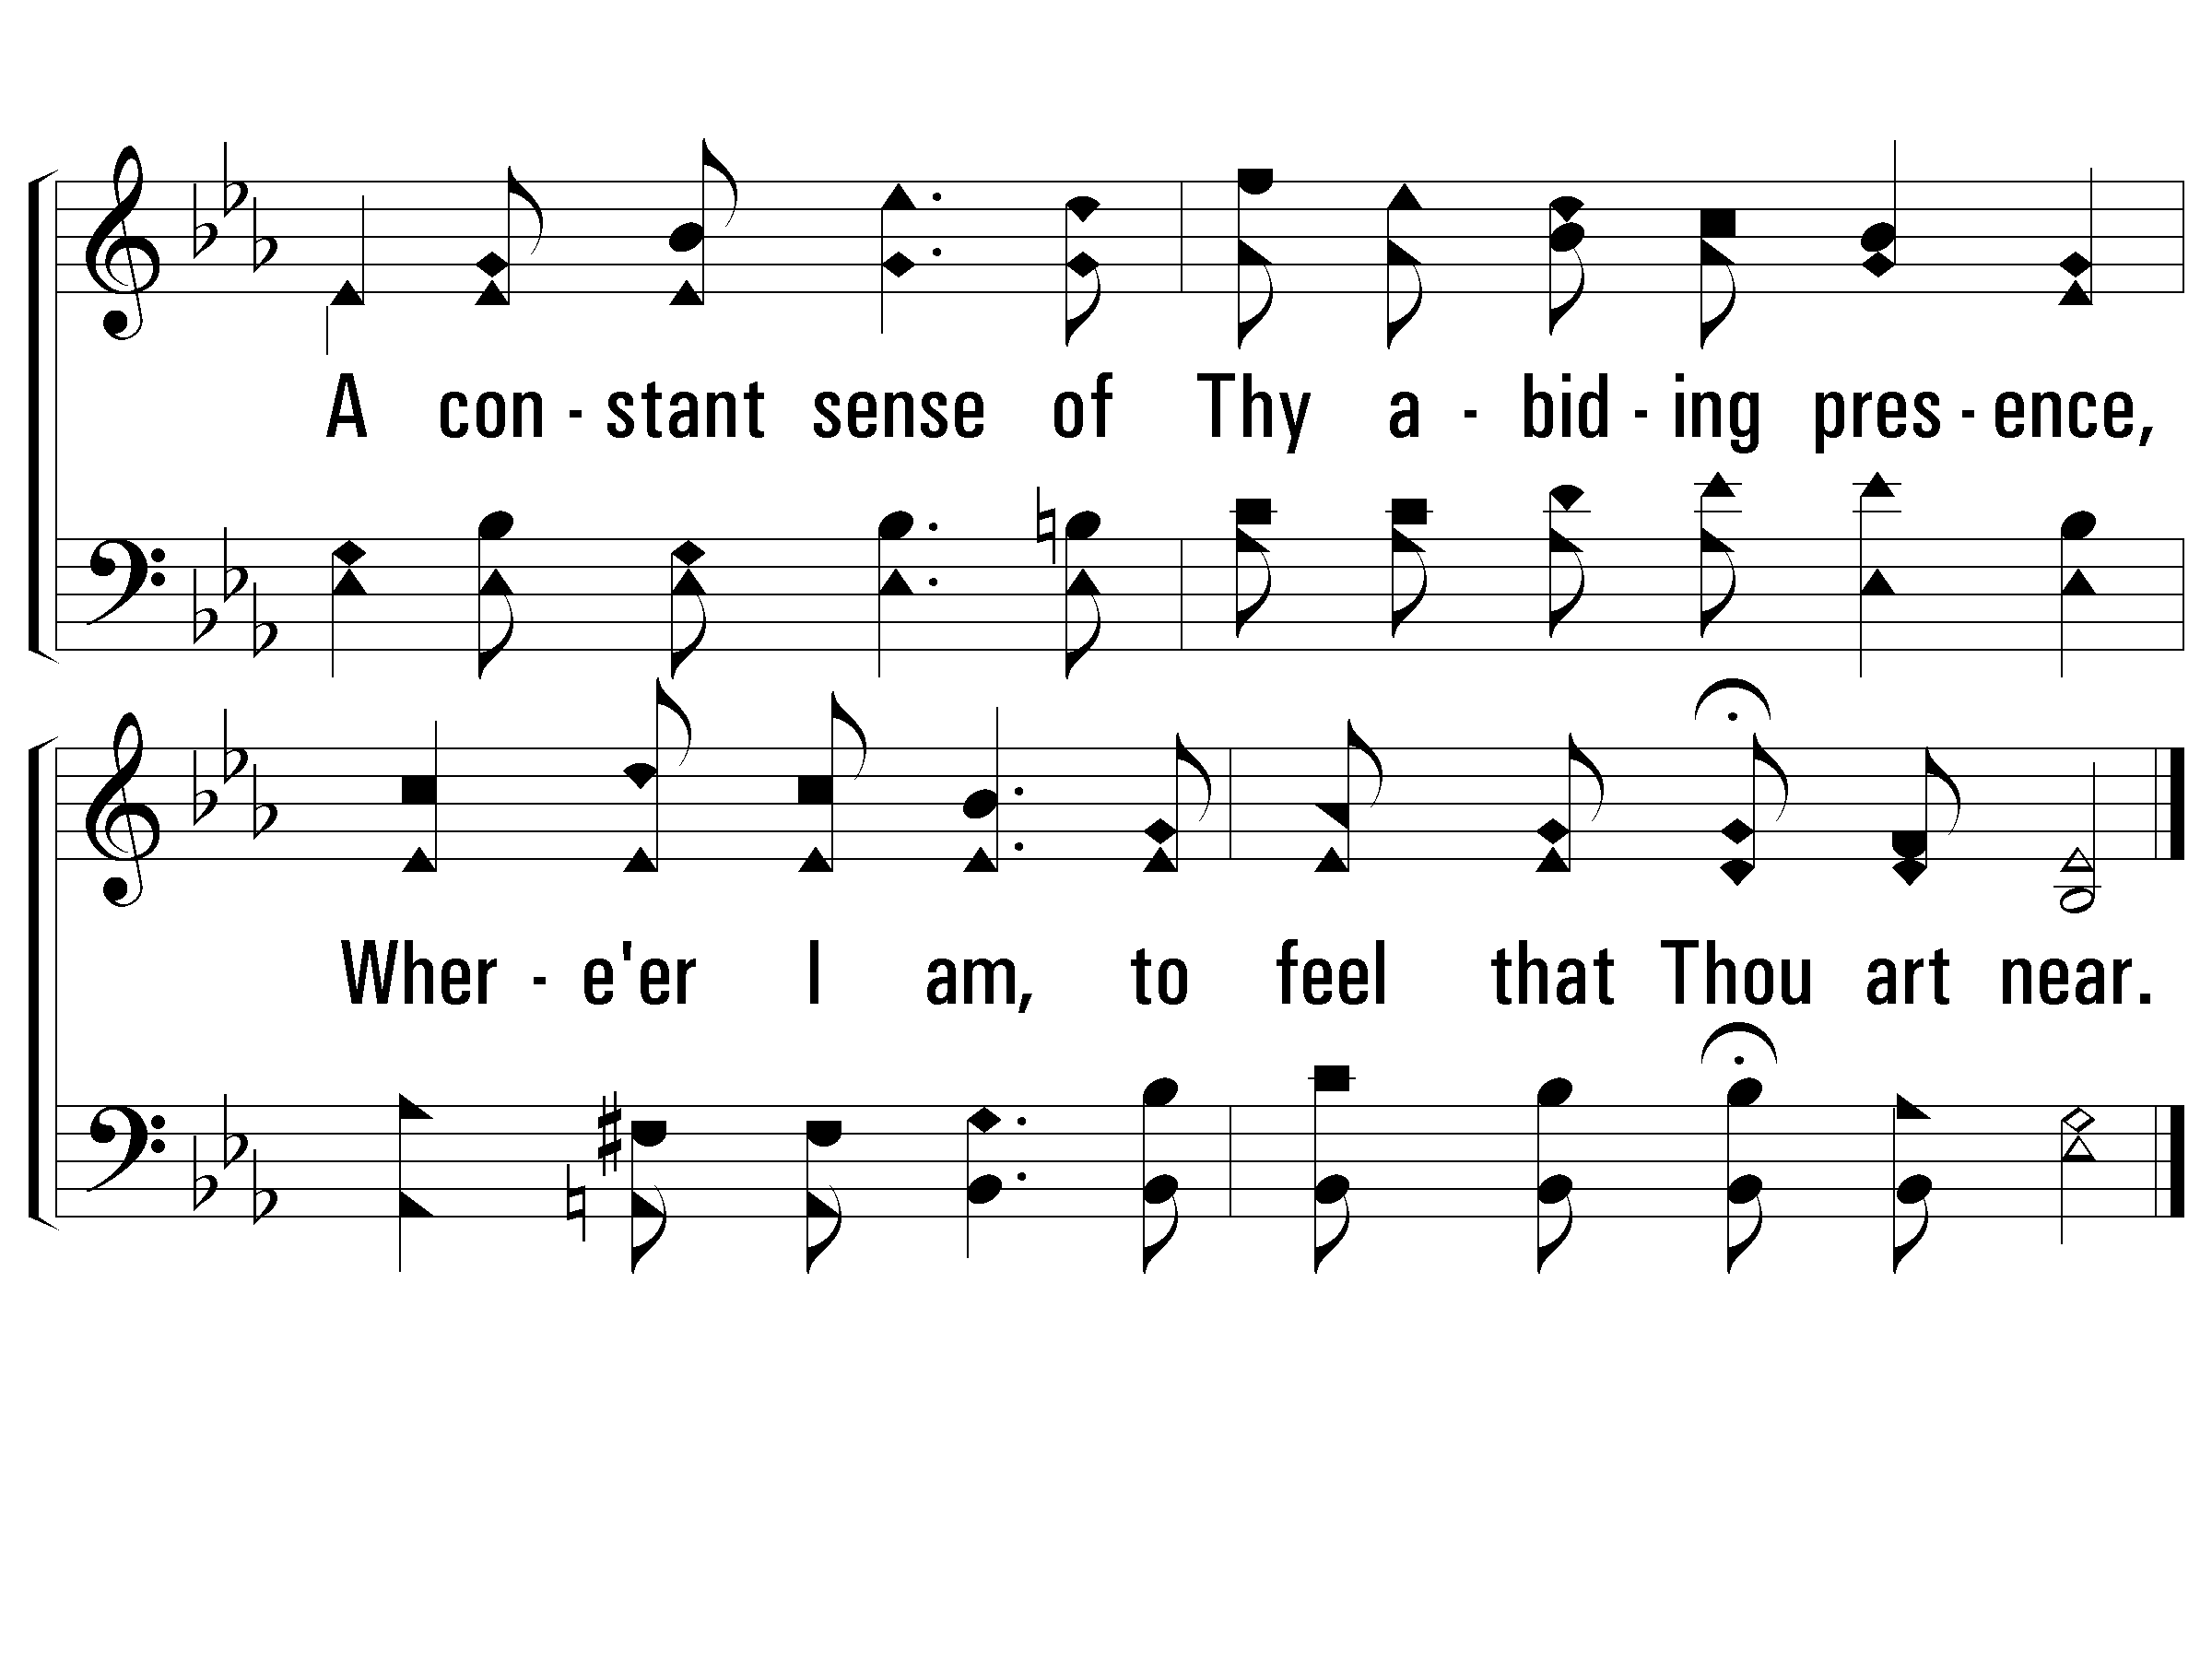
3 - Be With Me, Lord
© 2001 The Paperless Hymnal™

Slide 75
Prayer

Slide 76
Pierce My Ear

Slide 77
1-1 Pierce my ear
Pierce My Ear
0

Slide 78
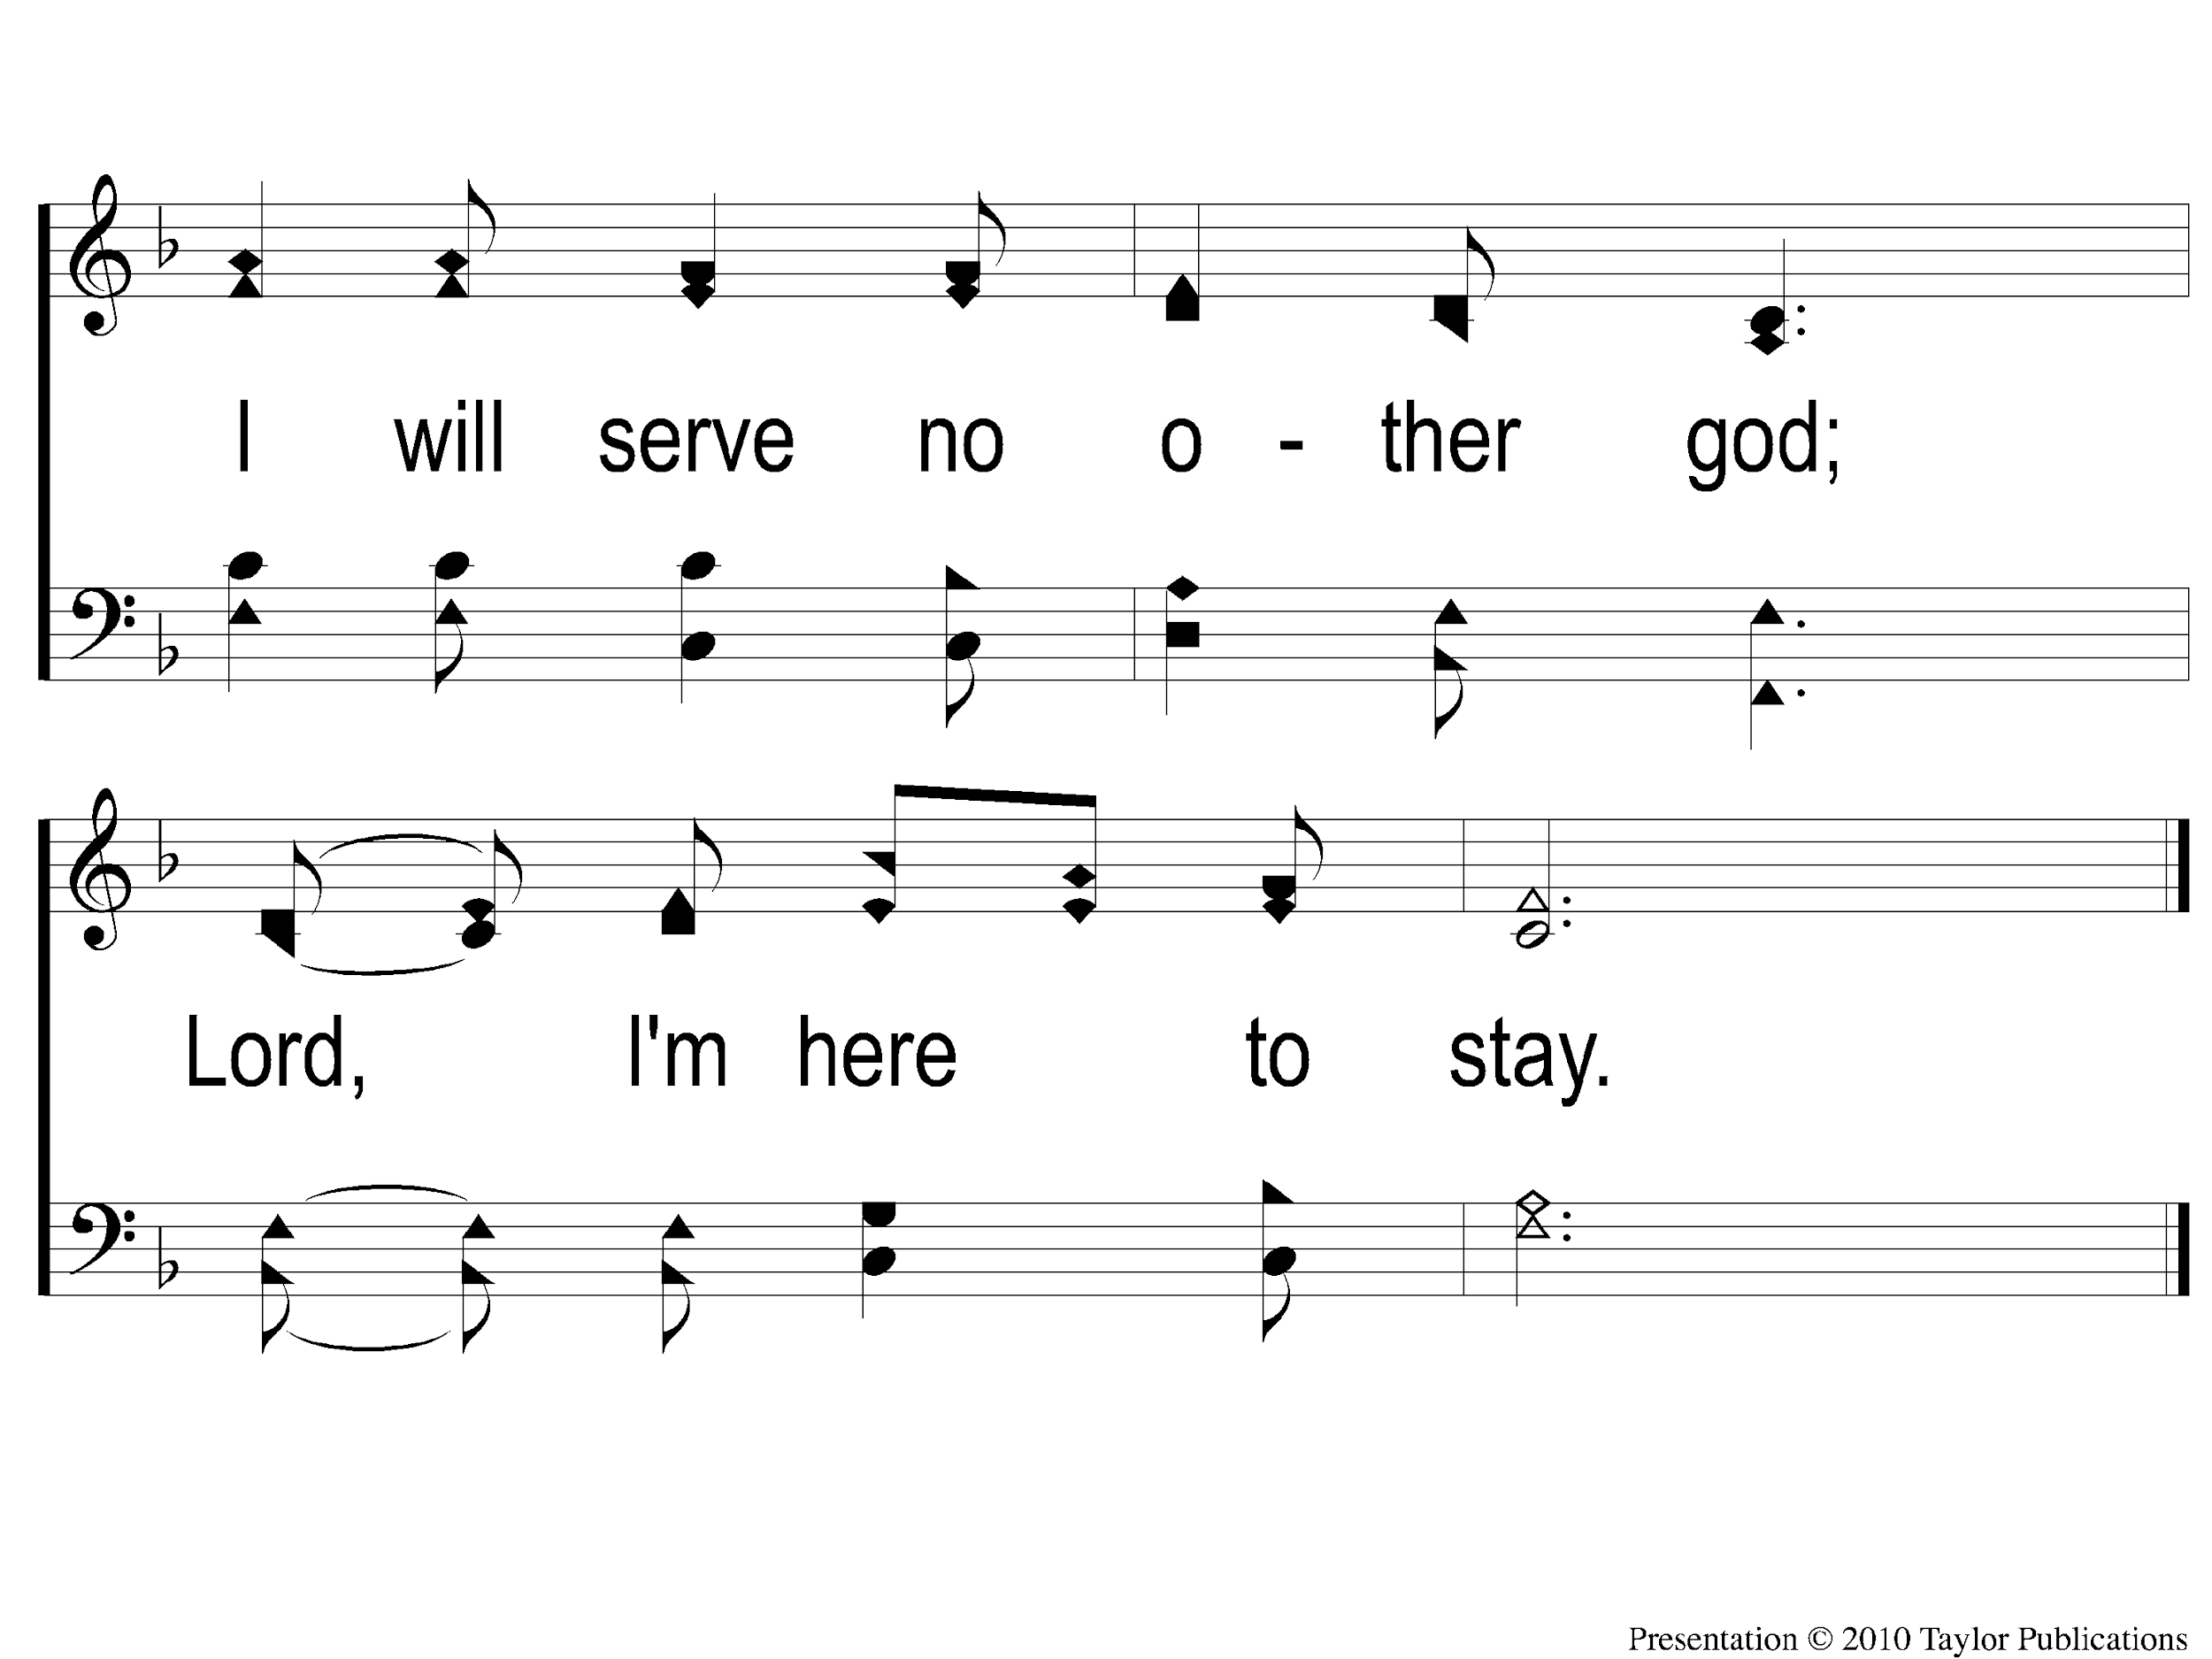
1-2 Pierce my ear
Pierce My Ear
0

Slide 79
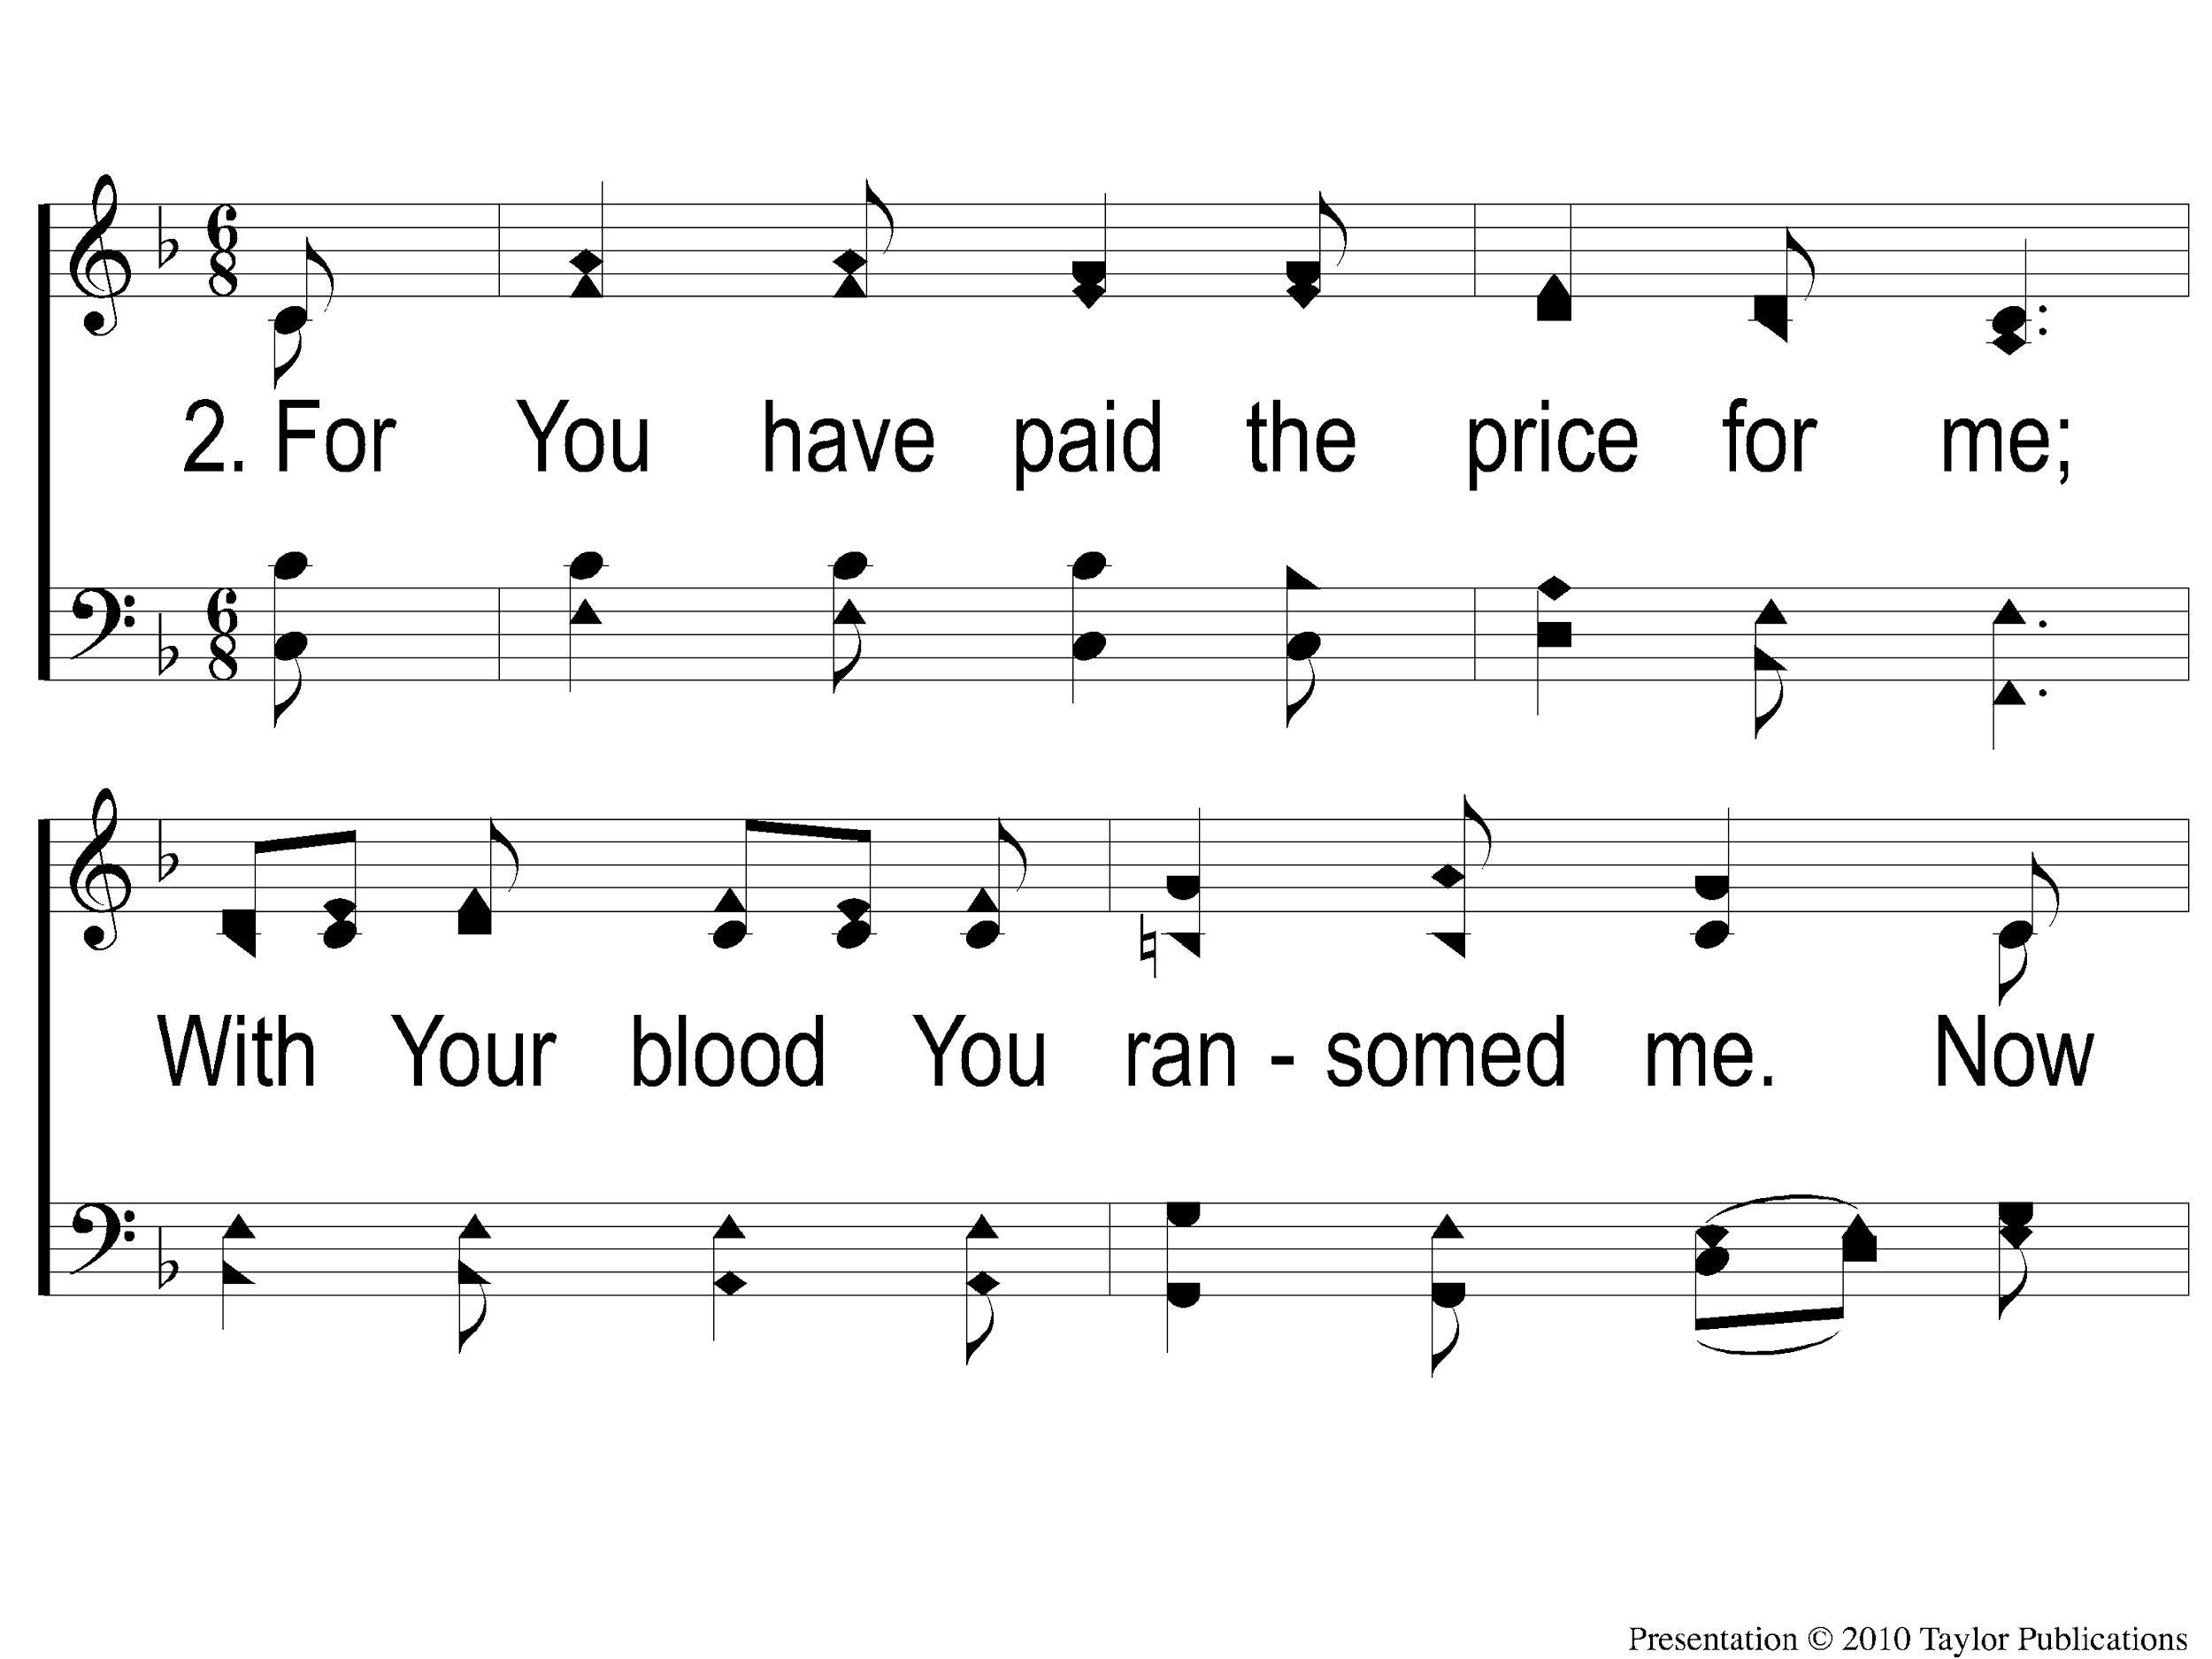
2-1 Pierce my ear
Pierce My Ear
0

Slide 80
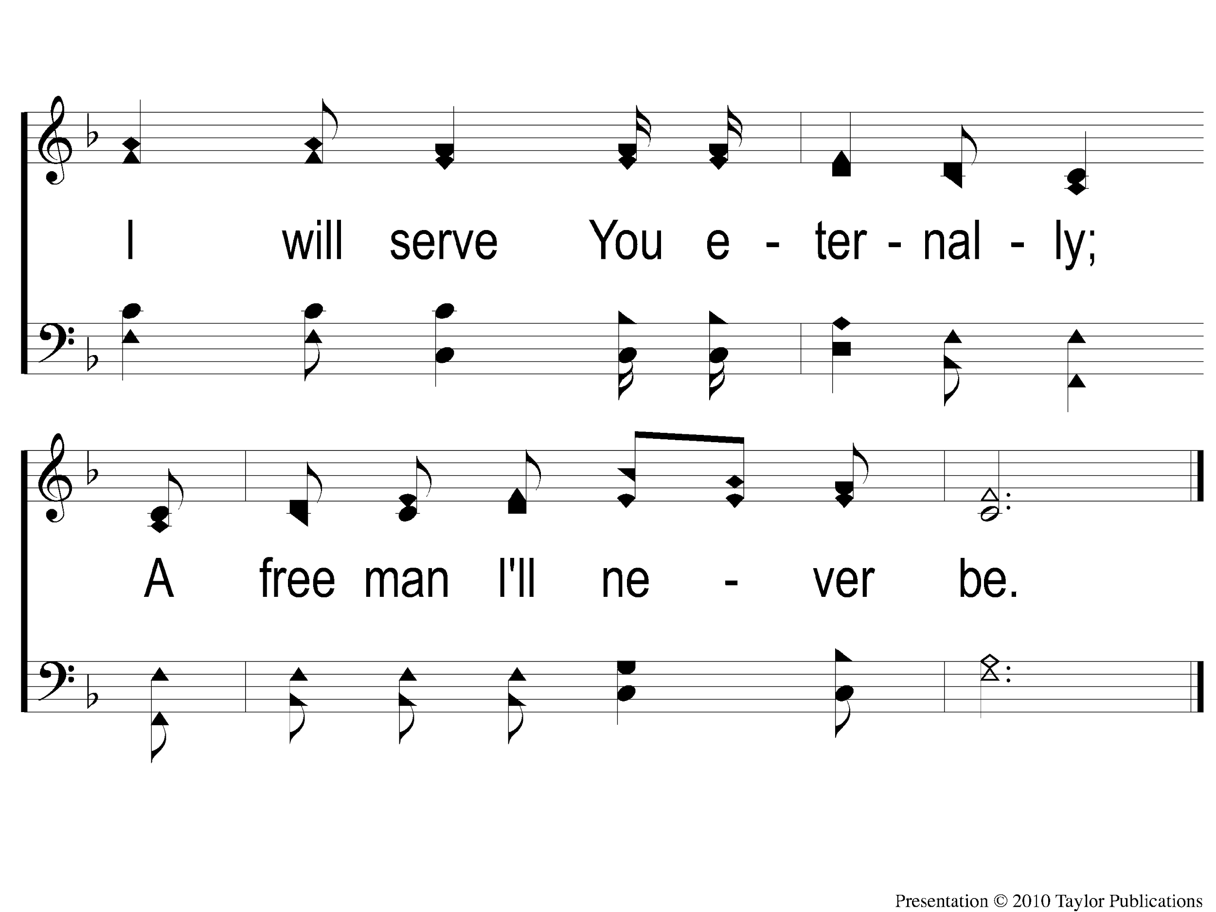
2-2 Pierce my ear
Pierce My Ear
0

Slide 81
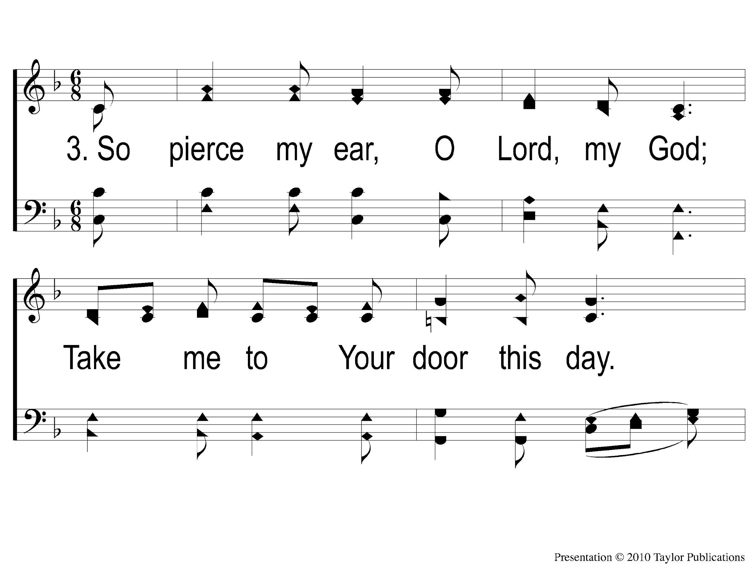
3-1 Pierce my ear
Pierce My Ear
0

Slide 82
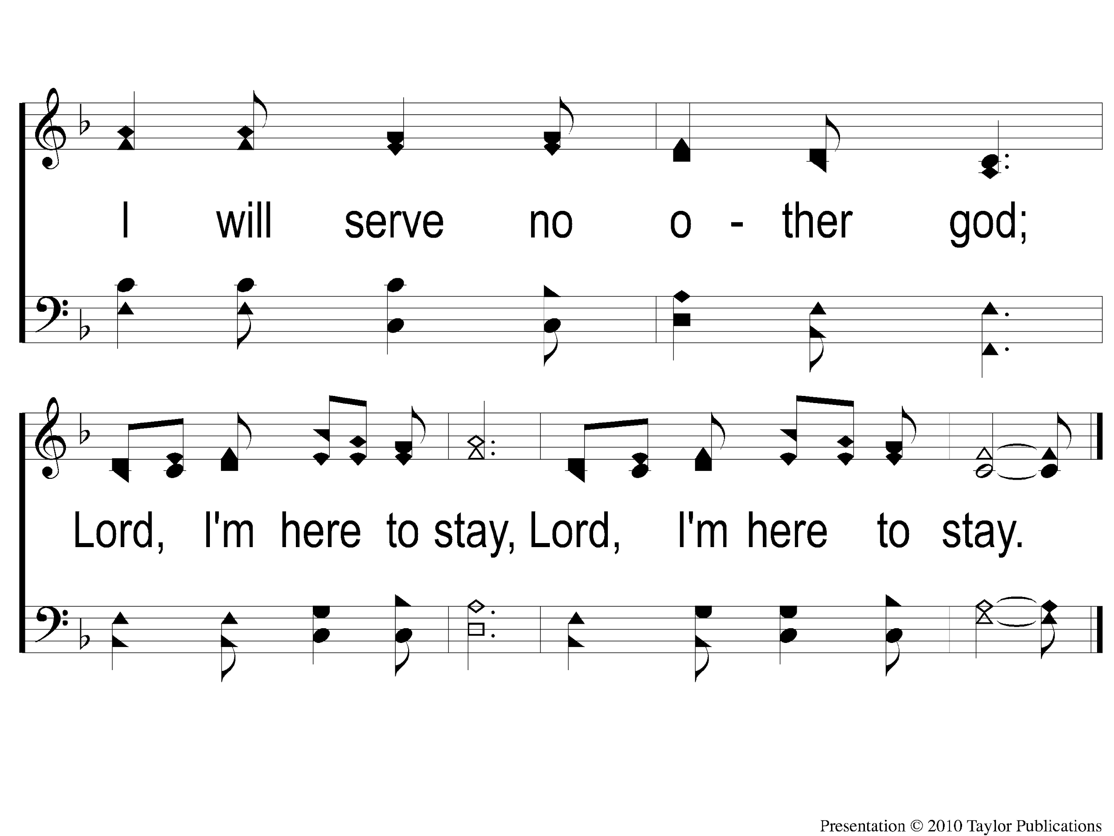
3-2 Pierce my ear
Pierce My Ear
0

Slide 83
Communion

Slide 84
What A Friend We Have In Jesus
#730

Slide 85
1 – What a Friend We Have In Jesus
1.
What a Friend we have in Jesus,
All our sins and griefs to bear;
What a privilege to carry
Everything to God in prayer.
O what peace we often forfeit,
O what needless pain we bear,
All because we do not carry
Everything to God in prayer.
Words: Joseph Scriven
Music: Charles C. Converse
© 2002 The Paperless Hymnal™

Slide 86
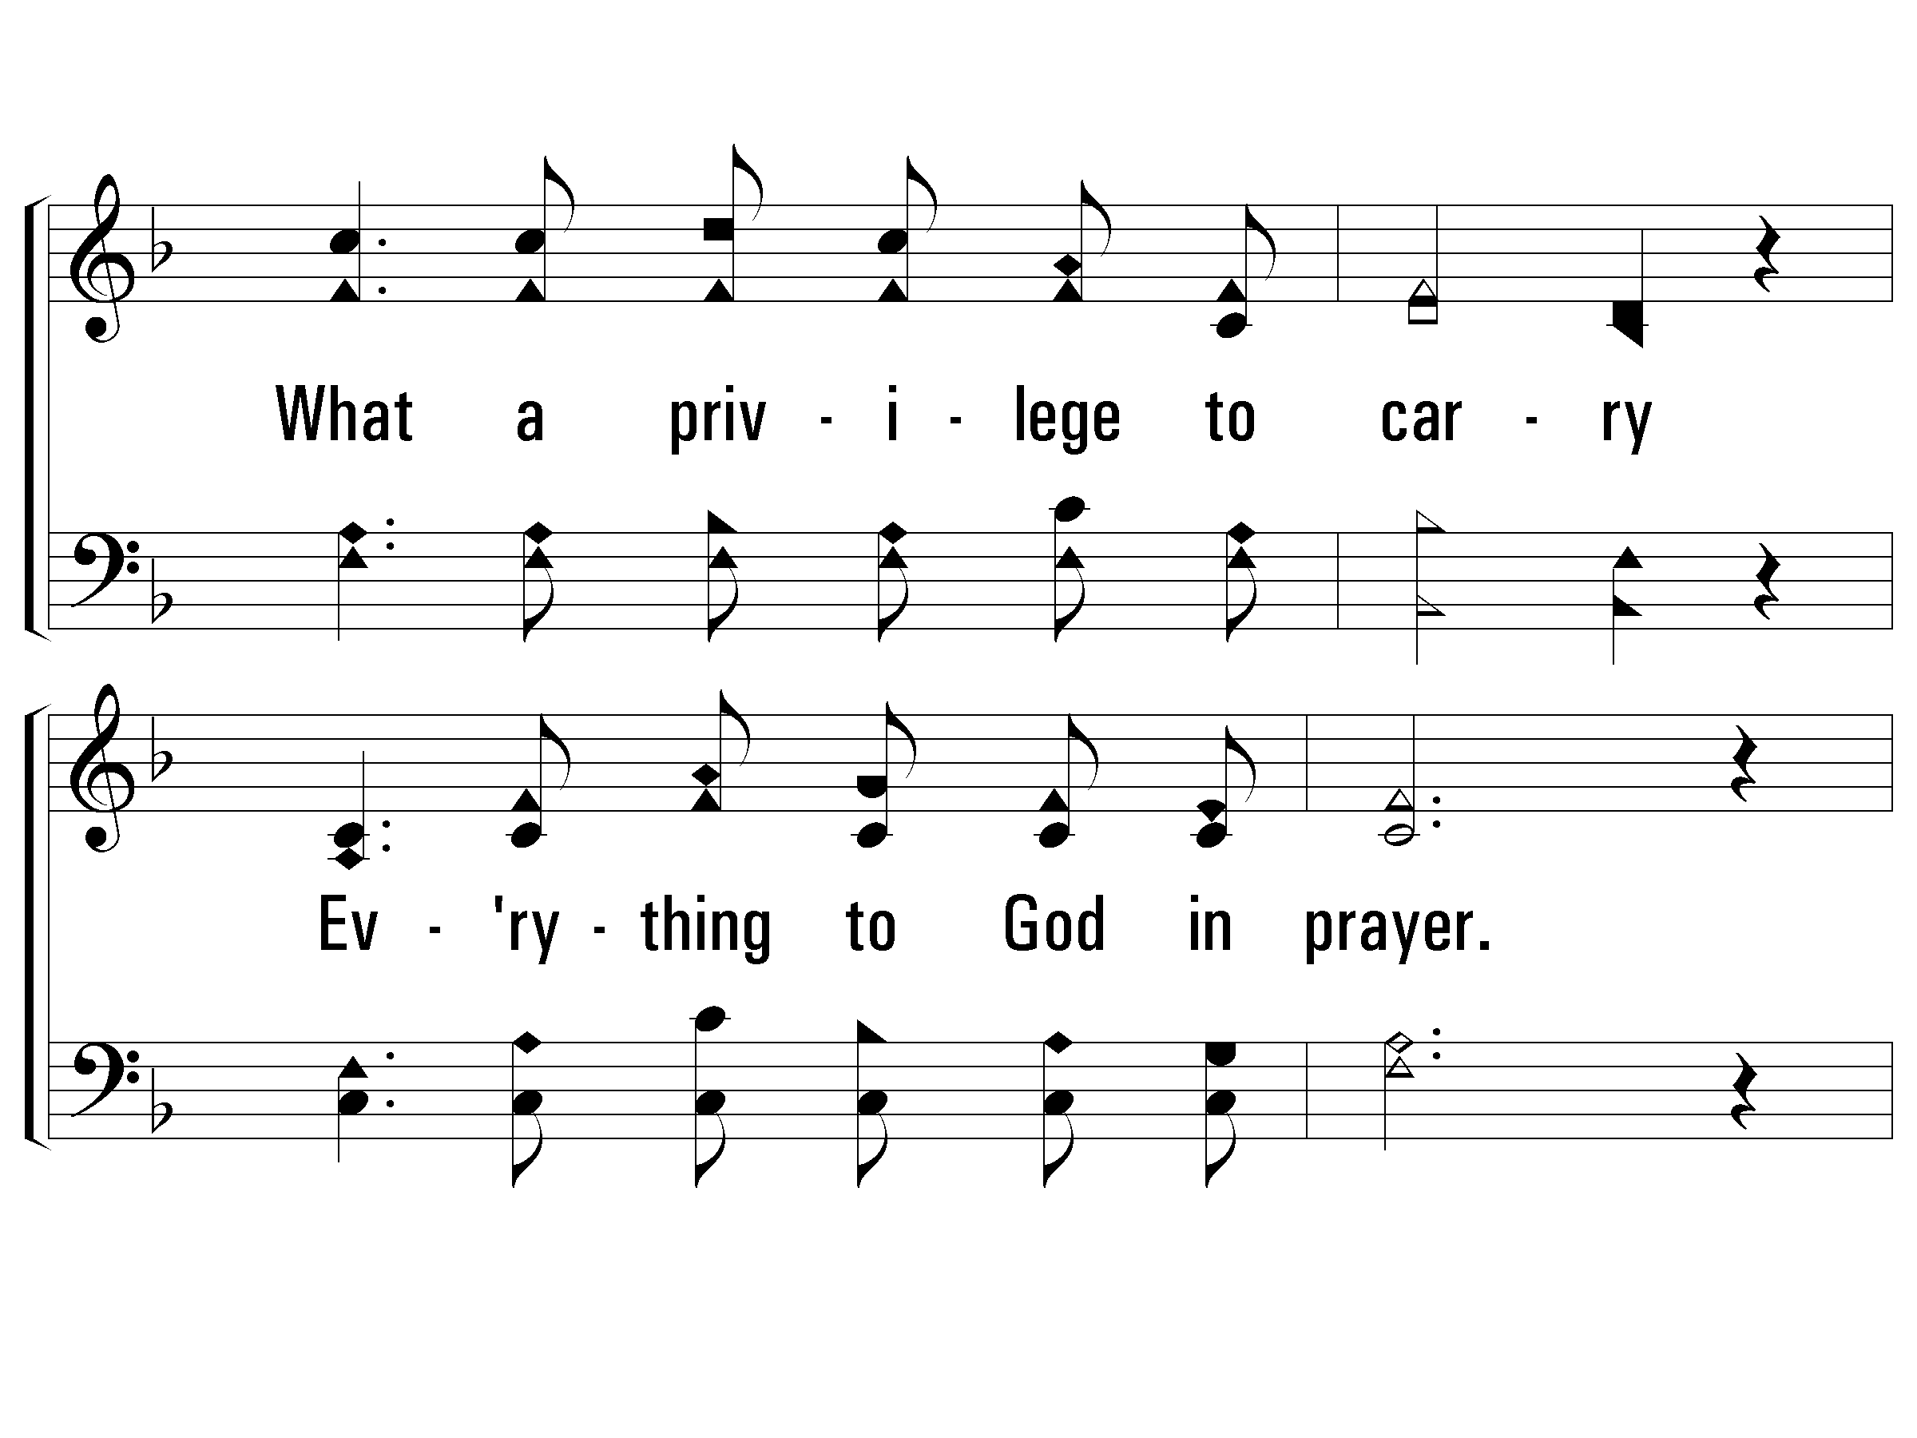
1 – What a Friend We Have In Jesus
© 2002 The Paperless Hymnal™

Slide 87
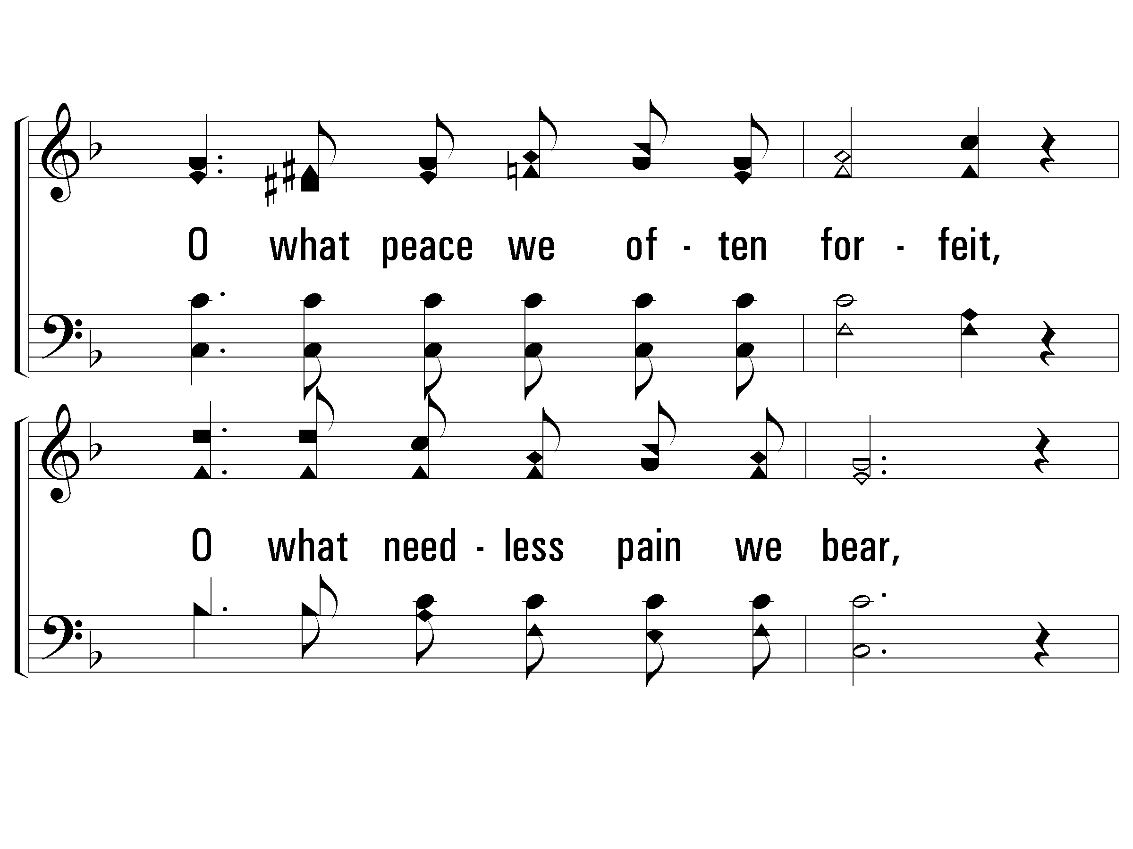
1 – What a Friend We Have In Jesus
© 2002 The Paperless Hymnal™

Slide 88
1 – What a Friend We Have In Jesus
© 2002 The Paperless Hymnal™

Slide 89
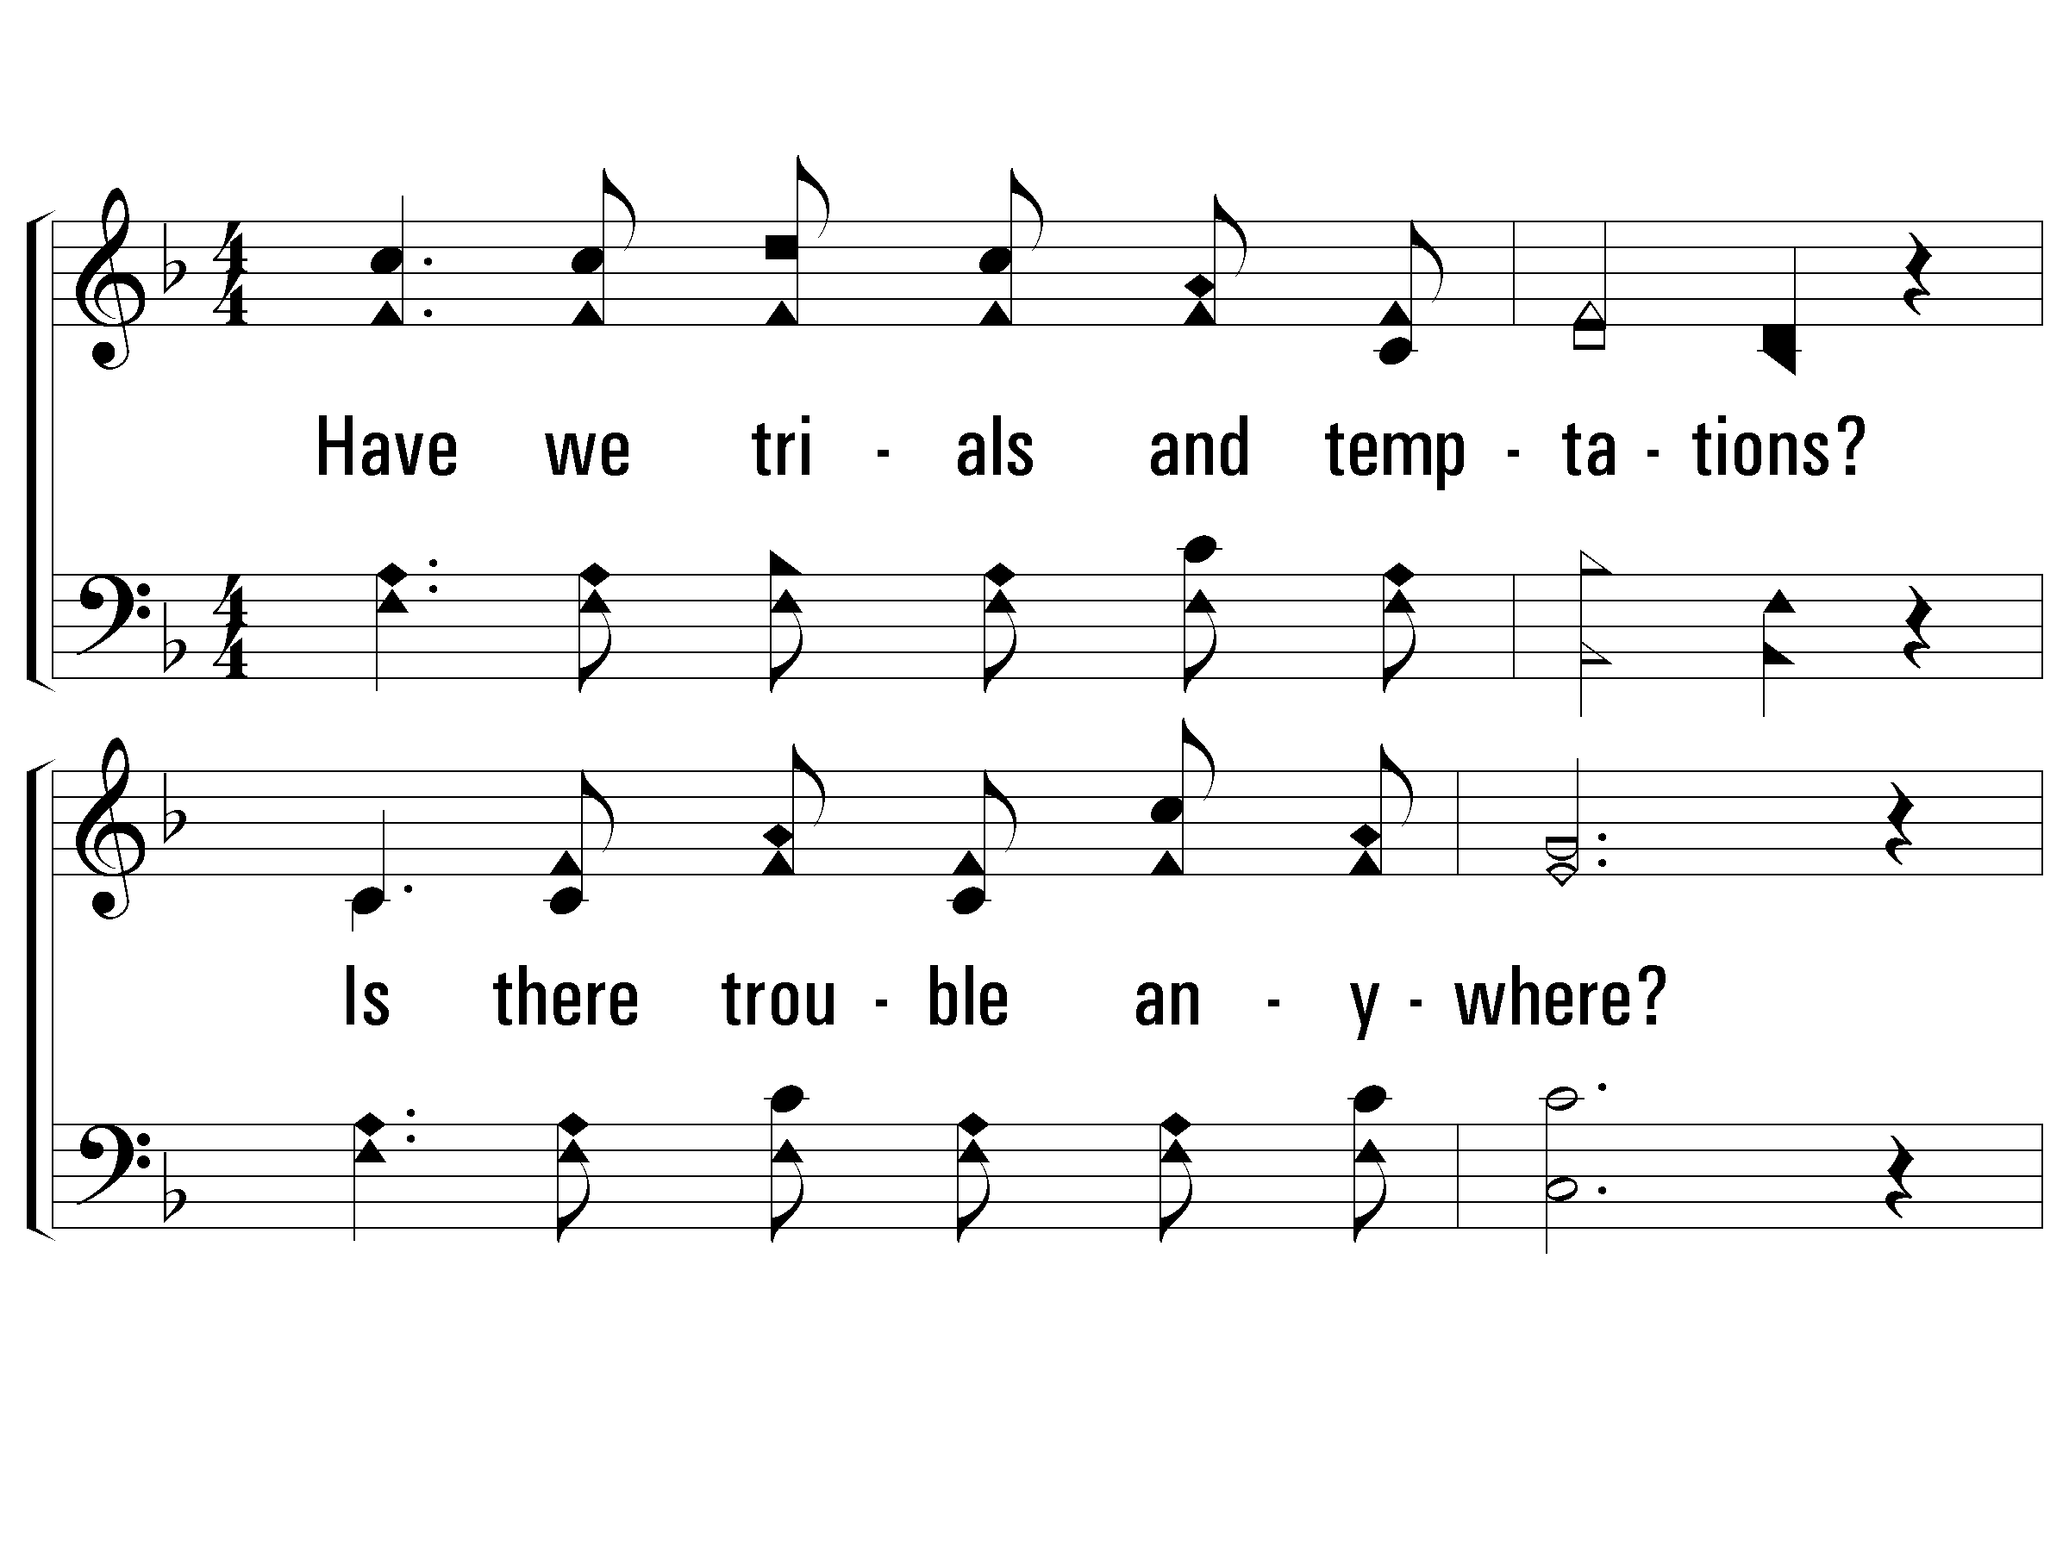
2 – What a Friend We Have In Jesus
2.
Have we trials and temptations?
Is there trouble anywhere?
We should never be discouraged,
Take it to the Lord in prayer.
Can we find a friend so faithful,
Who will all our sorrows share?
Jesus knows our every weakness:
Take it to the Lord in prayer.
Words: Joseph Scriven
Music: Charles C. Converse
© 2002 The Paperless Hymnal™

Slide 90
2 – What a Friend We Have In Jesus
© 2002 The Paperless Hymnal™

Slide 91
2 – What a Friend We Have In Jesus
© 2002 The Paperless Hymnal™

Slide 92
2 – What a Friend We Have In Jesus
© 2002 The Paperless Hymnal™

Slide 93
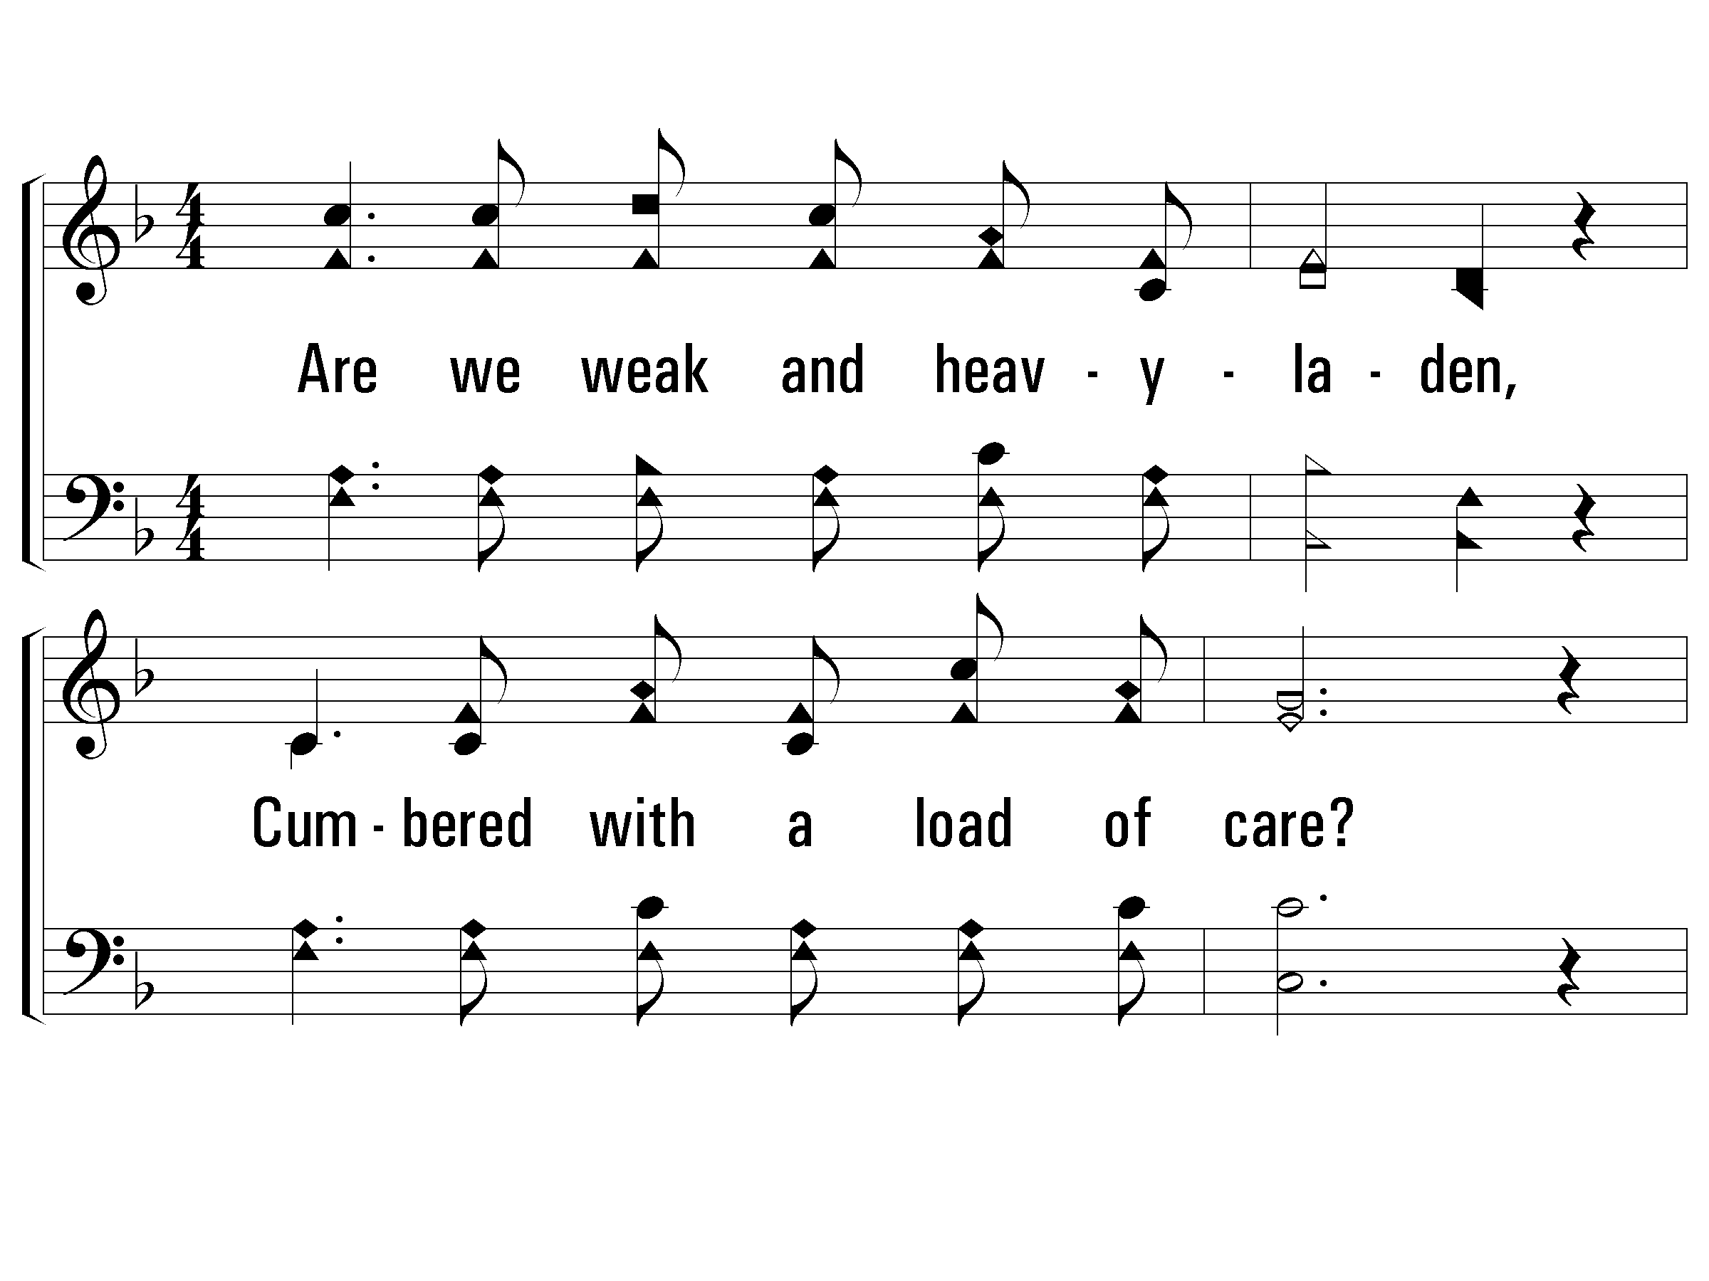
3 – What a Friend We Have In Jesus
3.
Are we weak and heavy-laden,
Cumbered with a load of care?
Precious Savior, still our refuge,
Take it to the Lord in prayer.
Do thy friends despise, forsake thee?
Take it to the Lord in prayer;
In His arms He'll take and shield thee,
Thou wilt find a solace there.
Words: Joseph Scriven
Music: Charles C. Converse
© 2002 The Paperless Hymnal™

Slide 94
3 – What a Friend We Have In Jesus
© 2002 The Paperless Hymnal™

Slide 95
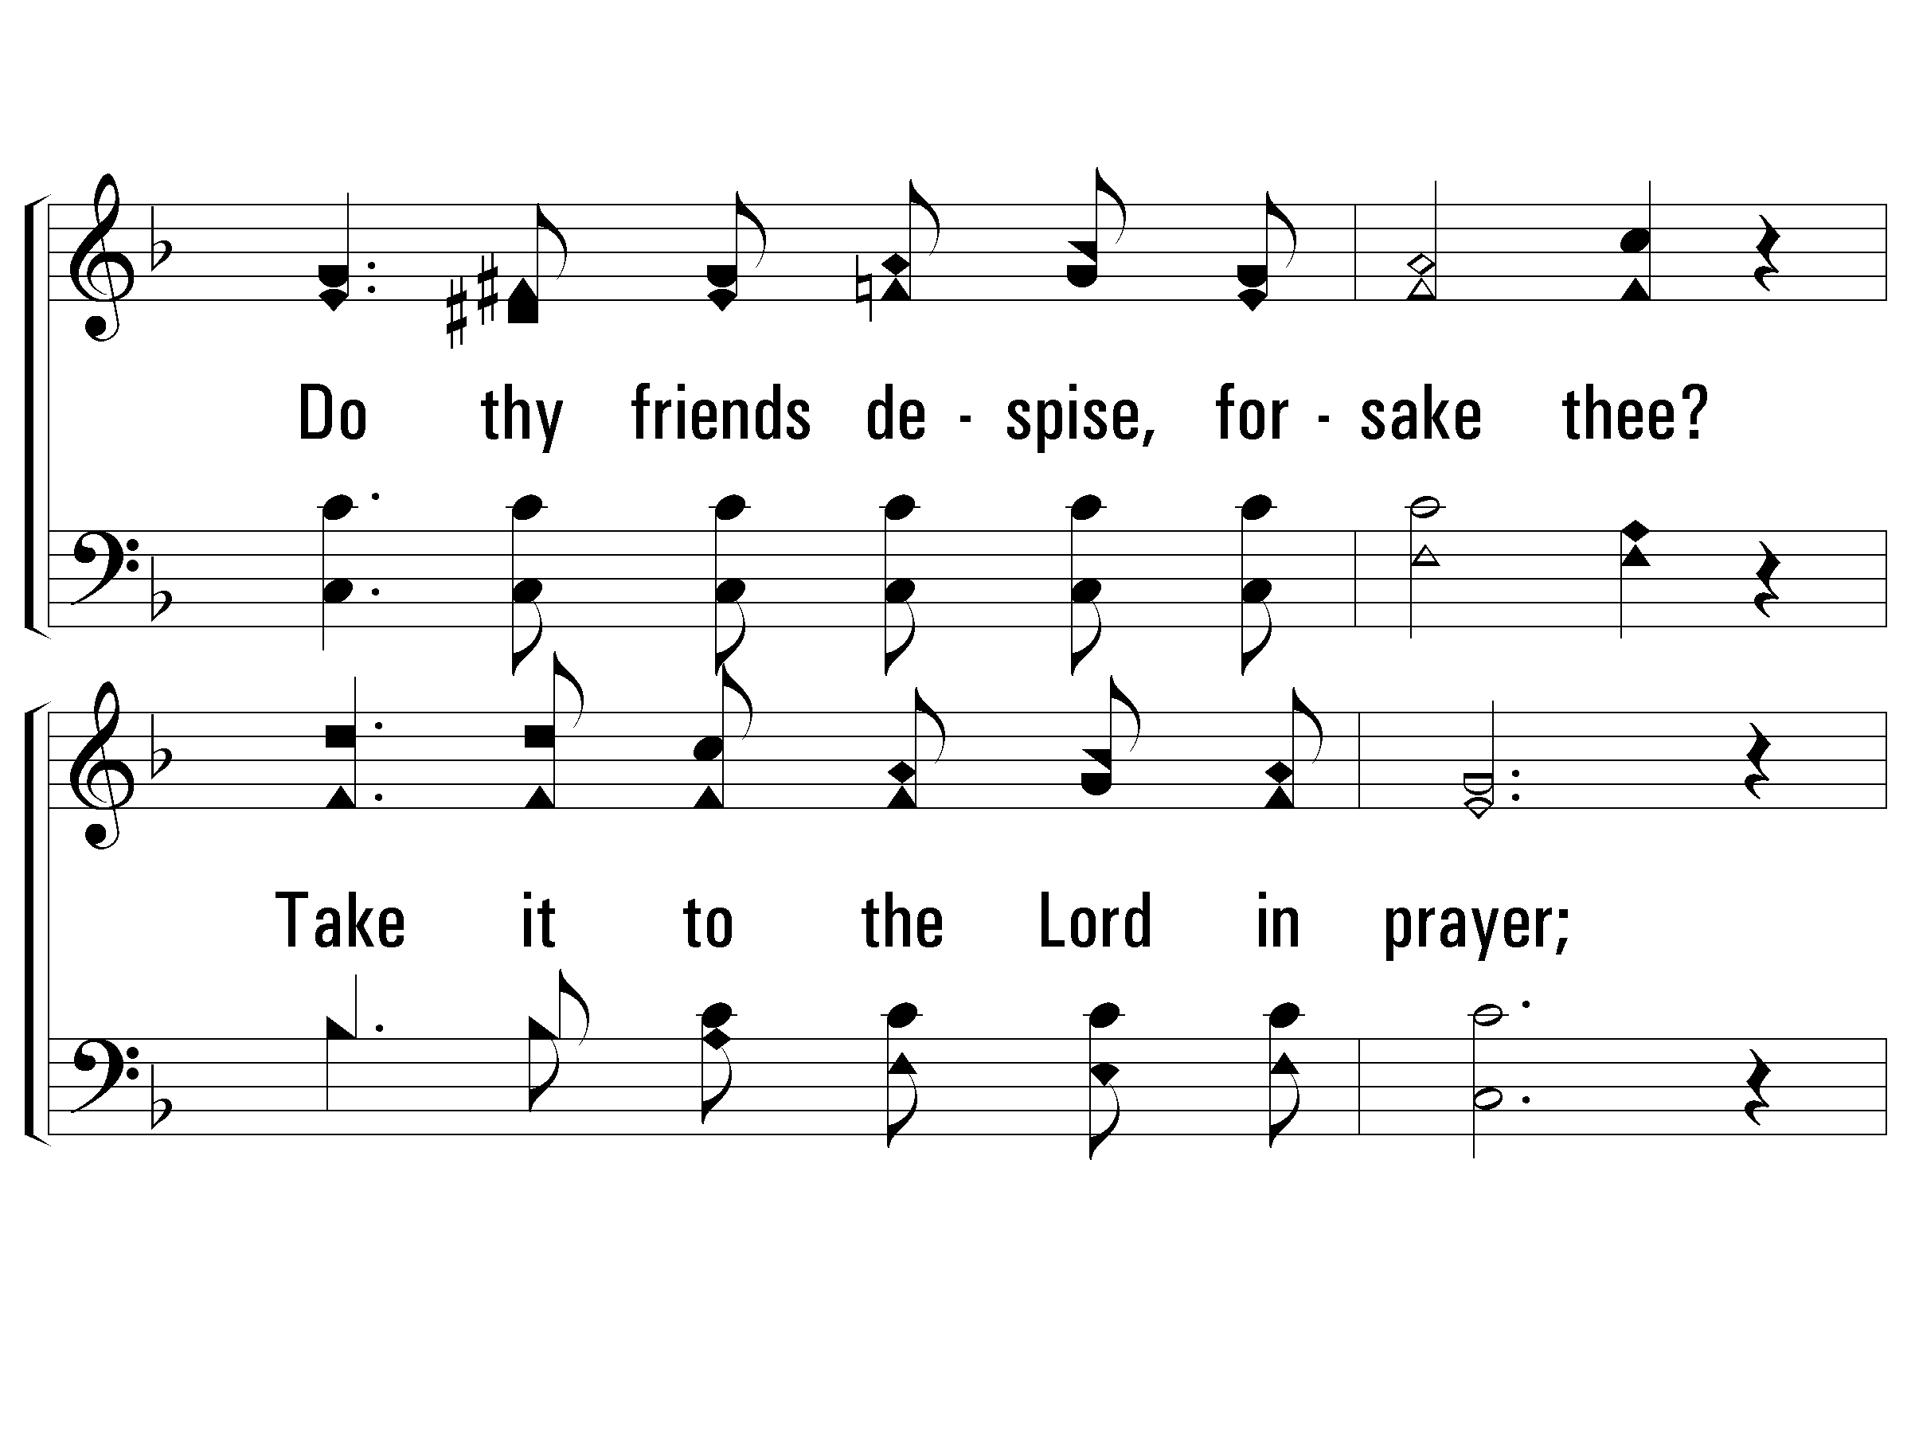
3 – What a Friend We Have In Jesus
© 2002 The Paperless Hymnal™

Slide 96
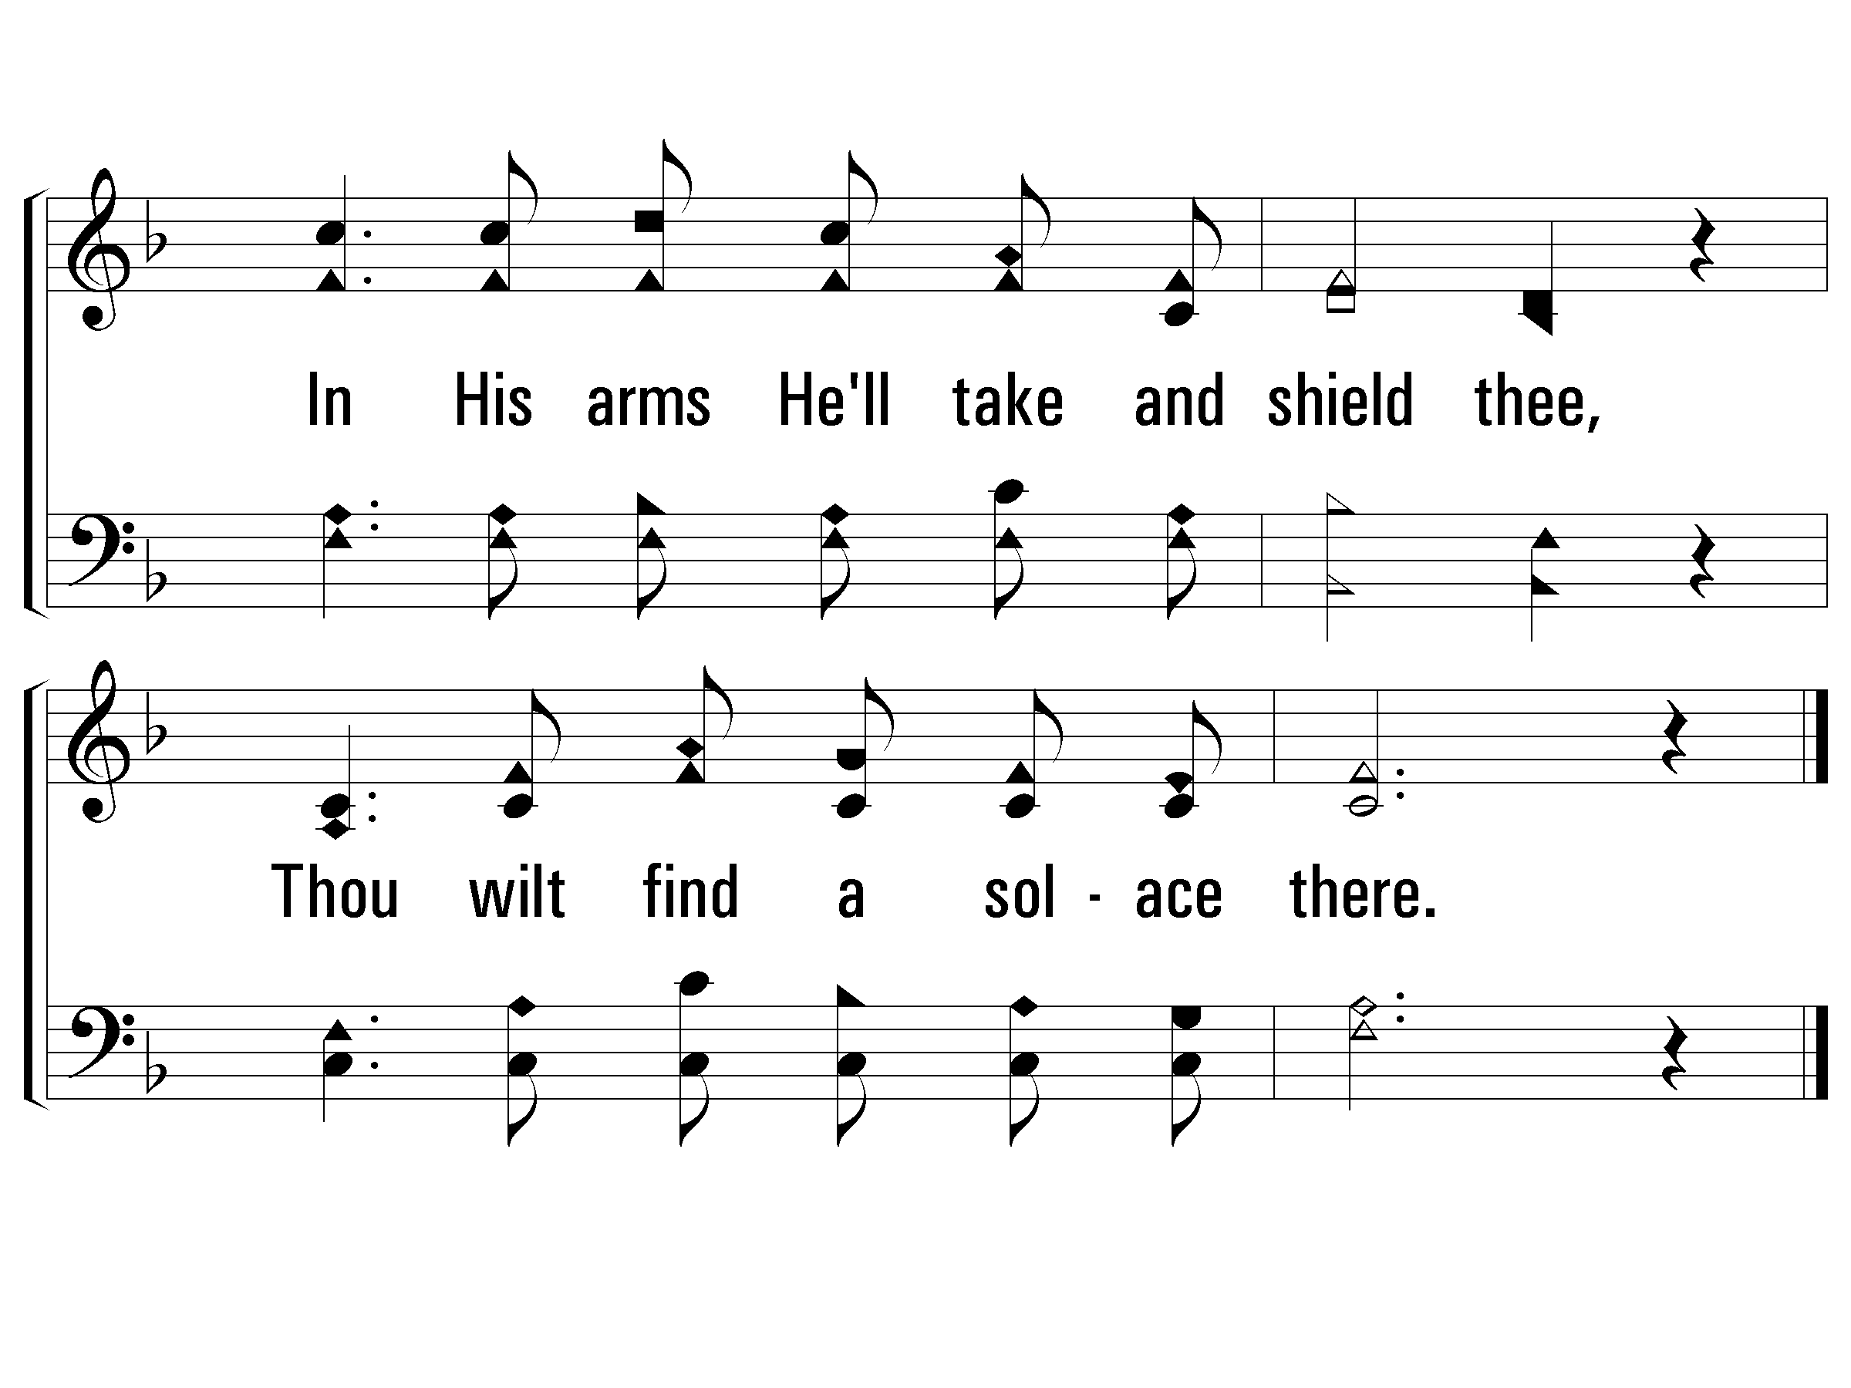
3 – What a Friend We Have In Jesus
© 2002 The Paperless Hymnal™

Slide 97
0-5th Grade
Dismiss to Class

Slide 98
OLD
Church
of Christ
UNION

Slide 99
Acts 17:22-31

Slide 100
²² So Paul stood in the midst of the Areopagus and said, “Men of Athens, I observe that you are very religious in all respects.

Slide 101
²³ For while I was passing through and examining the objects of your worship, I also found an altar with this inscription, ‘TO AN UNKNOWN GOD.’ Therefore what you worship in ignorance, this I proclaim to you.

Slide 102
²⁴ The God who made the world and all things in it, since He is Lord of heaven and earth, does not dwell in temples made with hands;

Slide 103
²⁵ nor is He served by human hands, as though He needed anything, since He Himself gives to all people life and breath and all things;

Slide 104
²⁶ and He made from one man every nation of mankind to live on all the face of the earth, having determined their appointed times and the boundaries of their habitation,

Slide 105
²⁷ that they would seek God, if perhaps they might grope for Him and find Him, though He is not far from each one of us; ²⁸ for in Him we live and move and exist, as even some of your own poets have said, ‘For we also are His children.’

Slide 106
²⁹ Being then the children of God, we ought not to think that the Divine Nature is like gold or silver or stone, an image formed by the art and thought of man.

Slide 107
³⁰ Therefore having overlooked the times of ignorance, God is now declaring to men that all people everywhere should repent,

Slide 108
³¹ because He has fixed a day in which He will judge the world in righteousness through a Man whom He has appointed, having furnished proof to all men by raising Him from the dead.”

Slide 109
Welcome Guests!
OLD UNION
NEW LIFE
Following Jesus changes everything!

Slide 110
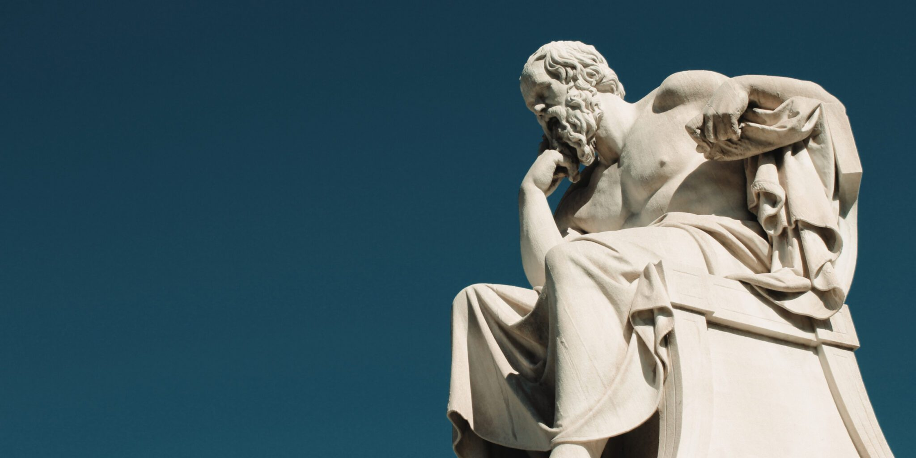
The Great Commission
What about
Philosophers?
Acts 17

Slide 111
But First…
Do you have any prior knowledge of Acts 17, Paul in Athens, the sermon on Mars Hill/Areopagus?
Are you a disciple of Jesus? Do you want to be?
Who are you? Where did you come from? Why are you here? Where are you going?

Slide 112
What is Philosophy
A really cool subject involving how we think about life’s meaning. – S. Russell
“A way of thinking about questions. Big questions.” – Smart looking guy on YouTube
The study of the basic ideas about knowledge, truth, right and wrong, religion, and the nature and meaning of life. - Google

Slide 113
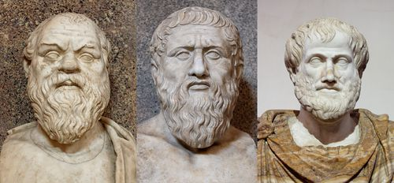
Socrates, Plato, Aristotle

Slide 114
St. Augustine of Hippo “All truth is God’s truth.”
Augustine, the greatest theologian of the first millennium, expresses [the above quote] in several places. In his On Christian Doctrine, for example, he writes, “Nay, but let every good and true Christian understand that wherever truth may be found, it belongs to his Master.” (II. 18).

Slide 115
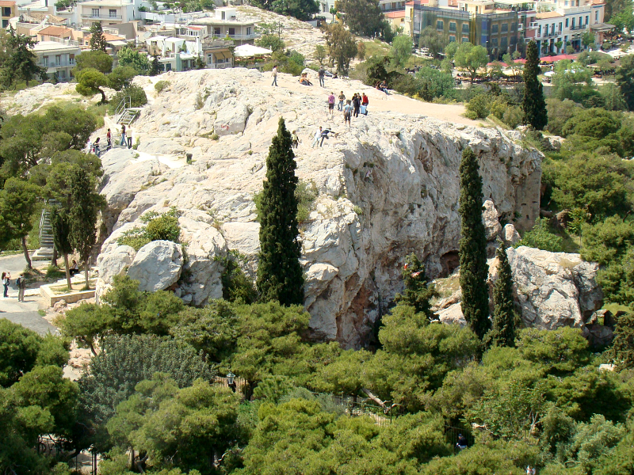
Getting the Word Out about Earth Day
List ideas here

Slide 116
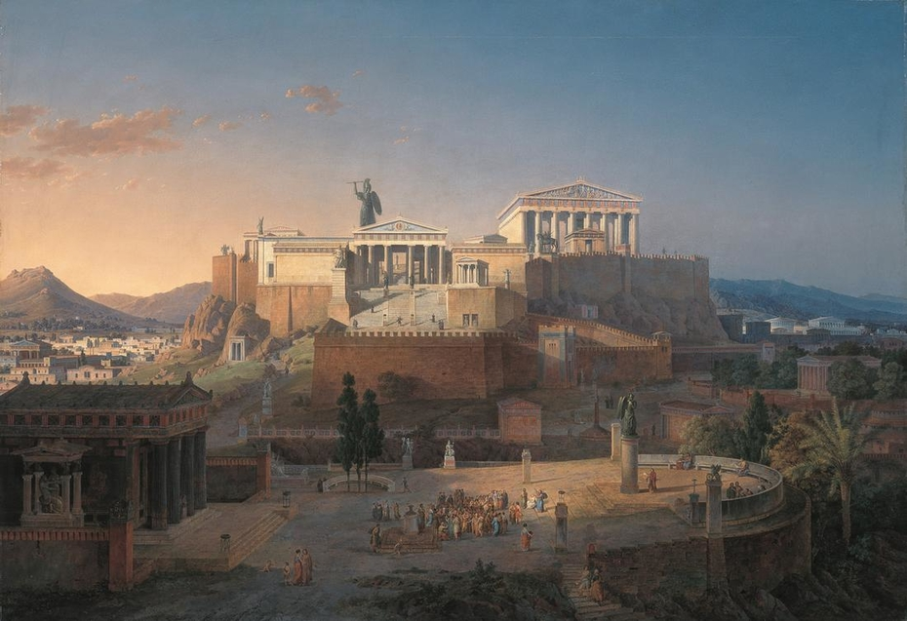
Getting the Word Out about Earth Day
List ideas here

Slide 117
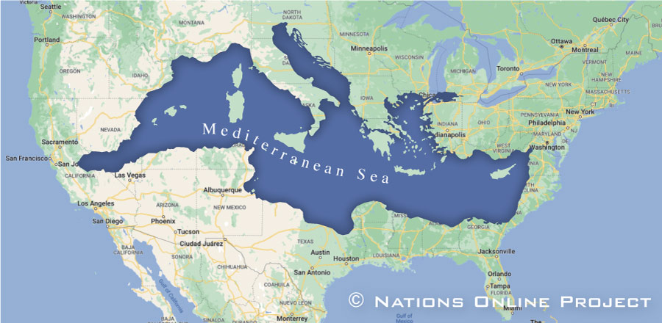
Getting the Word Out about Earth Day
List ideas here

Slide 118
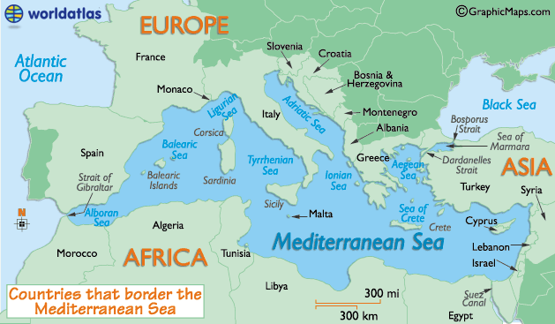
Getting the Word Out about Earth Day
List ideas here

Slide 119
Acts 17:10-15

Slide 120
Christianity is a “scriptural” religion.

Slide 121
“You search the Scriptures because you think in them you have eternal life; it is these that testify about Me.”
John 5:39-44

Slide 122
To preach/teach “scripturally” is to preach/teach Jesus.

Slide 123
2 Timothy 3:16-17
Psalm 1
Romans 10:17
“word of Christ”

Slide 124
1 – Here I Am To Worship
Light of the world, You stepped down into darkness,
Opened my eyes, let me see,
Beauty that made this heart adore You,
Hope of a life spent with You.
Word and Music: Tim Hughes / Arr: James W. Tackett
Copyright © 2000 Thankyou Music (Admin. EMI Christian Music Publishing)
International Copyright Secured. All Rights Reserved. Used By Permission.
© 2006 The Paperless Hymnal®

Slide 125
1 – Here I Am To Worship
© 2006 The Paperless Hymnal®

Slide 126
c – Here I Am To Worship
Here I am to worship. Here I am to bow down.
Here I am to say that You're my God.
You're altogether lovely, altogether worthy,
altogether wonderful to me.
© 2006 The Paperless Hymnal®

Slide 127
c – Here I Am To Worship
© 2006 The Paperless Hymnal®

Slide 128
2 – Here I Am To Worship
King of all days, all so highly exalted,
Glorious in heaven above,
Humbly You came to the earth You created,
All for our sake be-came poor.
Beauty that made this heart adore You,
Hope of a life spent with You.
Word and Music: Tim Hughes / Arr: James W. Tackett
Copyright © 2000 Thankyou Music (Admin. EMI Christian Music Publishing)
International Copyright Secured. All Rights Reserved. Used By Permission.
© 2006 The Paperless Hymnal®

Slide 129
2 – Here I Am To Worship
© 2006 The Paperless Hymnal®

Slide 130
c – Here I Am To Worship
Here I am to worship. Here I am to bow down.
Here I am to say that You're my God.
You're altogether lovely, altogether worthy,
altogether wonderful to me.
© 2006 The Paperless Hymnal®

Slide 131
c – Here I Am To Worship
© 2006 The Paperless Hymnal®

Slide 132
C – Here I Am To Worship
© 2006 The Paperless Hymnal®

Slide 133
Welcome ALL!
OLD UNION
NEW LIFE
Following Jesus changes everything!

Slide 134
Alas! And Did
My Savior Bleed
#12

Slide 135
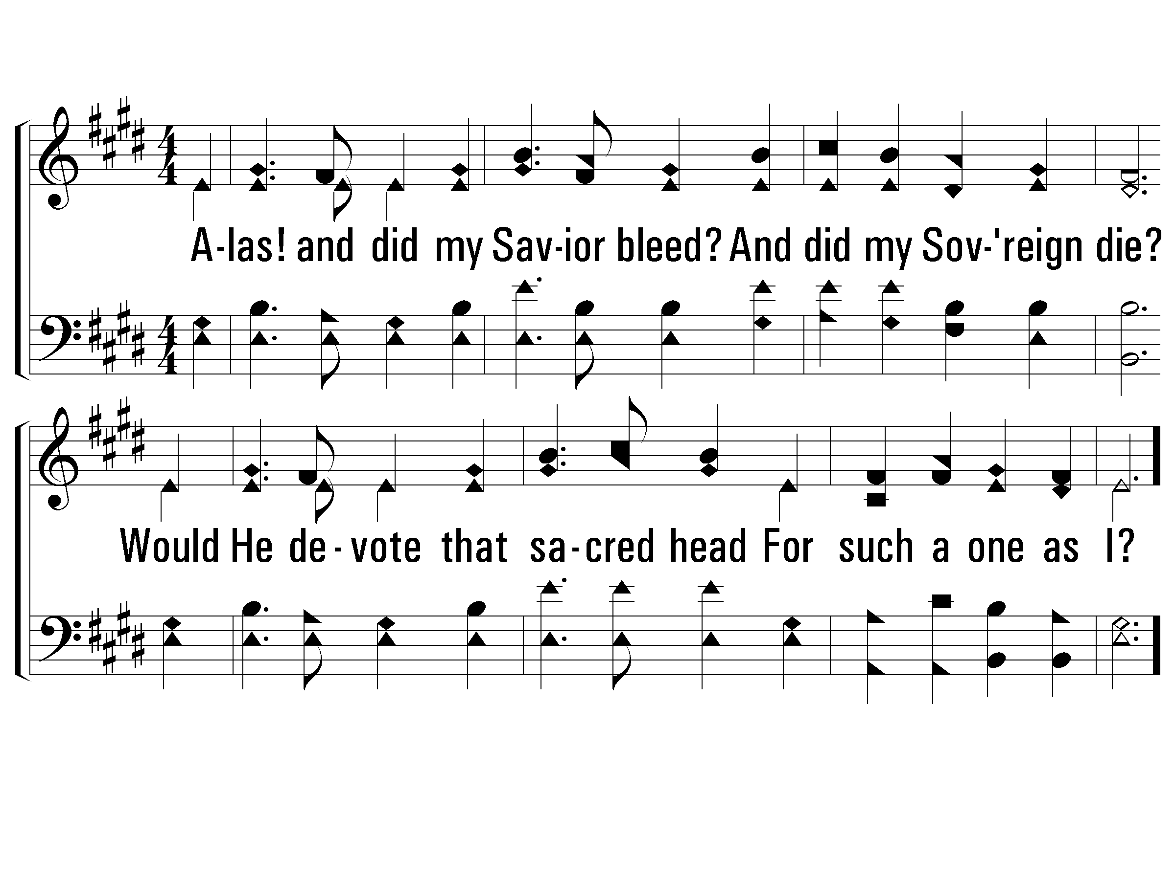
1 – Alas! and Did My Savior Bleed
1.
Alas! And did my Savior bleed?
And did my Sovereign die?
Would He devote that sacred head
For such a one as I?
Words by: Isaac Watts, chorus by Ralph E. Hudson / Music by: Ralph E. Hudson
© 2001 The Paperless Hymnal™

Slide 136
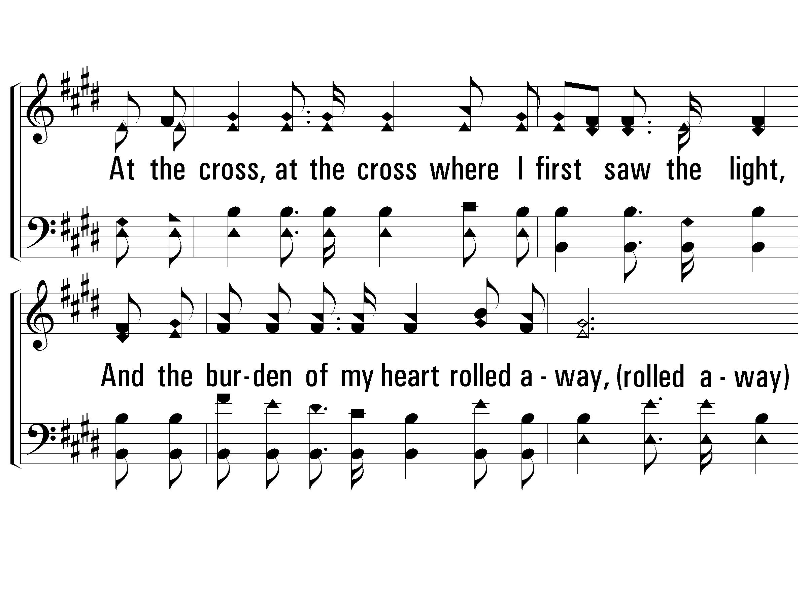
c – Alas! and Did My Savior Bleed
At the cross, at the cross where I first saw the light,
And the burden of my heart rolled away,
It was there by faith I received my sight,
And now I am happy all the day.
© 2001 The Paperless Hymnal™

Slide 137
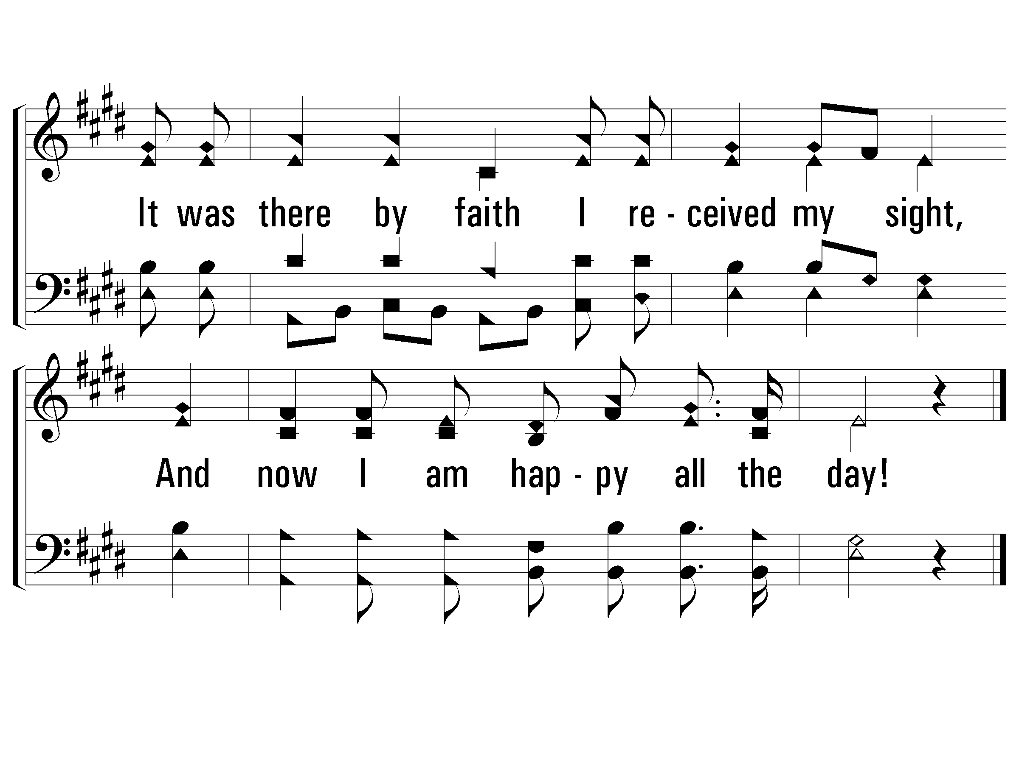
c – Alas! and Did My Savior Bleed
© 2001 The Paperless Hymnal™

Slide 138
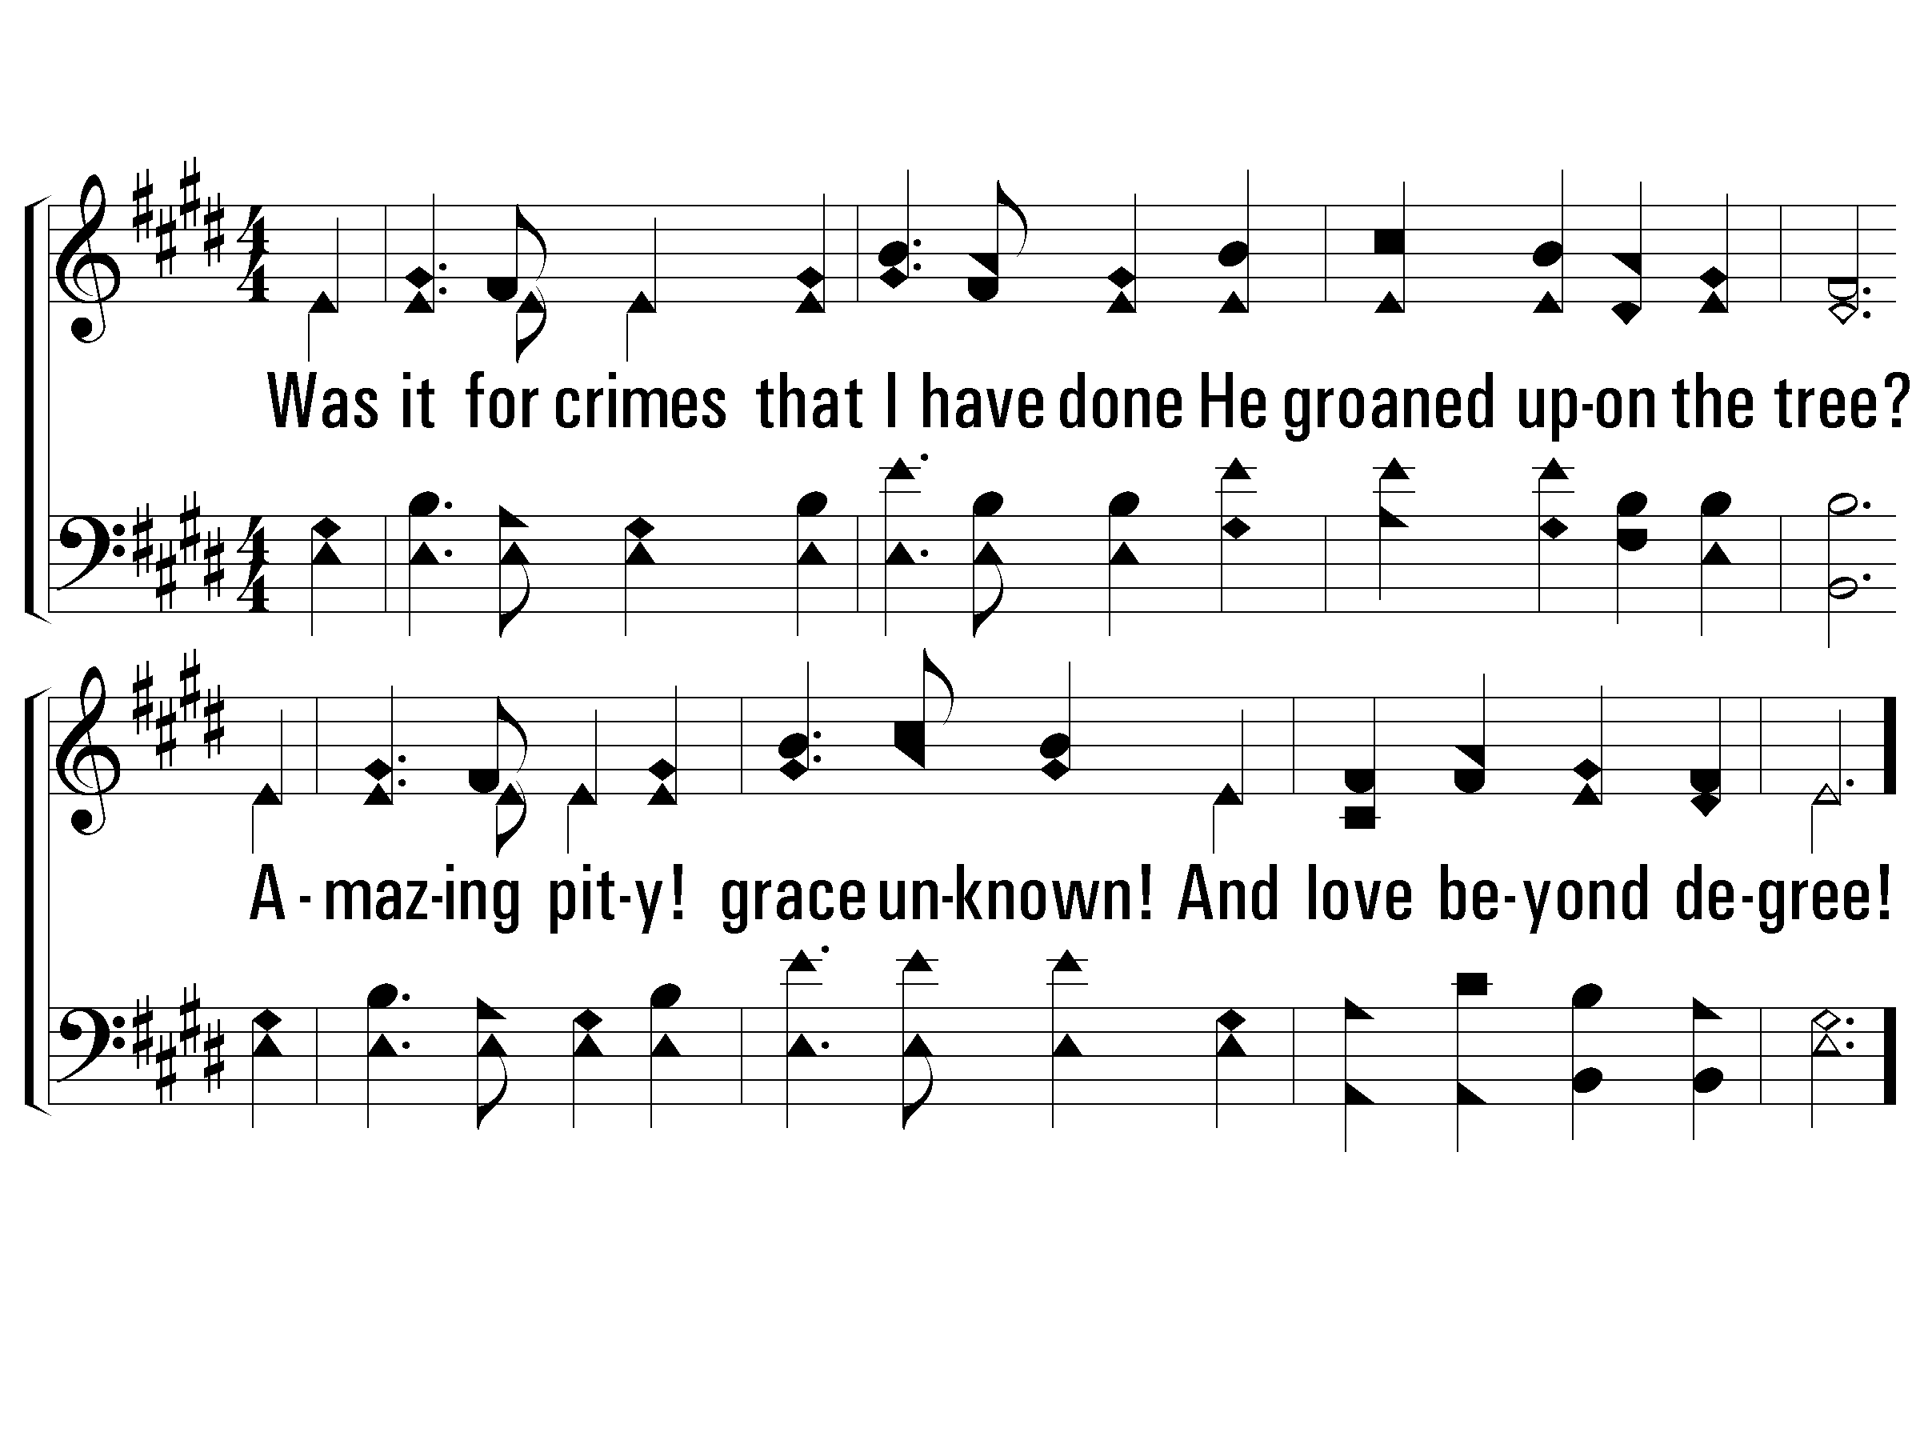
2 – Alas! and Did My Savior Bleed
2.
Was it for crimes that I have done
He groaned upon the tree?
Amazing pity! Grace unknown!
And love beyond degree!
Words by: Isaac Watts, chorus by Ralph E. Hudson / Music by: Ralph E. Hudson
© 2001 The Paperless Hymnal™

Slide 139
c – Alas! and Did My Savior Bleed
At the cross, at the cross where I first saw the light,
And the burden of my heart rolled away,
It was there by faith I received my sight,
And now I am happy all the day.
© 2001 The Paperless Hymnal™

Slide 140
c – Alas! and Did My Savior Bleed
© 2001 The Paperless Hymnal™

Slide 141
3 – Alas! and Did My Savior Bleed
3.
Well might the sun in darkness hide,
And shut his glories in,
When Christ, the mighty Maker died
For man, the creature's sin.
Words by: Isaac Watts, chorus by Ralph E. Hudson / Music by: Ralph E. Hudson
© 2001 The Paperless Hymnal™

Slide 142
c – Alas! and Did My Savior Bleed
At the cross, at the cross where I first saw the light,
And the burden of my heart rolled away,
It was there by faith I received my sight,
And now I am happy all the day.
© 2001 The Paperless Hymnal™

Slide 143
c – Alas! and Did My Savior Bleed
© 2001 The Paperless Hymnal™

Slide 144
4 – Alas! and Did My Savior Bleed
4.
Thus might I hide my blushing face
While His dear cross appears;
Dissolve my heart in thankfulness,
an melt mine eyes to tears.
Words by: Isaac Watts, chorus by Ralph E. Hudson / Music by: Ralph E. Hudson
© 2001 The Paperless Hymnal™

Slide 145
c – Alas! and Did My Savior Bleed
At the cross, at the cross where I first saw the light,
And the burden of my heart rolled away,
It was there by faith I received my sight,
And now I am happy all the day.
© 2001 The Paperless Hymnal™

Slide 146
c – Alas! and Did My Savior Bleed
© 2001 The Paperless Hymnal™

Slide 147
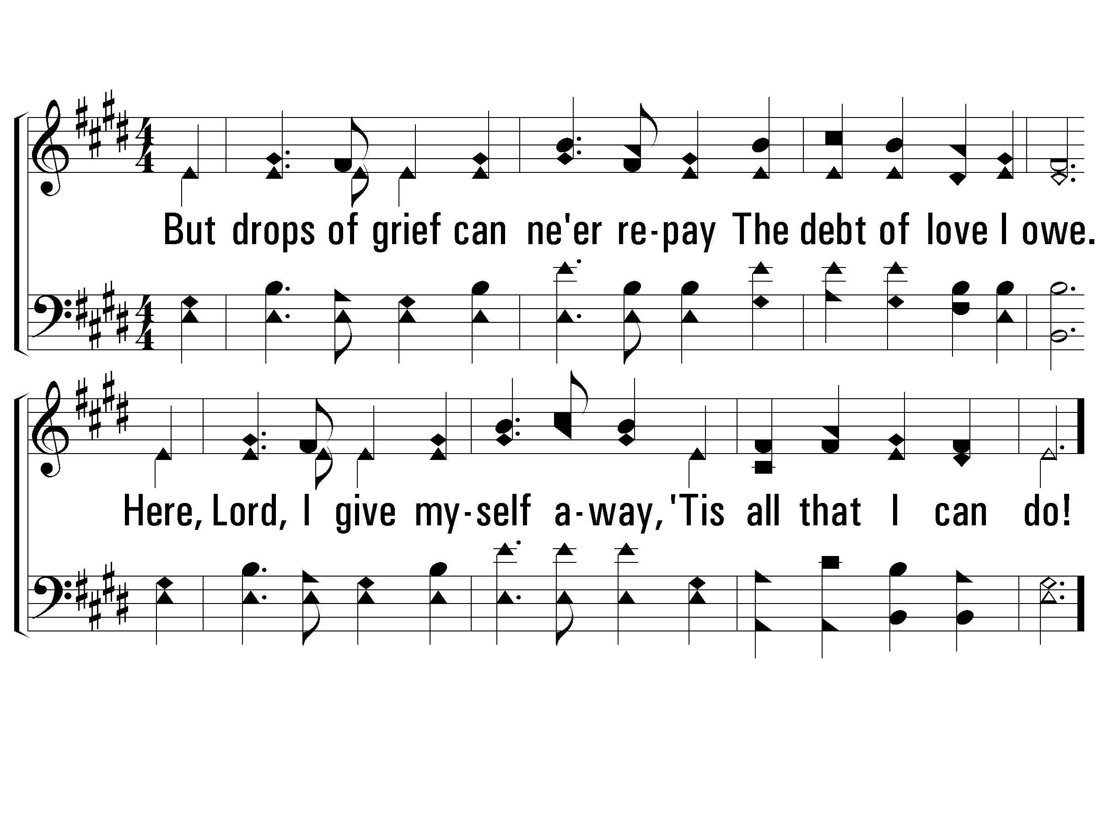
5 – Alas! and Did My Savior Bleed
5.
But drops of grief can ne'er repay
The debt of love I owe.
Here, Lord, I give myself away,
"Tis all that I can do!
Words by: Isaac Watts, chorus by Ralph E. Hudson / Music by: Ralph E. Hudson
© 2001 The Paperless Hymnal™

Slide 148
c – Alas! and Did My Savior Bleed
At the cross, at the cross where I first saw the light,
And the burden of my heart rolled away,
It was there by faith I received my sight,
And now I am happy all the day.
© 2001 The Paperless Hymnal™

Slide 149
c – Alas! and Did My Savior Bleed
© 2001 The Paperless Hymnal™

Slide 150
No, Not One
#680

Slide 151
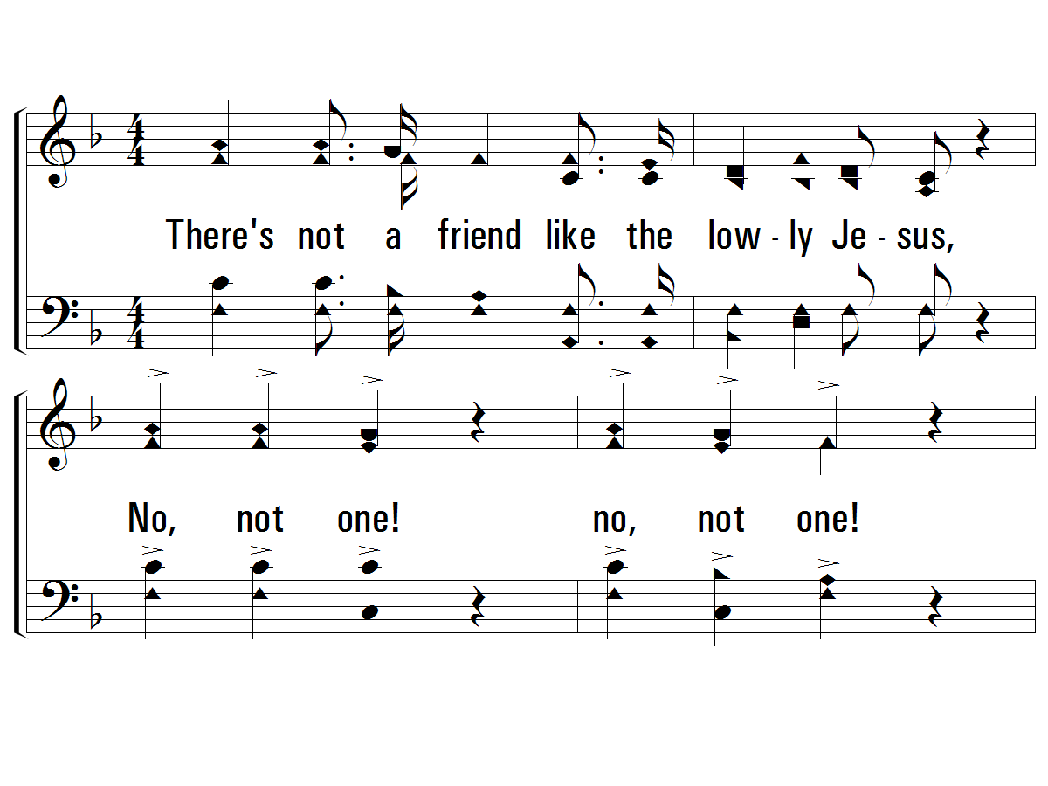
1 – There’s Not a Friend
1.
There's not a friend like the lowly Jesus,
No, not one! no, not one!
None else could heal all our souls diseases,
No, not one! no, not one!
Words by: Johnson Oatman Jr.
Music by: George C. Hugg
© 2001 The Paperless Hymnal™

Slide 152
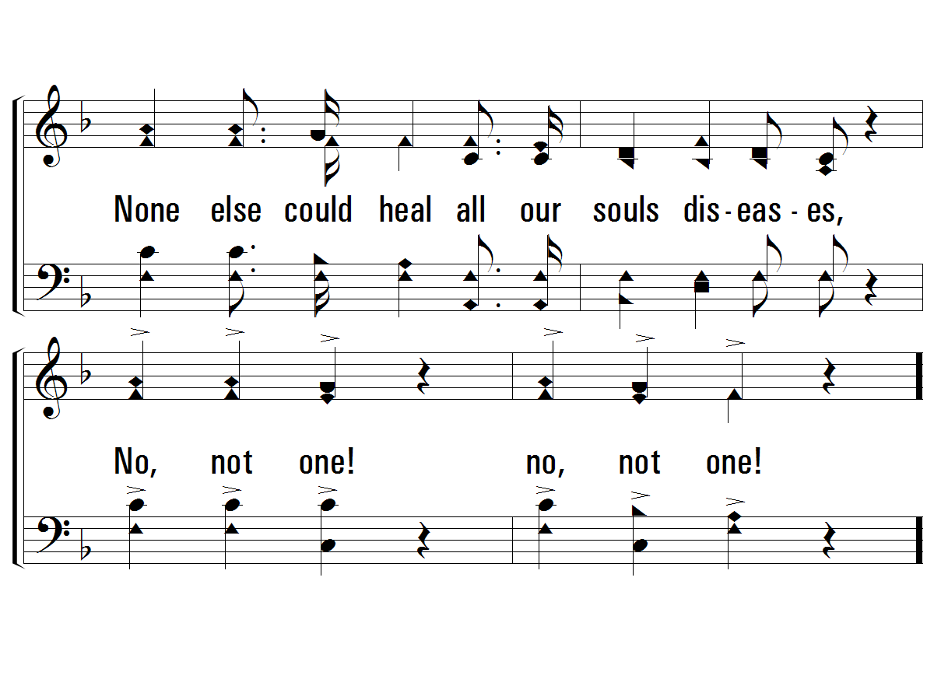
1 – There’s Not a Friend
© 2001 The Paperless Hymnal™

Slide 153
c – There’s Not a Friend
Jesus knows all about our struggles;
He will guide till the day is done;
There's not a friend like the lowly Jesus,
No, not one! no, not one!
© 2001 The Paperless Hymnal™

Slide 154
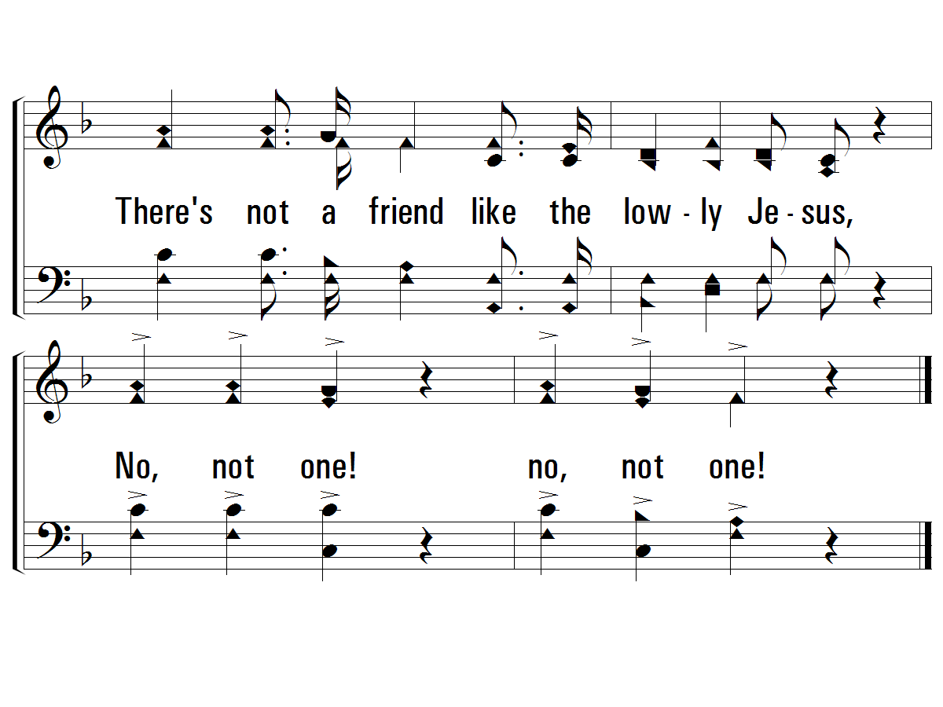
c – There’s Not a Friend
© 2001 The Paperless Hymnal™

Slide 155
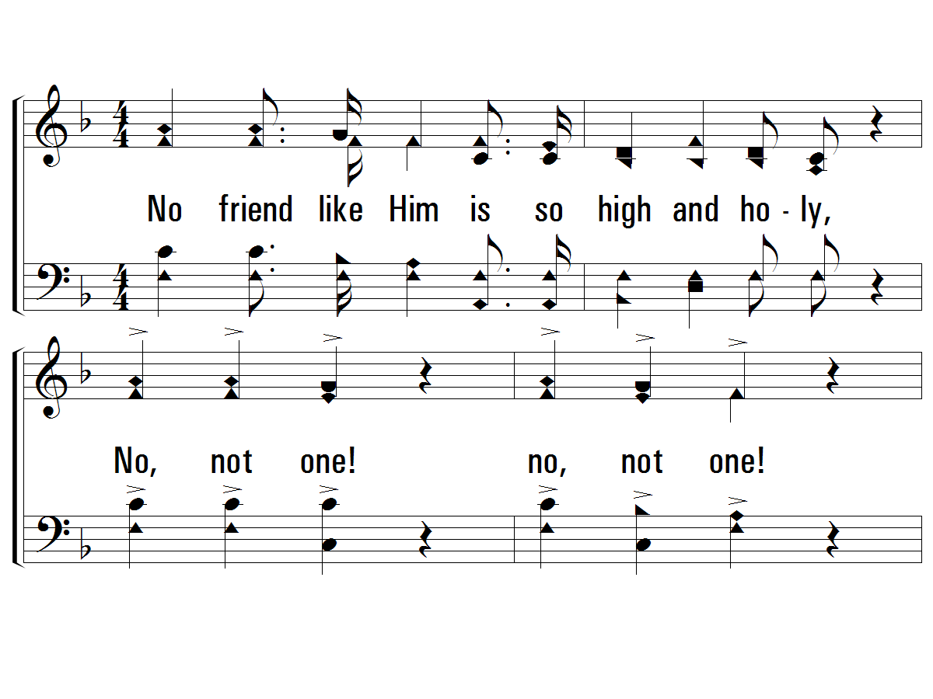
2 – There’s Not a Friend
2.
No friend like Him is so high and holy,
No, not one! no, not one!
And yet no friend is so meek and lowly
No, not one! no, not one!
Words by: Johnson Oatman Jr.
Music by: George C. Hugg
© 2001 The Paperless Hymnal™

Slide 156
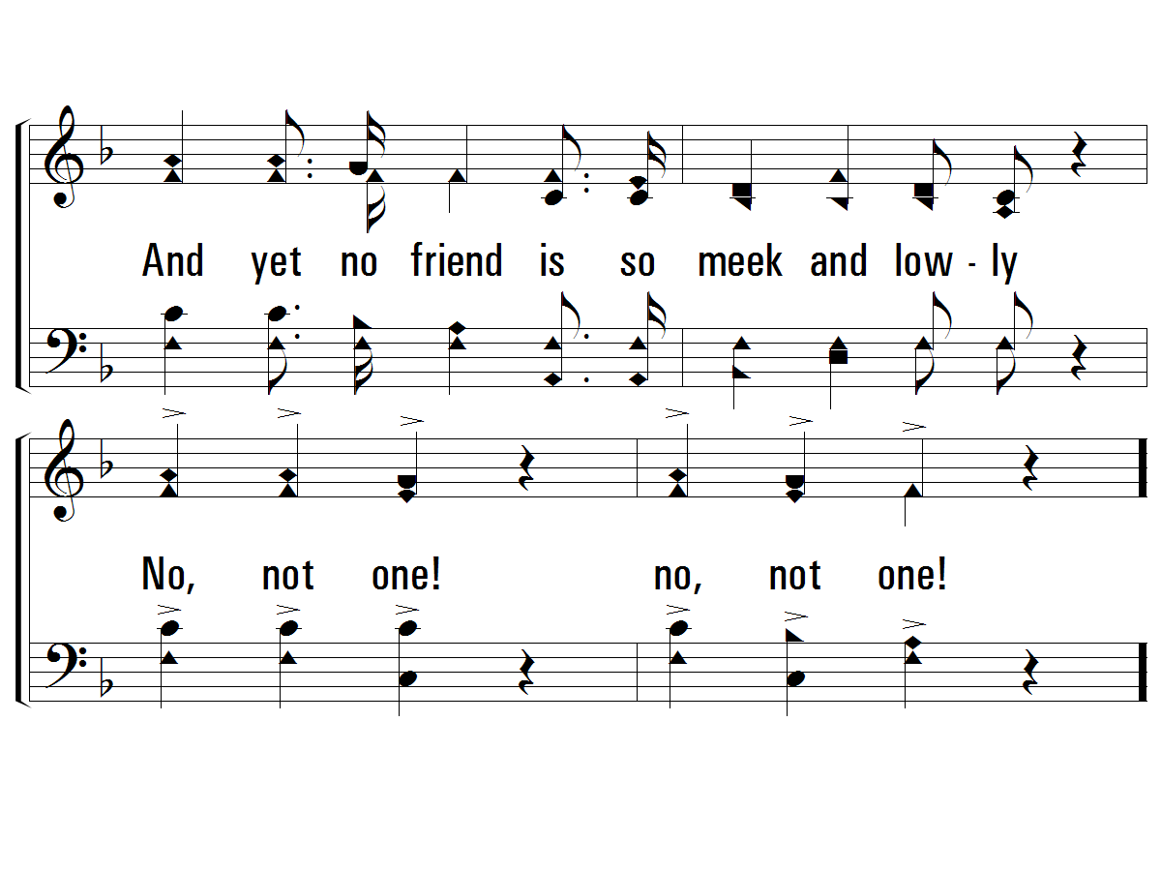
2 – There’s Not a Friend
© 2001 The Paperless Hymnal™

Slide 157
c – There’s Not a Friend
Jesus knows all about our struggles;
He will guide till the day is done;
There's not a friend like the lowly Jesus,
No, not one! no, not one!
© 2001 The Paperless Hymnal™

Slide 158
c – There’s Not a Friend
© 2001 The Paperless Hymnal™

Slide 159
3 – There’s Not a Friend
3.
There's not an hour that He is not near us,
No, not one! no, not one!
No night so dark but His love can cheer us,
No, not one! no, not one!
Words by: Johnson Oatman Jr.
Music by: George C. Hugg
© 2001 The Paperless Hymnal™

Slide 160
3 – There’s Not a Friend
© 2001 The Paperless Hymnal™

Slide 161
c – There’s Not a Friend
Jesus knows all about our struggles;
He will guide till the day is done;
There's not a friend like the lowly Jesus,
No, not one! no, not one!
© 2001 The Paperless Hymnal™

Slide 162
c – There’s Not a Friend
© 2001 The Paperless Hymnal™

Slide 163
DID EVER SAINT FIND THIS
FRIEND FORSAKE HIM?
NO, NOT ONE!
NO, NOT ONE!
OR SINNER FIND THAT
HE WOULD NOT TAKE HIM?
NO, NOT ONE!
NO, NOT ONE!

Slide 164
c – There’s Not a Friend
Jesus knows all about our struggles;
He will guide till the day is done;
There's not a friend like the lowly Jesus,
No, not one! no, not one!
© 2001 The Paperless Hymnal™

Slide 165
c – There’s Not a Friend
© 2001 The Paperless Hymnal™

Slide 166
WAS E’ER A GIFT
LIKE THE SAVIOR GIVEN?
NO, NOT ONE!
NO, NOT ONE!
WILL HE REFUSE
US A HOME IN HEAVEN?
NO, NOT ONE!
NO, NOT ONE!

Slide 167
c – There’s Not a Friend
Jesus knows all about our struggles;
He will guide till the day is done;
There's not a friend like the lowly Jesus,
No, not one! no, not one!
© 2001 The Paperless Hymnal™

Slide 168
c – There’s Not a Friend
© 2001 The Paperless Hymnal™

Slide 169
Prayer

Slide 170
OLD
Church
of Christ
UNION

